Slide 1
Implementing
Feed Management
Dan Ludwig
Grazing/Feed Management Specialist
USDA-NRCS Pennsylvania

Slide 2
Feed Management in PA
First offered for contracting in FY2008
  Coupled with Nutrient Management
FY2011 offered as a stand alone practice
  $500,000 in EQIP, $500,000 in CBWI
  51 farms contracted
    49 Dairy Operations
    4 Beef Operations

Slide 3
Requirements from Farm
Benchmark Plan
  Checklists
  Template and Narratives
  Rations- Current & Proposed
  Manure & Feed Analyses
  Tracking/Monitoring Worksheets
Quarterly Reports
  4 reports per year required for payment

Slide 4
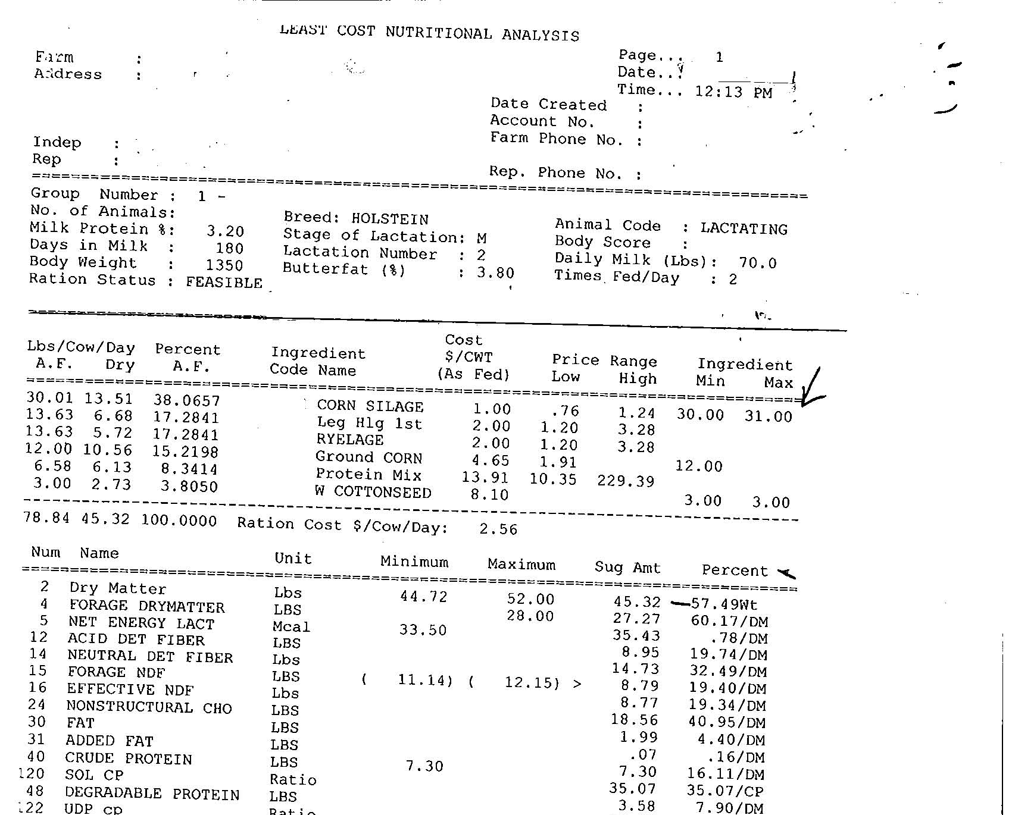
Ration

Slide 5
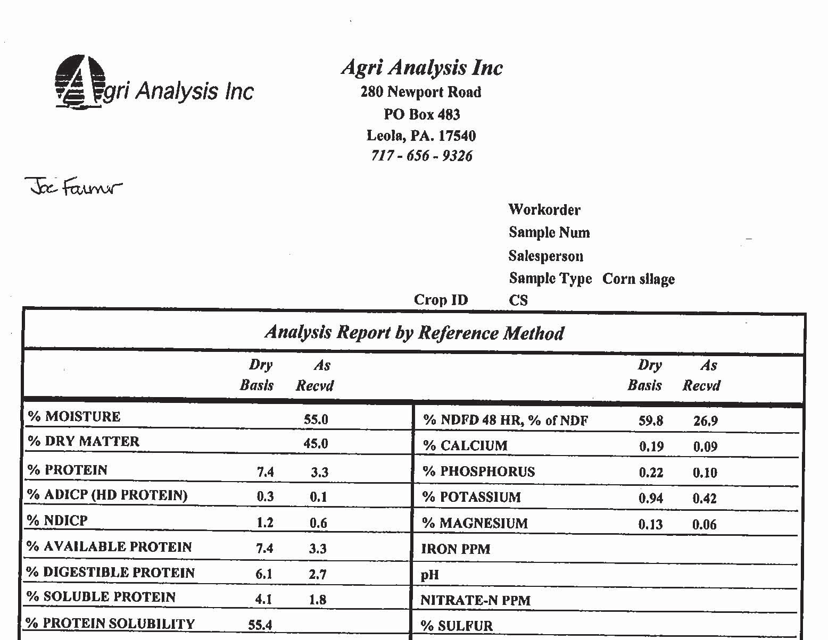
Feed Analysis

Slide 6
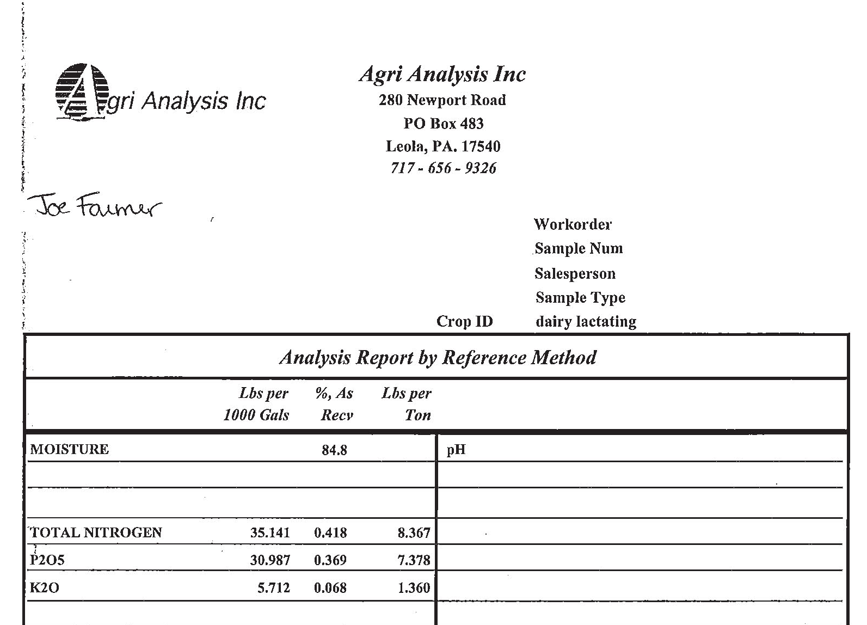
Manure Analysis

Slide 7
Tracking/Monitoring Worksheets
Dry Matter Intakes
  Actual vs. Formulated
  TMR and Component Fed Herds
    Spread sheet calculates composite values for component fed herds
    Crude Protein
    Phosphorus

Slide 8
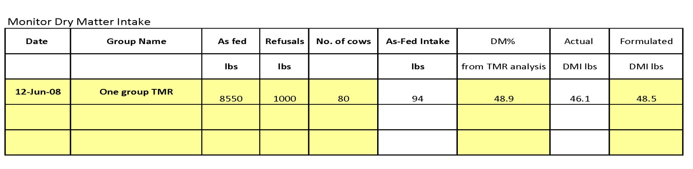
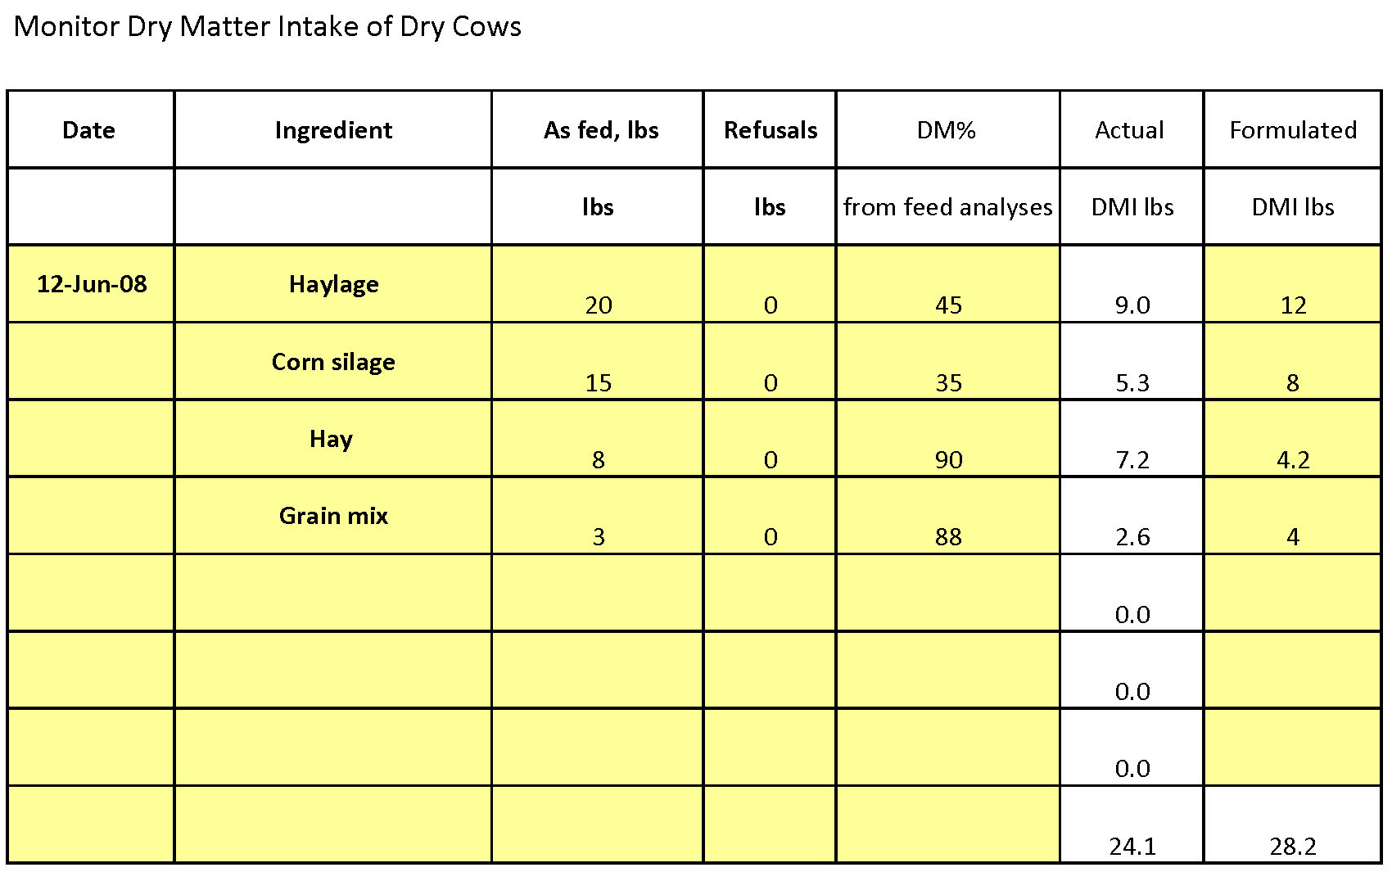
Dry Matter Intake

Slide 9
Ration Protein
Track Actual vs. Formulated levels
  Compare Ration Sheet to TMR Test Analysis
  Use Spread sheet to calculate composite ration Crude Protein from Component-fed herds
  Charts to track across the quarters

Slide 10
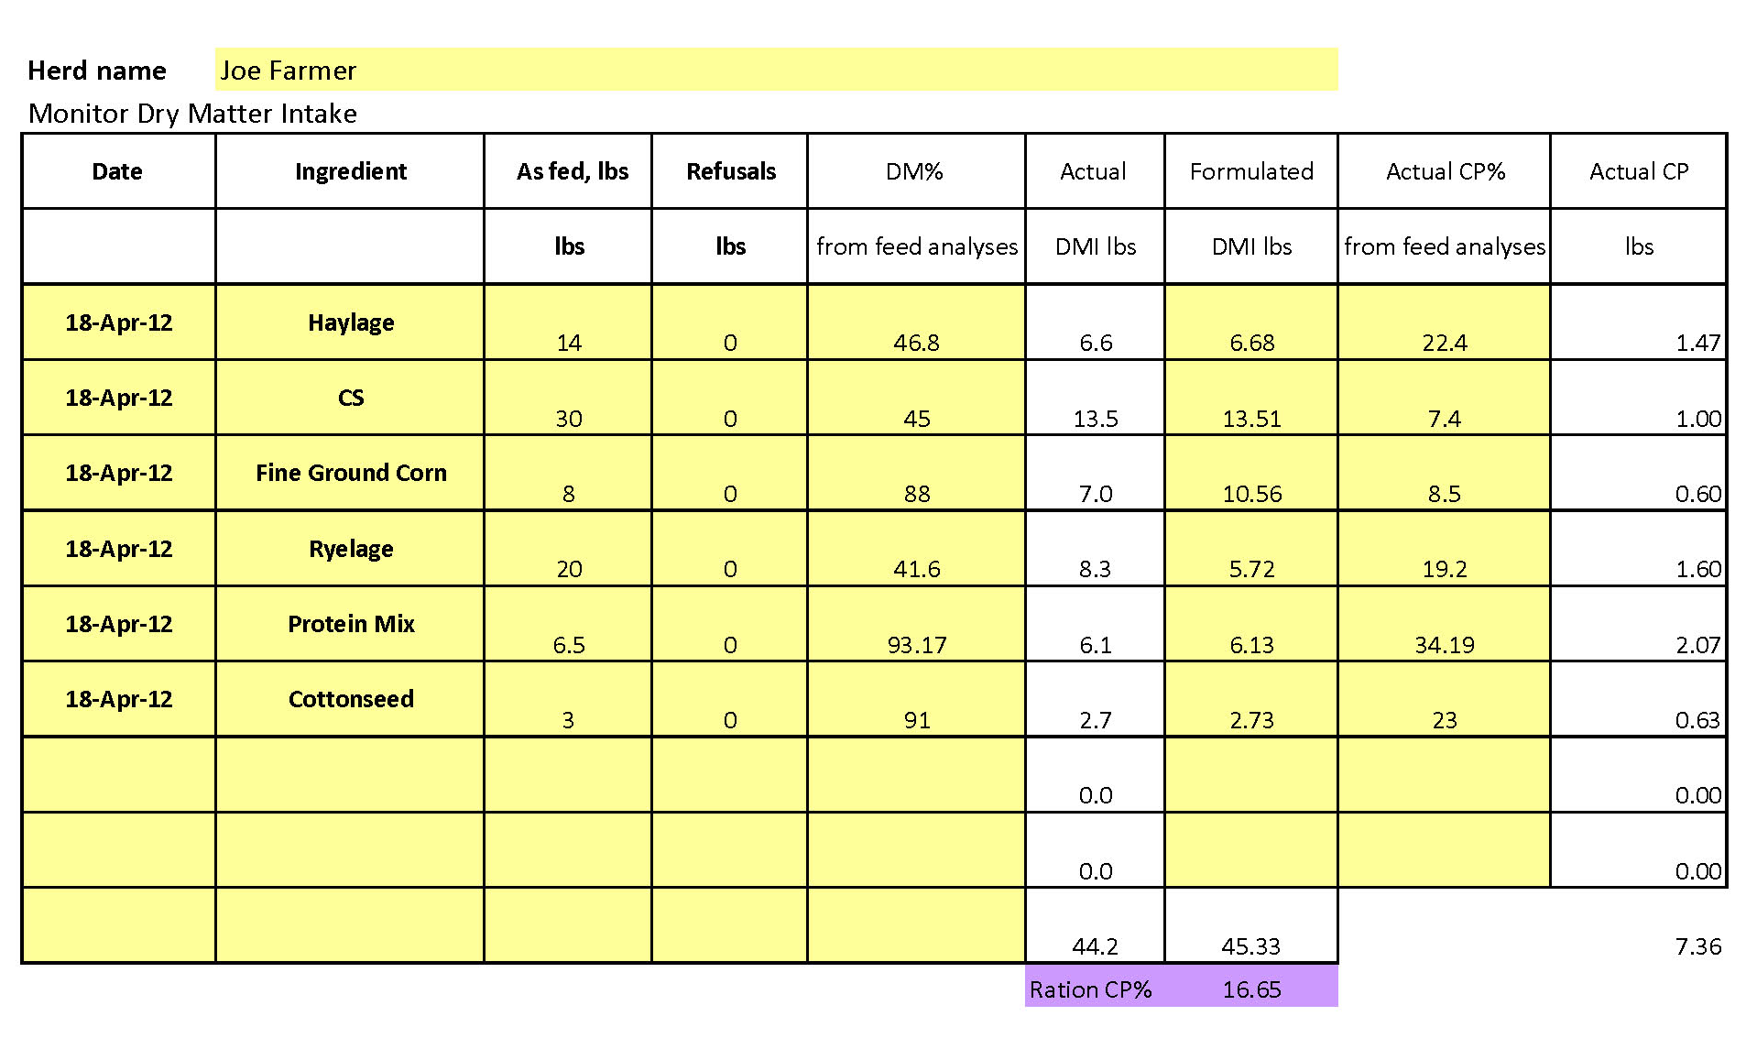
Ration Protein

Slide 11
Ration Protein

Slide 12
Ration Phosphorus
Track Actual vs. Formulated levels
  Compare Ration Sheet to TMR Test Analysis
  Use Spread sheet to calculate composite ration Crude Protein from Component-fed herds
  Track Phosphorus amounts in terms percent of requirement

Slide 13
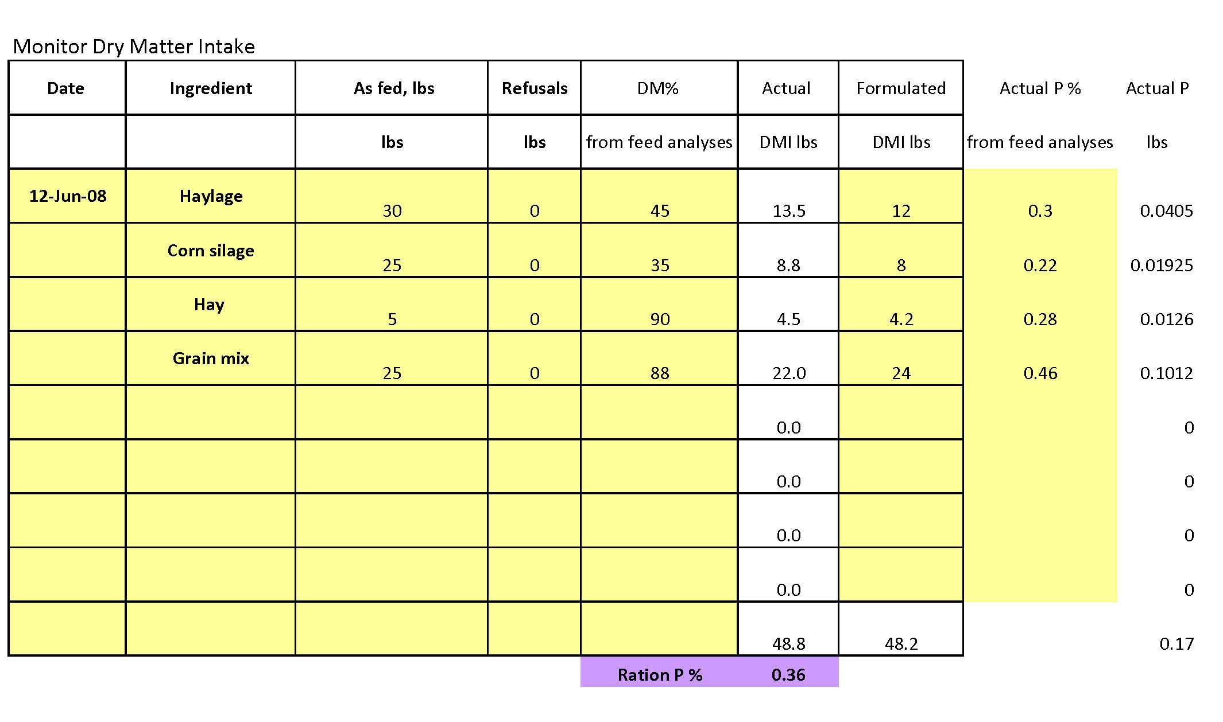
Ration Phosphorus

Slide 14
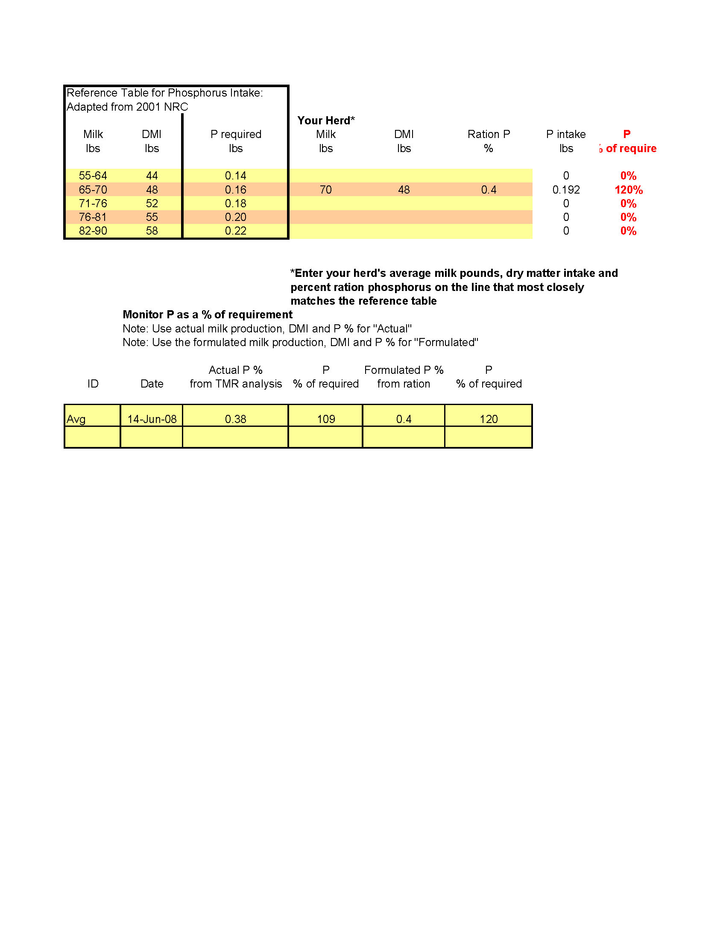
Ration Phosphorus

Slide 15
Tracking Phosphorus
Calculate fecal phosphorus using test analysis
  Lactating- (0.55 – 0.85%)
  Dry Cows- (0.60 – 0.85%)
  Heifers- (0.55 – 0.85%)
  Beef Cows- (0.65 – 0.90%)
  Growing Calves- (0.92 – 1.05%)
Calculated Excreted amount from Lactating

Slide 16
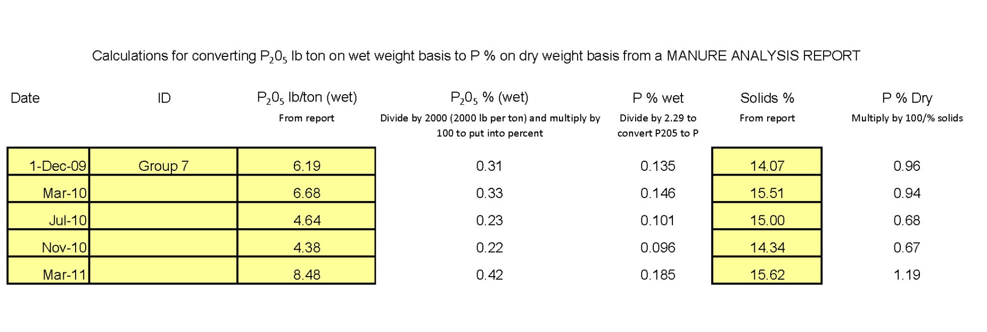
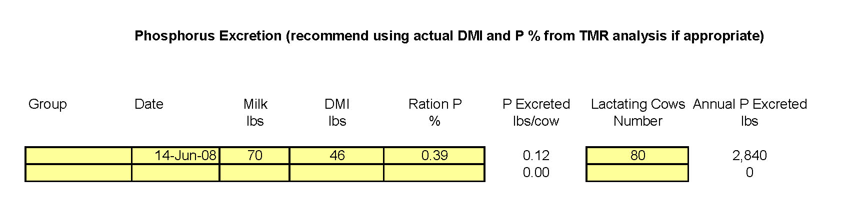
Tracking Phosphorus

Slide 17
Tracking Protein
Collect milk production data
  Bulk tank and Cooperative data
  DHIA reports
Collect Milk Urea Nitrogen (MUN) data
  Cooperative reports
  DHIA reports
Complete Milk Nitrogen Efficiency worksheet

Slide 18
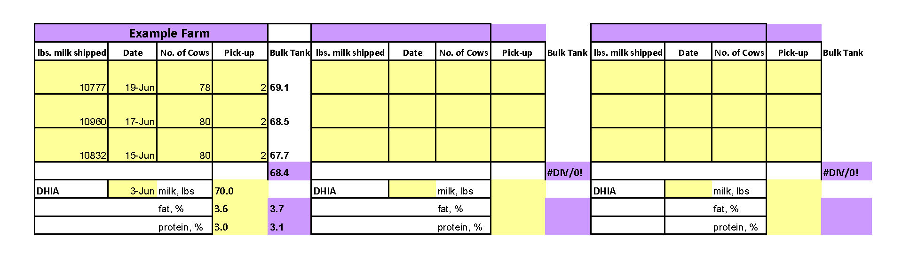
Bulk Tank Data

Slide 19
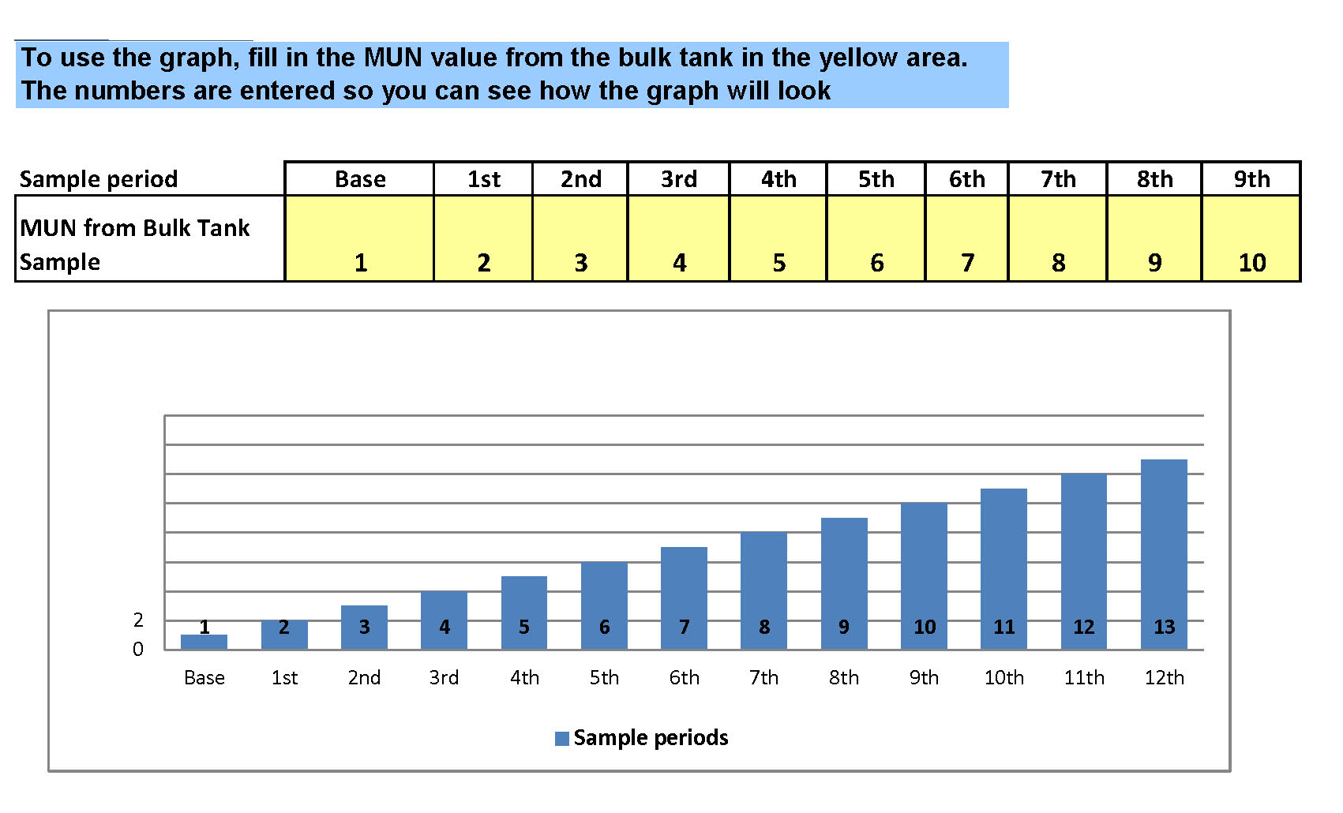
MUN data

Slide 20
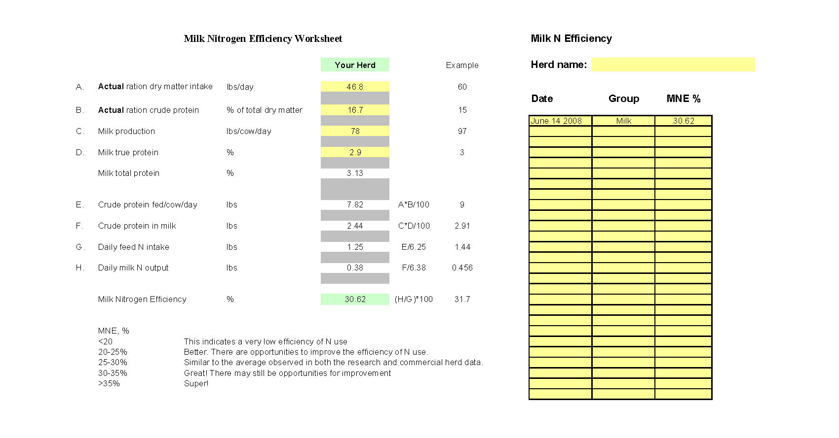
Milk Nitrogen Efficiency

Slide 21
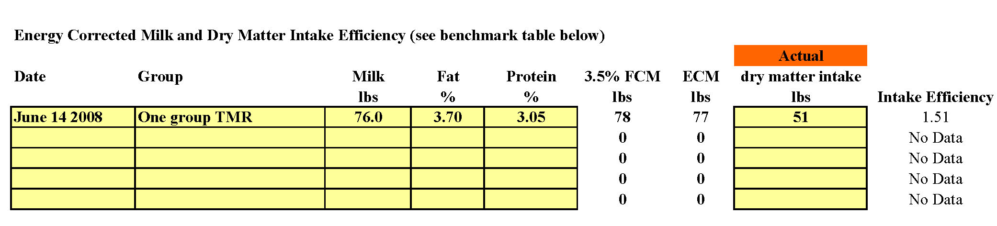
Other Efficiencies
Track Dry Matter Intake Efficiency
  Monitor dry matter intake
  Utilize milk components to calculate ratio
  1.3 – 1.6 is standard

Slide 22
Contracting Feed Management
Producers can select from 1 – 5 groups
Producers can select contract length
  1 – 3 years
Payments are designed to help cover the cost of implementing the plan
  Plan development costs
  Increased feed costs
  New infrastructure (mixers, pens, etc.)

Slide 23
PA Payment Level
Contract Payments over 3 year period
    Year 1 $2,000 per group
    Year 1 HU $2,400 per group*
    Year 2 $1,500 per group
    Year 2 HU $1,800 per group*
    Year 3 $1,100 per group
    Year 3 HU $1,300 per group*
    * HU Historically Underserved Producer
    ** Limit 5 groups per year per contract
    ** Must Develop and Implement Feeding Plan

Slide 24
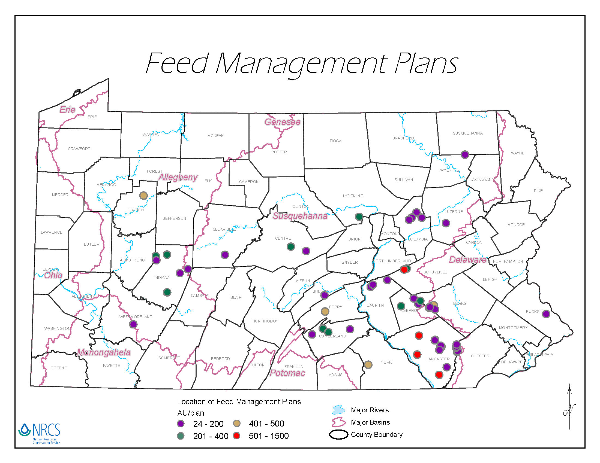

Slide 25
Results
Not all data compiled yet
  Snap shot of some of the farm data

Slide 26
Select Results from Plans being implemented
Plain Sect
48 Cow Component-fed Herd
Group | Date | Milk | DMI | Ration P | P Excreted | Lactating Cows | Annual P Excreted
 |  | lbs | lbs | % | lbs/cow | Number | lbs
Lactating | 14-Jul | 88 | 45.9 | 0.41 | 0.11 | 55 | 1,828
Lactating | 2-Nov | 61 | 46.4 | 0.41 | 0.14 | 41 | 1,692
Lactating | 14-Feb | 79 | 47 | 0.38 | 0.11 | 49 | 1,607
Averages
48
-221

Slide 27
Select Results from Plans being implemented
Plain Sect
62 Cow TMR-fed Herd
Group | Date | Milk | DMI | Ration P | P Excreted | Lactating Cows | Annual P Excreted
 |  | lbs | lbs | % | lbs/cow | Number | lbs
Lactating | 14-Apr | 83 | 45.32 | 0.43 | 0.12 | 58 | 2,126
Lactating | 14-Jul | 89 | 43.3 | 0.42 | 0.10 | 63 | 1,955
Lactating | 2-Nov | 80.9 | 49.49 | 0.4 | 0.13 | 64 | 2,443
Lactating | 2-Feb | 81.9 | 43.8 | 0.4 | 0.10 | 63 | 1,950
Averages
62
-176

Slide 28
Select Results from Plans being implemented
English Farm
Pre-Peak TMR-fed Herd
Group | Date | Milk | DMI | Ration P | P Excreted | Lactating Cows | Annual P Excreted
 |  | lbs | lbs | % | lbs/cow | Number | lbs
Pre Peak | 20-Jul | 89 | 47.3 | 0.41 | 0.11 | 126 | 4,374
Pre Peak | 10/11 | 83 | 46.5 | 0.42 | 0.12 | 128 | 4,708
Pre Peak | 1/12 | 85 | 49.5 | 0.34 | 0.09 | 134 | 3,752
Averages
129
-956

Slide 29
Select Results from Plans being implemented
English Farm
Heifer TMR-fed Herd
Group | Date | Milk | DMI | Ration P | P Excreted | Lactating Cows | Annual P Excreted
 |  | lbs | lbs | % | lbs/cow | Number | lbs
Heifer | 20-Jul | 69 | 47.1 | 0.39 | 0.12 | 133 | 4,932
Heifer | 10/11 | 67 | 48 | 0.43 | 0.15 | 133 | 5,927
Heifer | 1/12 | 67 | 47.8 | 0.33 | 0.10 | 136 | 4,042
Averages
134
-890

Slide 30
Select Results from Plans being implemented
English Farm
Lactating TMR-fed Herd
Group | Date | Milk | DMI | Ration P | P Excreted | Lactating Cows | Annual P Excreted
 |  | lbs | lbs | % | lbs/cow | Number | lbs
Lactating | 20-Jul | 76 | 55.1 | 0.40 | 0.15 | 255 | 11,822
Lactating | 10/11 | 72 | 53.6 | 0.38 | 0.14 | 240 | 10,166
Lactating | 1/12 | 80 | 55.2 | 0.32 | 0.10 | 263 | 8,394
Averages
252
-3,428

Slide 35


Slide 36


Slide 37
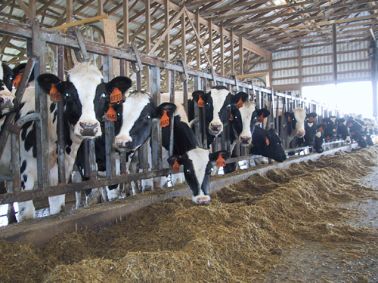
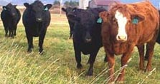
Questions?

