Slide 1
Identifying Resource Concerns: Which concerns are really legitimate?
Johnny Chism, Resource Conservationist, USDA NRCS Arkansas, Harrison, Arkansas
Arlen Ricke, Landscape Planning Specialist, USDA NRCS Conservation Planning and Technical Assistance Division, Washington, D.C.
Notes:
Hello, Good Morning or Afternoon depending on your time zone! I’m Johnny Chism, Area Resource Conservationist in Harrison Arkansas.
Some of you may be wondering why I was asked to conduct this webinar. I have been an instructor with the National Conservation Boot Camp for several years. About 4 years ago, I was introduced to the Resource Concern checklists in Boot Camp. I thought that they were such a good tool to make determining resource concerns more consistent and they would be a good tool for training new planners, I took copies back to our state where we adapted them for Arkansas and have been using them since. Our checklists are based on land use where there is one checklist for each land use as most states currently use. Later on, I learned that the checklists were provided to all states and many states have adapted and used them.
It has always surprised me when I teach this lesson in Boot Camp to participants from all over the Nation, how few of our new planners are actually aware of the checklists, even though most states have them. And I have wondered if planners in other states are aware of them and are using them.
Late last year in meetings to update the Boot Camp curriculum, Arlen Ricke, Kristie McKinley and myself thought it would be a good idea to somehow make the information available Nationally so that more planners might be aware of the availability of the form. During that process to develop a National form, we decided to make the form more closely match FOTG Section III Planning Criteria and to combine all land uses on one form, so that a planner would not have to take multiple versions of the form to the field to conduct Resource Inventories, we also added a place to document if the concern was a client objective and included a summary page where the planner could quickly see all identified concerns.
This webinar will introduce you to this form and the method to use it. Hopefully, this process will allow planners to consistently and legitimately identify resource concerns in their plans. Regardless of whether or not you use the form, if planners are properly trained on the planning criteria in FOTG Section III, and use that information to inventory resources, the resource concerns that they identify will be consistent and legitimate. But the form is such a good training tool, I encourage all planners to use it.

Slide 2
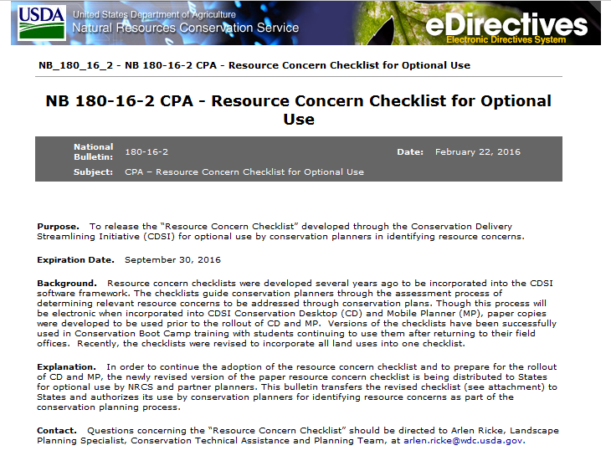
Notes:
A national Bulletin was recently released to make the new checklist available. I am going to turn the presentation over to Arlen to discuss the bulletin.

Slide 3
Notes:
Inventorying Resources and Identifying resource concerns is one of the first steps in the Conservation Planning Process. In my experience in the past, determining resource concerns was more of a “Beauty is in the eye of the beholder” method. If several conservationists went to the same field, they would come up with several different resource concerns based on their individual judgement, training and biases. These inconsistencies in identifying Resource concerns may have been due to lack of training in the proper method for determining those concerns and probably varied by state and often field office.
At the end of this lesson you will be able to:
Understand the criteria that NRCS uses to evaluate natural resource conditions in the field and document the resource concerns for conservation planning purposes.

Slide 4
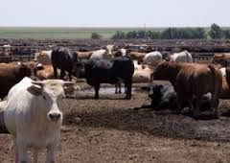
I need water for my cattle…did we miss something else?
Notes:
Determining the natural resource issues that a participant has on their land can be challenging.
How do we decide what resources we will be working with on a piece of land? Does the landowner call us and say “I’ve heard that NRCS can help me with a fences. Or…”my cows don’t have enough water, can you help dig a well?”
Many times you get only pieces of the story or symptoms of the problem. Many times the producer may tell you what he needs or wants such as: “I need a pond”. The producer has diagnosed his own problem, which would be similar to you calling your doctor and saying “I’m having serious pain, I need a prescription for oxycodone”
Sometimes we as planners fall into the trap of letting the producer determine his own solution. If he asks for an EQIP contract with fences, we give him what he wants and then determine the resource concerns that would justify planning fences.
In many cases we have the planning process backwards, we first create an alternative and then we identify resource concerns instead of the other way around.
Your doctor would not give you a prescription without seeing you and determining the best treatment for you. In some cases your doctor might find more serious problems than what you wanted a prescription for, if you were having serious pain, he would probably want to find the cause instead of just giving you something for the symptoms. We as planners should use a similar process for diagnosing the resource concerns for the producer.
Over the years this process for determining the natural resource issues has evolved into a set of Resource concerns that are standard throughout the agency nationwide and helps us to treat the problems found.

Slide 5
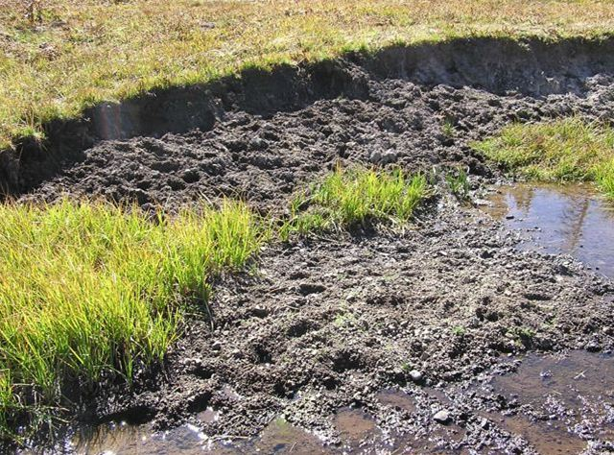
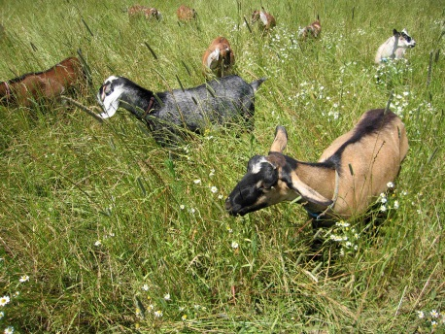
RESOURCE CONCERNS
An expected degradation of the soil, water, air, plant or animal resource base to the extent that the sustainability or intended use of the resource is impaired.
Notes:
The National Planning Procedures Handbook describes Resource Concerns as an “expected degradation of the soil, water, air, plant or animal resource base to the extent that the sustainability or intended use of the resource is impaired.” This was known in the past as SWAPA- Soil-Water-Air-Plants-Animals. The Human concern (H) was added sometime later; (Human includes economic and social issues) Recently we have added Energy to this list. These major Resources were divided into 79 Resource Concerns at that time.

Slide 6
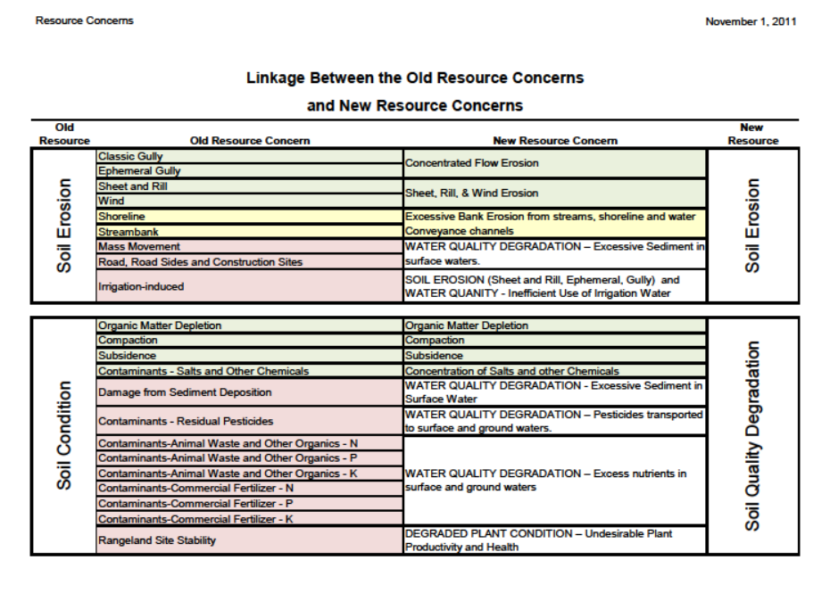
Notes:
When the CDSI or Conservation Delivery Streamlining Initiative for NRCS came about, it was decided that we needed to fine-tune our Resource Concerns and many overlapped, so several were combined and/or removed. Currently there are 31 Major concerns with 44 Component Resource Concerns used to evaluate and identify natural resource problems; for example the Major concern of Soil Erosion-Sheet, Rill and Wind Erosion is broken into the components of Sheet and Rill erosion and Wind Erosion. And the Major concern of Soil Erosion-Concentrated Flow Erosion is broken into the components of Ephemeral Gully erosion and Classic Gully erosion.

Slide 7
Planning Criteria
FOTG Section 3
Issued by National Bulletin 450-11-6
Included in All States FOTG
Developed Screening and Assessment Method to determine Resource Concerns
Replaces subjective Quality Criteria
Better defines when a concern is or is not present
RC Checklists were developed from Planning Criteria
Notes:
Another change with CDSI was the change in FOTG Section III from subjective Quality Criteria to Planning Criteria with better defined and less subjective criteria. The new Planning Criteria was sent out by National bulletin in 2011 and was added to all states FOTG. The Planning Criteria included screening and assessment questions to streamline the process of identifying Resource Concerns. Resource Concern Checklists were developed directly from the Planning criteria. Some States developed their own State Specific checklists. If your state does not have their own checklists, you can use this Nationally developed checklist in your planning.

Slide 8
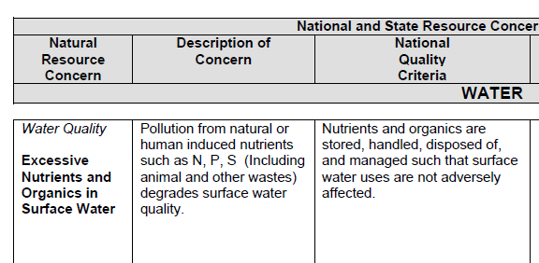
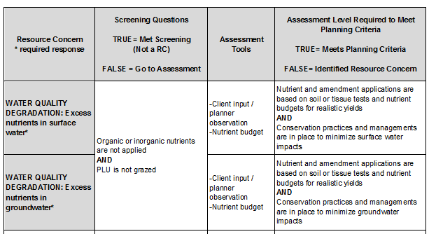
Comparison of QC vs PC
“old” Quality Criteria
“new” Planning Criteria
Notes:
If we compare the old Quality Criteria for Excessive Nutrients and Organics in Surface Water to the new Planning Criteria for Water Quality Degradation Excess Nutrients in Surface Water. Notice how the planning criteria is better defined and less subjective.
If you look at the old Quality criteria: “Nutrients and organics are stored, handled, disposed of, and managed such that surface water uses are not adversely affected.”
It is no wonder that several conservationists would have different ideas on whether the concern was present or not.
In the new Planning criteria, “Nutrient and amendment applications are based on soil or tissue tests and nutrient budgets for realistic yields and Conservation practices and managements are in place to minimize surface water impacts”
The determination of whether or not the criteria is met is less subjective and the end results from different planners should be more consistent. Granted, there is still some room for interpretation in the planning criteria (as there should be) and not all planners will agree on every concern but the criteria should be interpreted more consistently than in the past.

Slide 9
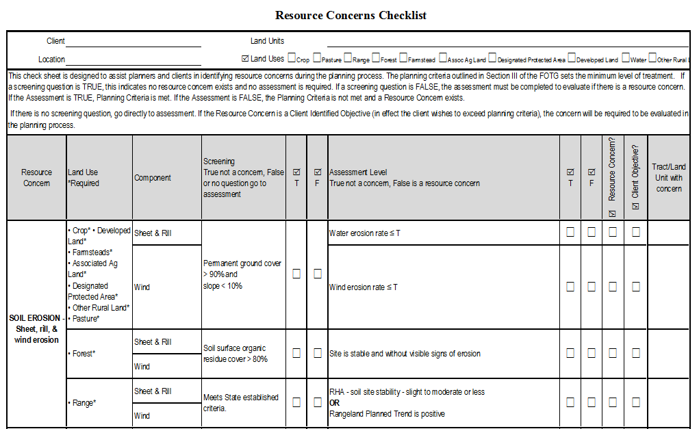
Notes:
Suppose you were not feeling well today and went for a Doctor’s appointment. What does the Doctor do to determine your condition and give you a diagnosis?
Does the Doctor look at you and immediately write a prescription, or maybe schedule exploratory surgery?
Typically the Doctor would ask you what symptoms you have and ask you a series of questions relating to what you tell about your condition. This would narrow the potential problem and allow for a more complete diagnosis and treatment.
Just like the Doctor who evaluated our health symptoms, we as Conservationists begin the planning process assisting land users is to identify and evaluate their resource concerns. To help streamline the process the checklists use a series of screening and assessment questions to determine if a resource concern is present.
Our doctor may also use screening questions and assessment tools to determine if we have any health concerns. For example if you go to the doctor for a checkup, he may ask you some simple “screening” questions such as do you exercise, do you smoke, are you overweight? Depending on the answers to those questions he may order other “assessment” tests such as Blood Cholesterol, Triglycerides, EKG, etc. The doctor does not routinely order time consuming test that may not be needed.
As Planners, we may not need to run time consuming tests such as RUSLE2 if the permanent ground cover is greater than 90% and the slope is less than 10% to determine whether a soil erosion concern is present.
For example: in the past if a planner went out to a fescue pasture that was 98% ground cover and 1% slope, the only way to document that there was not a soil erosion concern was to run RUSLE2 even though they knew that there was not a concern. Now, they can use the screening question to document that the concern is not present without having to take the time to run RUSLE2.
The Resource Concerns Checklists are set up with screening and assessment questions to help the planner save time without having to run time consuming Assessment tools that are not needed.
On the checklist Note that:
If the Screening question is True the resource concern is not present and no further assessment will have to be done.
If the screening question is False, the planner should proceed to the assessment question. If the assessment question is True, the resource concern is not present. If the assessment question is False the Resource Concern is present.
If there is no screening question, the planner should go directly to the assessment Question.

Slide 10
Notes:
In some Cases, the producer may identify a concern that is important to him. For example, he may have enough Watering Facilities to address a concern for his livestock but wants to improve those facilities and go above and beyond what is required to meet planning criteria, in effect it is a client objective to improve his Livestock production by improving water availability. Or maybe even though the Soil Erosion is less than T the producer wants to do better, we should consider that concern in the planning process. The last column gives the planner a place to record that the resource concern is an objective that is important to the producer and should be considered in the planning process whether or not the concern meets planning criteria.
In other words, Is a resource concern? No. Is it a client objective? Yes, so the planner should consider it in the planning process and develop alternatives that include practices that would have positive effects toward that objective.

Slide 11
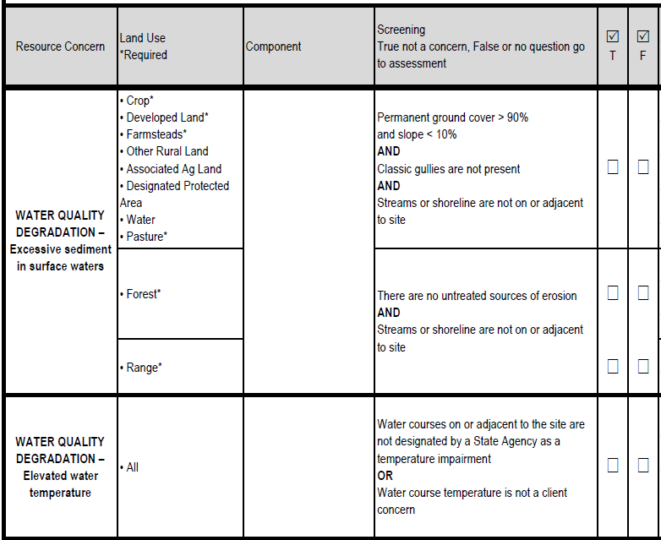
True
True
X
True
Notes:
Some questions have multiple parts linked by AND or OR;
On questions that have AND
All AND Statements must be true for the question to be true
Let’s look at a couple of examples, In the first example, all questions are true, so the entire statement is true, (Read each statement)
The permanent ground cover is more than 90% at all times and the slope is less than 10%, so the first statement is True.
There are no classic gullies, so the second statement is true.
And there is not a stream or shoreline on or adjacent to the site, so the last statement is true.
Since all three statements are true the entire Question is True.
So the planner would not need to evaluate the Assessment question and the resource concern is not present.

Slide 12
True
True
X
False
Notes:
In the second example one question is false, so the entire statement is False.
The permanent ground cover is more than 90% at all times and the slope is less than 10%, so the first statement is True.
There are no classic gullies, so the second statement is true.
However there is a stream adjacent to the site, so the last statement is false.
Since one of the statements is false the entire Question is False, and the planner would need to proceed to the assessment question.

Slide 13
True
X
X
True
True
Notes:
On questions that have OR
Only one OR Statement must be true for the question to be true
Let’s look at a some examples, In the first example, both questions are true, so the entire statement is true,
Water courses are not designated as temperature impaired so the first statement is true and the client is not concerned about water course temperature so the second statement is True. Therefore the entire screening question is True and the planner would not need to evaluate the Assessment question and the resource concern is not present.

Slide 14
True
X
X
False
Notes:
Remember on questions that have OR
Only one OR Statement must be true for the question to be true
In the second example one question is true and one is false, however because of the OR statement the entire statement is still true.
Water courses are not designated as temperature impaired so the first statement is true but the client is concerned about water course temperature so the second statement is False. Even though the client is concerned about the Water course temperature the entire screening question is True and the planner would not need to evaluate the Assessment question and the resource concern is not present. However since the client is concerned about the Water Course temperature, the Concern should be identifed as a client objective even though it will not be marked as a resource concern and the planner should consider the objective when developing alternatives for the decision maker.

Slide 15
False
X
False
Notes:
In order for the entire statement to be false both statements linked with the OR must be false.
In the third example both questions are false, so the entire question is false.
Water courses are designated as temperature impaired so the first statement is false and the client is concerned about water course temperature so the second statement is False. The entire screening question is False and the planner would need to evaluate the Assessment question to determine if the resource concern is present.
Please Note: that on any of screening questions, if the planner is not sure how they should answer the question, it is recommended that they answer false and proceed to the assessment. In other words “ if you are not sure, go to the assessment”.
The screening questions are designed to save time, not take more time in deliberating how to answer the question, so if there is any doubt it is ok to answer False and go to the assessment.

Slide 16
Required Resource Concerns
Note that some Resource Concerns are required to be evaluated on particular land uses (required land uses will have an asterisk)
Some Resource Concerns are optional (no asterisk)
Not Applicable to certain Land uses. (land use not listed)
Notes:
Note on the form that some Resource Concerns are required to be evaluated on particular land uses. Some concerns are optional and some are not applicable. These were identified for screening and assessment in Conservation Desktop to assure that important concerns are evaluated, while still streamlining the process of evaluating resource concerns.

Slide 17
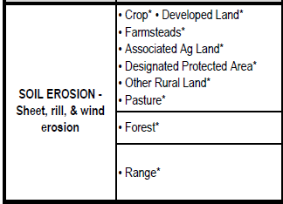
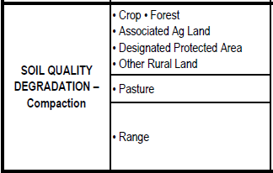
The Soil Erosion - sheet, rill and wind erosion concern is required to be evaluated on all land uses except the Water land use.
The Soil Quality Degradation – Compaction concern is optional for most land uses and not applicable for the Developed Land, Farmsteads, and Water land uses.
Notes:
For example, soil erosion, sheet, rill and wind erosion is an important and common resource concern which is required to be evaluated on all land uses except for the Water land use. It is Not Applicable to the Water land use because erosion is not a concern on water therefore, the Water land use is not listed.
The soil quality degradation compaction concern is optional for most land uses (which are listed without an asterisk) and is not applicable for Developed land, farmsteads and water land use (which are not listed).
Optional concerns should be evaluated and used for developing alternatives if present, but may not be required in Conservation Desktop to streamline the planning process.

Slide 18
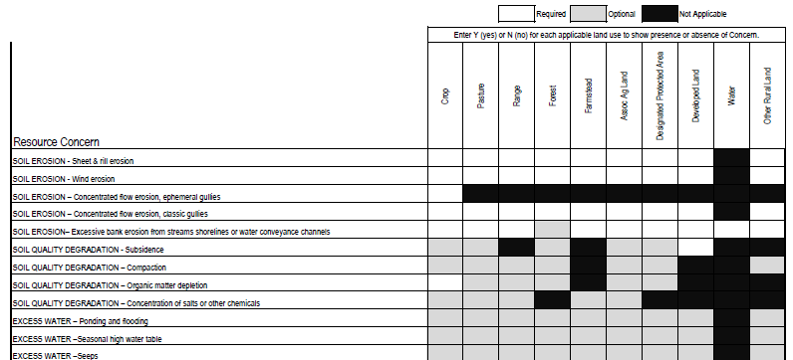
Summary page
Notes:
The last page or summary page of the checklist is a place for the planner to check off on Resource concerns for each land use. It also will show the required, optional or Not applicable status for each concern for each land use.

Slide 19
Steps in Using the checklist for the Environmental Evaluation
Determine Resource Concerns (RC) on the planning unit
Using the Checklist, document the Benchmark Condition on the Environmental Evaluation (NRCS-CPA-52)
Develop Alternatives by using the identified RC’s, the planner’s experience and other tools to identify practices to solve the problems
Use the checklist, the planner’s experience and other tools to predict expected results of No Action and each alternative on the Environmental Evaluation
Notes:
The checklist can make determining resource concerns more consistent but can also help in documenting present and future conditions on the environmental evaluation as well as help in developing alternatives.
The planner would follow these steps:
The planner should first, determine Resource Concerns (RC) on the planning unit, this step usually would have 2 parts:
The first part is the screening in the field, where the planner should answer the screening questions and gather any information needed to run the Assessment tools such as RUSLE2.
The second part would be back in the office where the planner runs any applicable screening tool to make a final decision on whether the concern is present. Note that some of the assessment tools should be run in the field, such as SVAP2, Rangeland Health Assessment and Pasture Condition scoring.
Then using the information from the Checklist, the planner should document the Benchmark Condition on the Environmental Evaluation (NRCS-CPA-52)
Then the planner should use the identified RC’s and their knowledge of practice effects or other tools such as the CPPE, a site specific practice effects worksheet, or the Conservation Practice effects network diagram to identify practices to solve the problems. From the identified practices, the planner should develop alternatives for the decision maker’s consideration
At that point the planner should use the checklist and other tools such as the CPPE, a site specific practice effects worksheet, or the Conservation Practice effects network diagram to predict expected results of No Action and each alternative on the Environmental Evaluation by predicting expected effects of the alternatives.

Slide 20
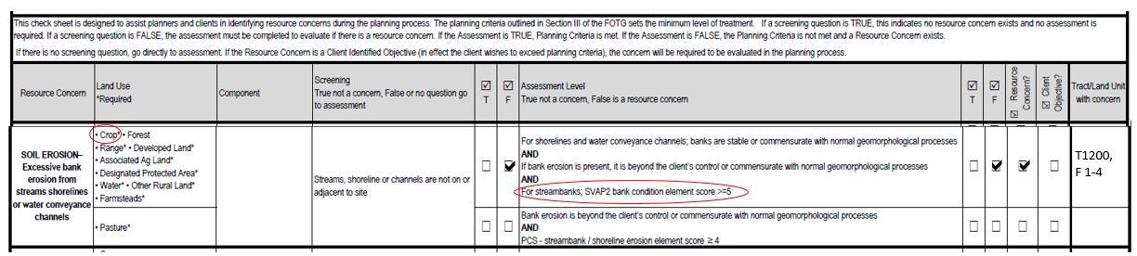
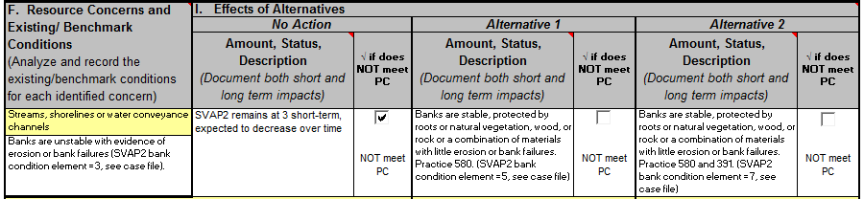
Present Condition
Future Conditions
Notes:
Here is an example of how the Checklist can be used to complete the Environmental Evaluation (NRCS-CPA-52). On the top of the screen is a portion of the checklist and on the bottom is a portion of the CPA-52.
Look at the Crop land use. Cropland fields 1-4 in Tract 1200 have a stream that runs between the fields. The planner would answer the screening question as false and proceed to the assessment. In reviewing the bank condition element of SVAP2, the planner determines that the stream has several bank failures, the banks are not protected and would score 3 on the bank condition element. Since the score is less than 5, the planner would answer false to the assessment question and determine that there is a resource concern. The planner has now determined the present or benchmark condition so that information should be documented in the first column of the CPA-52.
As the planner proceeds through the planning process, alternatives are developed using the identified concerns and the expected effects that practices will have on the resource. The planner determines that the Streambank and Shoreline Protection (580) and the Riparian Forest Buffer (391) practices would have a positive effect on the concern and includes the 580 practice in the first alternative and both the 580 and 391 practices in the second alternative that will be presented to the decision maker.
At this time, the planner can now begin to predict the future conditions and the checklist questions can help with that. The planner should predict what would happen if no action is taken. Using the assessment question, would the SVAP2 bank condition improve to 5 or more with No Action? That is highly unlikely, so the planner should document in the second column that the bank condition will remain at 3 short term but will decrease over time and mark that the No Action alternative does not meet planning criteria.
Then the planner predicts that the Streambank and Shoreline Protection (580) practice included in the first alternative would cause the SVAP2 bank condition score to improve to 5, that information should be recorded in the column for the first alternative.
Then the planner predicts that the Streambank and Shoreline Protection (580) and Riparian Forest Buffer practices included in the second alternative would cause the SVAP2 bank condition score to improve to 7, that information should be recorded in the column for the second alternative.
The planner would not check the boxes that the Alternatives “do not meet PC” because in the planner’s estimation the Streambank Stabilization and Riparian Forest Buffer practices would have the effect of improving the SVAP2 bank condition to 5 or more and would meet planning criteria.

Slide 21
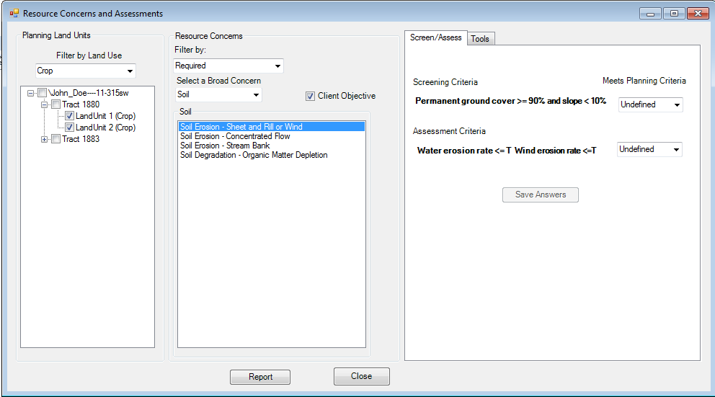
Conservation Desktop Resource Concerns
Screening and Assessment Data Entry
Notes:
In addition to the benefits of more consistently identifying resource concerns and training of new planners, planners should become familiar with the process of using screening and assessment questions because:
The current plan is that in the future, Resource Concerns will be evaluated in Conservation Desktop. This module may possibly be added to Customer Service Toolkit prior to the release of Conservation Desktop. Resource concerns will be able to be assessed by Land Units, Land use, and Required concerns. The tools to assess concerns will be linked directly to the screening and assessment tool.

Slide 22
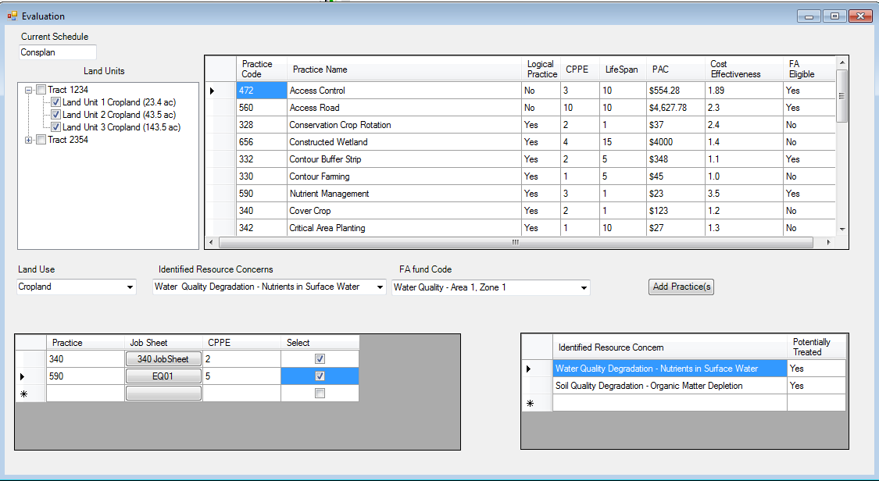
Evaluate Schedule
Notes:
Once the Screening and Assessment is completed, by interfacing with the CPPE, Practices will be identified that address the concerns and the planner may add selected practices to an alternative for the producer.

Slide 23
Notes:
The checklist can be a part in completing all four steps of Phase I, the collection and analysis phase, as a tool in helping to identify problems, inventory resources and analyze the resource data. If addressing a particular concern is a client objective, the checklist can also be a part of the determine objectives step.
Once the Collection and Analysis Phase is completed, the planner can move into Phase II, the decision support phase. Practices can be selected that address the concerns and the planner may add selected practices to an alternative for the producer as part of the continuation of the planning process by Formulating Alternatives. The checklist should also assist the planner in the Evaluate Alternatives step of Phase II, by giving the planner the criteria to determine if the alternative addresses the concern.
The checklists should also be used in Phase III, Step 9, to Evaluate the Plan, and see if the outcome turned out as we predicted and the client’s objectives were met. I know we don’t actually get around to that last step very often, but for planners that take the time to do it, it is a valuable learning opportunity and also promotes a continued working relationship with the landowner.

Slide 24
Natural Resource Concerns identified are opportunities used in the planning process. The client may identify some of these and others may be found through our resource inventory process and by screening and assessment of the individual concerns.
National Planning Procedures Handbook,
NPPH 180 Part 600
Notes:
Natural Resource Concerns identified are opportunities used in the planning process. The client may identify some of these and others may be found through our resource inventory process and by screening and assessment of the individual concerns.
The checklists can help us compare Resource Management System (RMS) plans to progressive planning. The first step in developing an RMS plan is to determine the resource concerns that are present. The client may choose to address some or all of the resource concerns identified. They may address some now, and others later, or they can choose to only address those that meet their current objectives. Do we just plan the practices the landowner wants (like writing the oxycodone prescription) or do we present alternatives to the decision maker that treat all the resource concerns?
Technical Assistance is key in identifying and assessing benchmark conditions, resource concerns and effects of current conditions. The NRCS objective in conservation planning is to help the client manage resources for sustained used and productivity while considering the Human elements: economic and social needs.

Slide 25
Some Questions You may have:
Will the RC checklist be a required form?
Will States be able to adapt the form?
Notes:
At this point you may have some questions such as:
Will the RC checklist be a required form?
Whether the form is required for all plans would be a decision for the individual state, but generally, No the form will not be required Nationally. However, the form is a great training tool, to train new planners on the process of identifying resource concerns. Even experienced planners could benefit from using the form on several plans to internalize the process of identifying concerns.
Will States be able to adapt the form?
Yes, and since some states’ FOTG Section III planning criteria has been adapted for their individual situations, that state would probably need to adapt the form to fit their planning criteria.
We will answer your other questions at the end of the presentation.

Slide 26
Demonstration
Notes:
Even though I am going to be demonstrating the use of the form electronically, keep in mind this checklist is probably best used in paper form on a clipboard with the planner in the field. Planners could make various notes as they proceed through completing the checklist, in the field. Generally, the screening questions and some of the assessment questions can be answered on site in the field. However, some of the assessment tools (such as RUSLE2) will have to be run in the office on the computer to answer the assessment question.

Slide 27
Scenario
You are working with a producer Joe Farmer. Joe has some cropland, pasture, forest and a headquarters area. Joe is really concerned about a stream that flows through his cropland and pasture fields. Even though the stream is in better shape in the pasture fields, he wants his neighbors to appreciate the care he takes to protect the stream.
Notes:
Here is the scenario I will use to demonstrate the form:
The planner is working with a producer Joe Farmer. Joe has some cropland, pasture, forest and a headquarters area. Joe is really concerned about a stream that flows through his cropland and pasture fields. Even though the stream is in better shape in the pasture fields, he wants his neighbors to appreciate the care he takes to protect the stream.

Slide 28
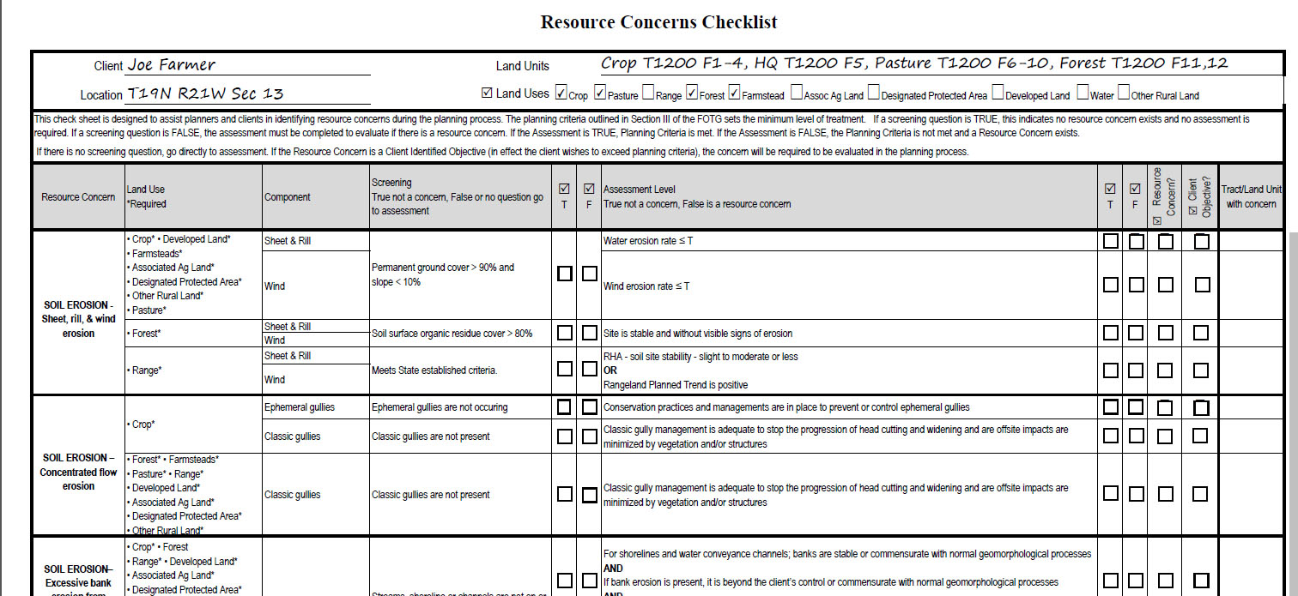
Notes:
Now lets work through completing part of the form to demonstrate how it could be used. Keep in mind that his form is designed to be a tool to assist the planner in identifying Resource Concerns in the field.
The first step would be to document the Client, Location and Land Units information. Also all the land uses that are in the planning unit should be checked.

Slide 29
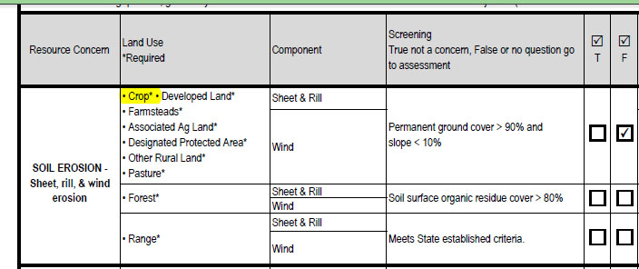
Notes:
Generally in the field, the planner will be evaluating Resource Concerns by land use, so we will start with the Cropland land use. For Sheet, Rill and Wind erosion the screening question asks if the permanent ground cover is greater than 90% and the slope is less than 10%. On cropland that is annually tilled, there is not 90% cover all of the time, so the screening question is false and we should proceed to the assessment question.

Slide 30
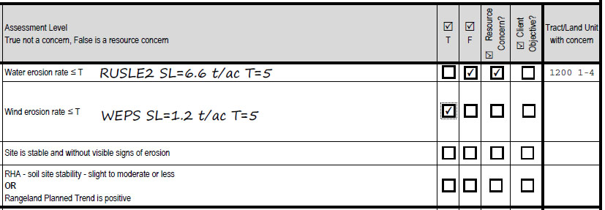
Notes:
The assessment question is based on RUSLE2 for water erosion and WEPS for wind erosion. These may be tools that the planner would have to run after they return to the office. Once they tools are ran, the planner could document the results on the sheet and check the boxes on whether or not the concern is present. If the concern is present the planner could also document the particular fields with the concern. In this case, the soil loss exceeds T on water erosion, but does not on wind erosion. Therefore, there is a resource concern for water or sheet and rill erosion.
The planner should also list the land units where the concern is present.

Slide 31
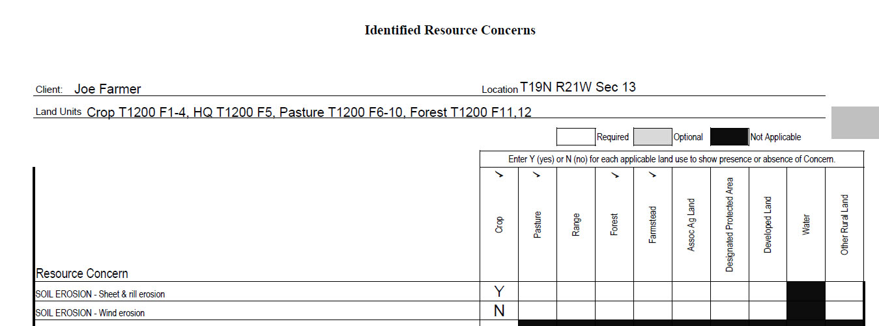
Notes:
Once the decision is made on whether or not concerns are present, the planner could use the last page of the form as a summary of the concerns. In this case, the Sheet and Rill erosion concern is present but the wind erosion concern is not present on the cropland.

Slide 32
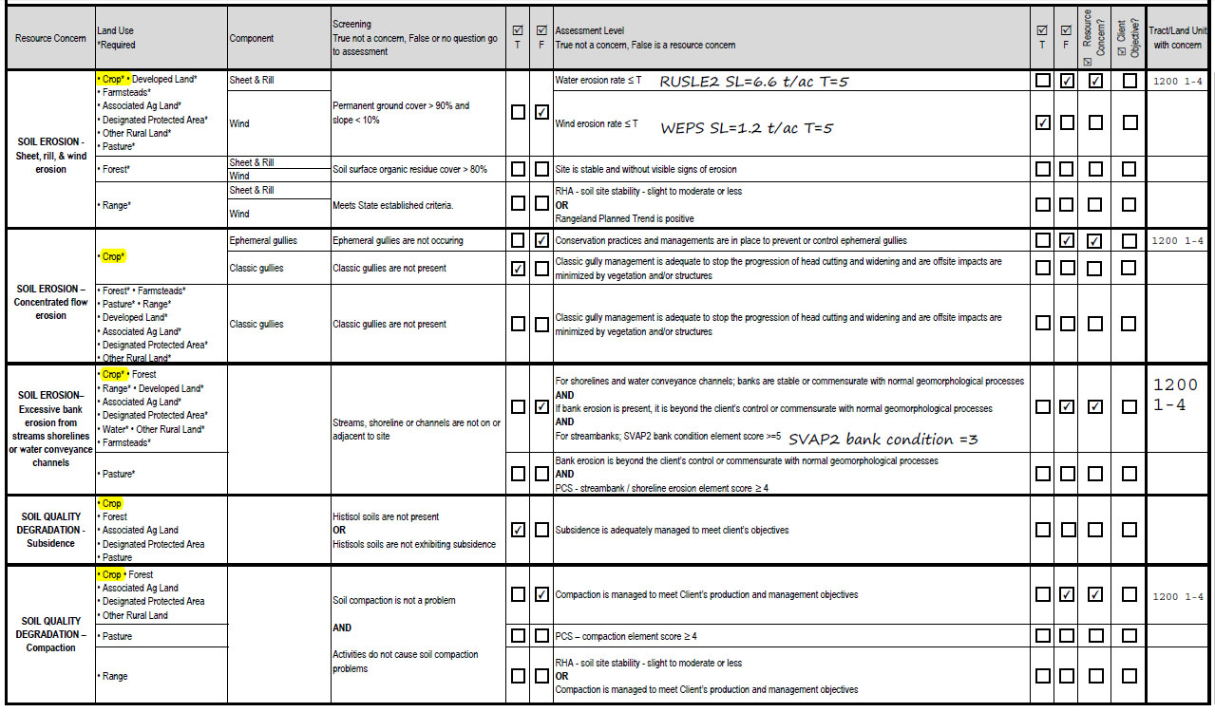
Notes:
The planner is still evaluating the Cropland concerns, so he moves to the next resource concern, Concentrated flow soil erosion. In this case the planner determines that ephemeral gullies are occurring, so the screening would be false. Classic gullies are not occurring so the screening question is true. The planner should continue on to the assessment question for ephemeral gullies but there is not a concern for Classic gullies, so the assessment for classic gullies would not have to be completed.

Slide 33
Notes:
On the assessment question for ephemeral gullies, practices and managements are not in place to control the gullies so the assessment question is false and the concern is present. The planner should check the resource concern box and list the land units where the concern is present.

Slide 34
Notes:
The planner should proceed to the next Resource concern. There is a stream present adjacent to the crop fields, so the screening question is false and the planner should proceed to the assessment question.

Slide 35
Notes:
On the assessment question, the first statement is true, because there is no shoreline present. On the second statement, there is some bank erosion and the planner determines that it is not commensurate with normal geomorphological processes and the statement is false. Since the statements are linked with AND, if one statement is false the entire assessment question is false, At this point the planner could determine that the entire assessment question is false, but may want to go ahead and check the final statement. On the third statement the planner should evaluate the cropland against the bank condition element of Streambank Visual Assessment Protocol or SVAP2.

Slide 36
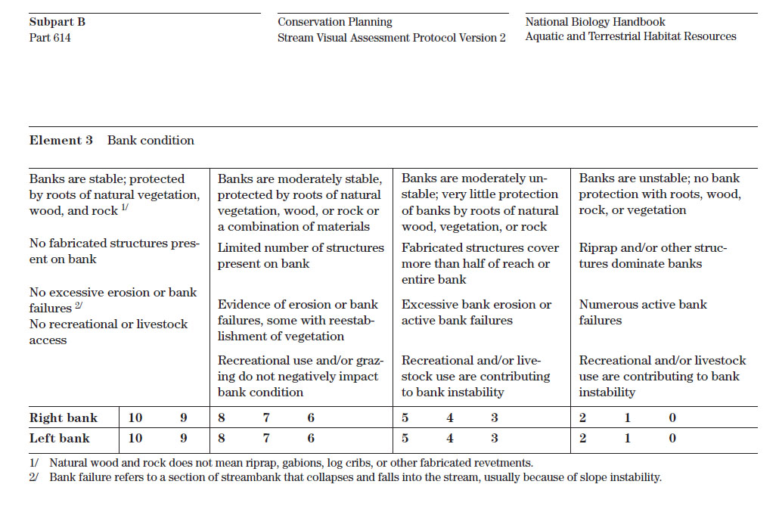
Notes:
When the planner refers to the bank condition element of SVAP2, he determines that banks are unstable and there is excessive bank erosion and active bank failures and would score 3 on the bank condition element. Note that the planner does not have to complete and entire SVAP2 score but for this assessment would only have to evaluate the bank condition. So even though the planner may not be trained in the entire SVAP2 procedure they would only have to be trained on evaluating the Bank condition element for evaluating resource concerns.

Slide 37
Notes:
The planner could document the SVAP2 bank condition score and since it is less than 5 the last statement is false. Since all 3 statements are linked by AND, all 3 statements must be true for the assessment question to be true, therefore the assessment question is false and Soil Erosion excessive bank erosion is a resource concern. The planner should check that the resource concern is present and should record the land units that have the concern.

Slide 38
Notes:
The next resource concern is Soil Quality Degradation – Subsidence. The planner determines that Histosols are not present so the screening question is true, the Resource Concern is not present and the planner should proceed to the next concern.

Slide 39
Notes:
During resource inventories, the planner observed a plow pan in the fields and the producer is using conventional tillage with several operations that contribute to compaction, so both parts of the screening question is false and the planner should proceed to the assessment question. Note that since the statements are linked with AND, only one statement would have to be false for the entire statement to be false.

Slide 40
Notes:
The client mentioned that his crop yields have been decreasing and he has noticed that he has to apply more irrigation water to his crops and would like some advice on how to improve his profitability. The planner determines that the client’s production and management objectives are not being met, so the assessment question is false, the resource concern is present, and records the land units where the concern is present.
The planner would continue screening and assessing each resource concern, until all the resource concerns have been identified for the cropland fields.

Slide 41
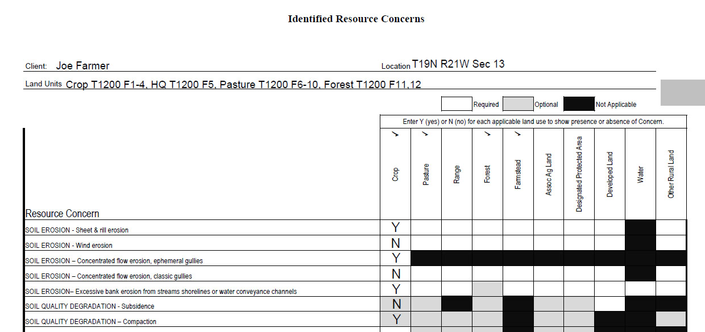
Notes:
Once all the concerns are identified, the planner should record the presence or absence of each concern on the cropland land units, by entering Y for yes or N for No on all the concerns.

Slide 42
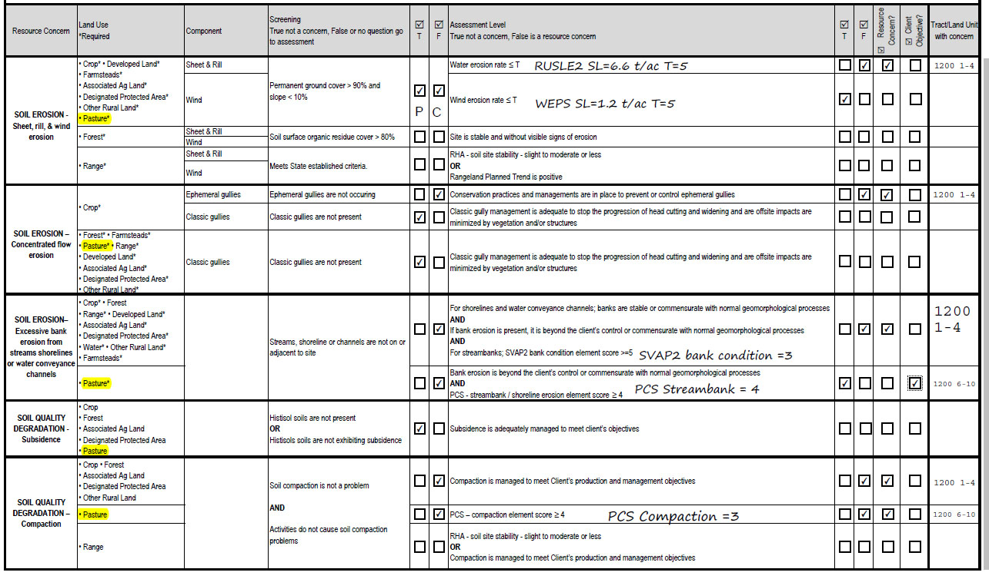
Notes:
After all the concerns are identified for the cropland fields, the planner should proceed through other land uses on the planning unit. In this case the client also has pasture land units. The planner begins by evaluating the Soil Erosion, sheet, rill and wind erosion on the pasture. In this case the ground cover exceeds 95% at all times and the slope is less than 10%, so the planner would mark the screening question true and move to the next concern. Note that since the screening question is the same for crop and pasture, and the crop question was false and the pasture question is true, the planner would check the applicable answer for each land use and make a note that P is for the pasture answer and C is for the crop answer.

Slide 43
Notes:
The planner would continue to Soil Erosion – Concentrated Flow erosion. Notice that the screening question for pasture and other land uses is different than cropland since ephemeral gullies only occur on cropland. In this case the planner determines that there are no gullies in the pasture, the screening question is true and the concern is not present on the pasture.

Slide 44
Notes:
The planner should proceed to Soil Erosion – excessive bank erosion. Since there is no screening question the planner should proceed directly to the assessment question.

Slide 45
Notes:
For the assessment the planner determines that the bank erosion is commensurate with normal geomorphological processes, so the first statement is true. For the second statement, the planner must refer to the Pasture Condition Score streambank shoreline erosion element. Note that Cropland uses SVAP2 for the assessment and Pasture uses PCS for the assessment.

Slide 46
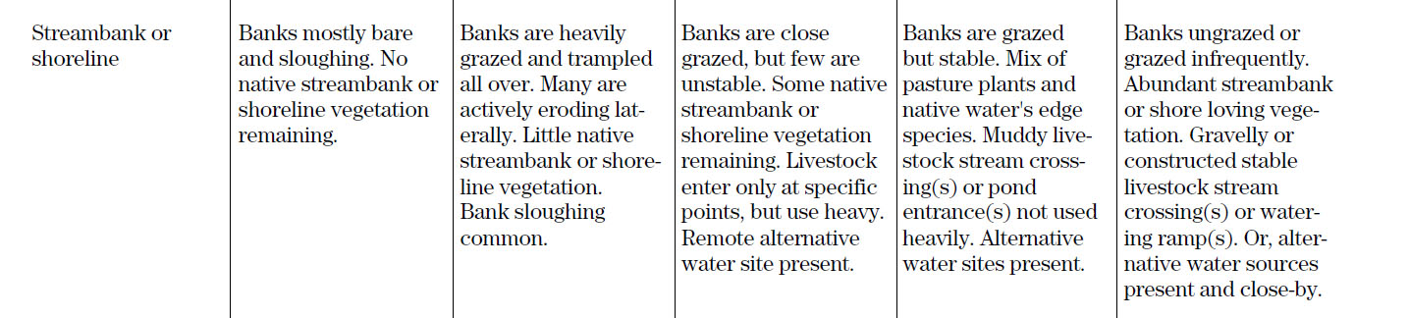
1
2
3
4
5
Notes:
When the planner, refers to the pasture condition score, streambank or shoreline erosion element, he determines that the banks are grazed but stable and fits the description for a score of 4. Notice that the planner may not have to complete the entire pasture condition score sheet but only the streambank or shoreline erosion element, to assess this particular concern.

Slide 47
Notes:
The planner could document his determination and since the score is 4 or more the statement is true. Since both statements linked by AND are true the entire assessment question is true and the concern is not present. However, it was a client objective for his neighbors to appreciate the care he takes in protecting the stream, so the planner should mark the concern as a client objective, list the land units and include the concern when developing alternatives later in the planning process.

Slide 48
Notes:
The next resource concern is Soil Quality Degradation – Subsidence. The planner determines that Histosols are not present so the screening question is true, the Resource Concern is not present and the planner should proceed to the next concern.

Slide 49
Notes:
For Soil Quality Degradation – Compaction,
During resource inventories, the planner observed evidence of compaction in the fields and cattle trails and concentrated areas, so both parts of the screening question is false and the planner should proceed to the assessment question.

Slide 50
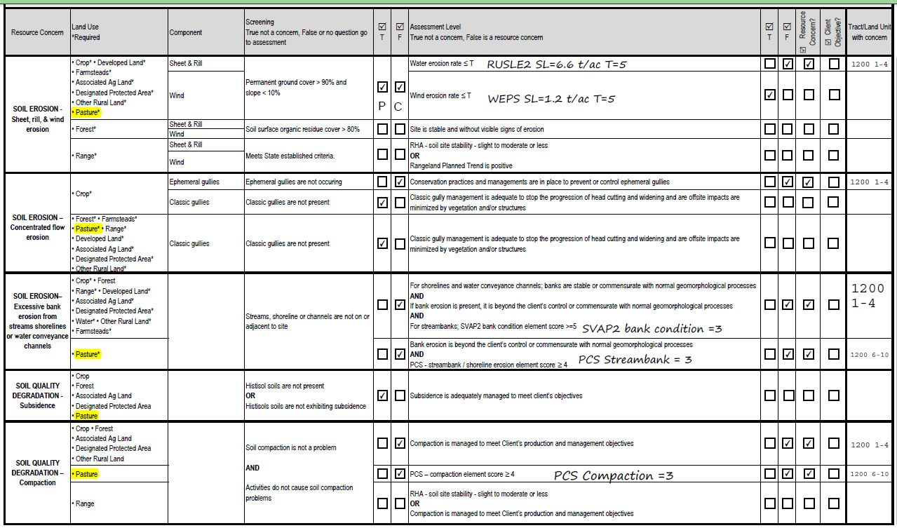
Notes:
For the assessment, the planner should once again refer to the pasture condition score, in this case the compaction element.

Slide 51
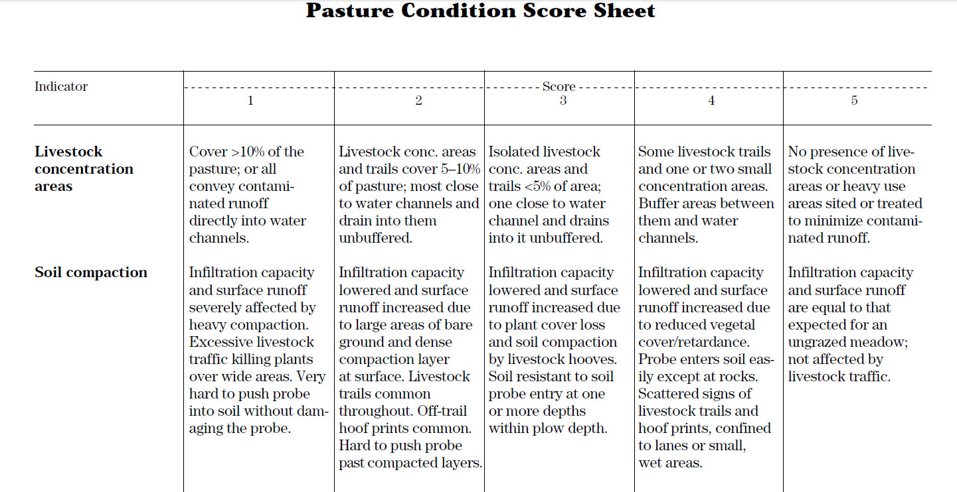
Notes:
The planner determines that infiltration capacity is lowered due to compaction and scores the Soil Compaction element as a 3.

Slide 52
Notes:
Since the Compaction element is less than 4, the assessment question is false, the resource concern is present, and the planner should record the land units where the concern is present.

Slide 53
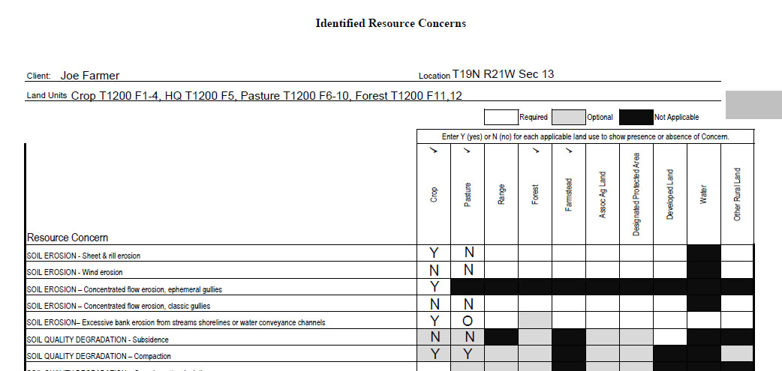
Notes:
Again, the planner should proceed through all of the concerns for the pasture, then summarize the presence or absence of the concerns for the pasture. Note that the planner could also document an individual resource concern as an objective with an O.

Slide 54
Questions
Notes:
Hopefully with this demonstration, you are able to understand how to use this checklist to screen and assess resource concerns for several land uses. The intent of the form, is to provide a form that the planner can take to the field to systematically assess all concerns. It is not intended to be a required form, and most planners after using it several times in planning will internalize the process, and should be able to go through the process mentally without having to use a form. In this way it is also a great training tool to help new planners better understand the systematic approach to determining Resource Concerns so that they will be able to legitimately and consistently identify resource concerns.
Thank you, now do we have questions?

