Slide 1
LiDAR-derived Hillshades make sense
NRCS ENTSC Webinar, February 27, 2013
Reed Sims, GIS Specialist
USDA- NRCS
Colchester, Vermont
Notes:
Intro slide

Slide 2
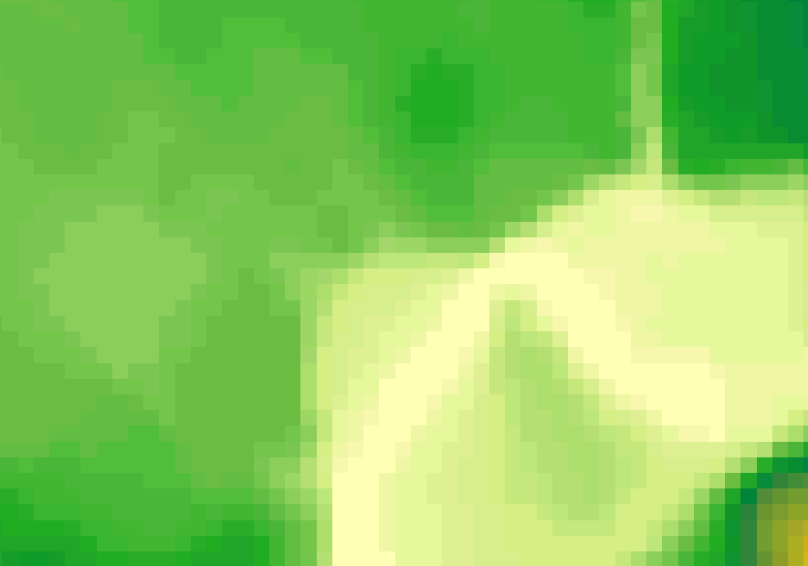
Old 30 meter elevation data
Would you use this in conservation planning?
Slide borrowed from Jarlath O’Neill-Dunne, UVM
Notes:
USGS 30 meter National Elevation Dataset (NED) displayed at a scale of 1:7000
These are the data we used for more than 20 years. You can see broad areas of information. The color variations shows the white areas as lower elevations than the green, and the dark green areas are higher elevations than light green areas.
This type of data requires field visits to see what is really happening on the land.

Slide 3
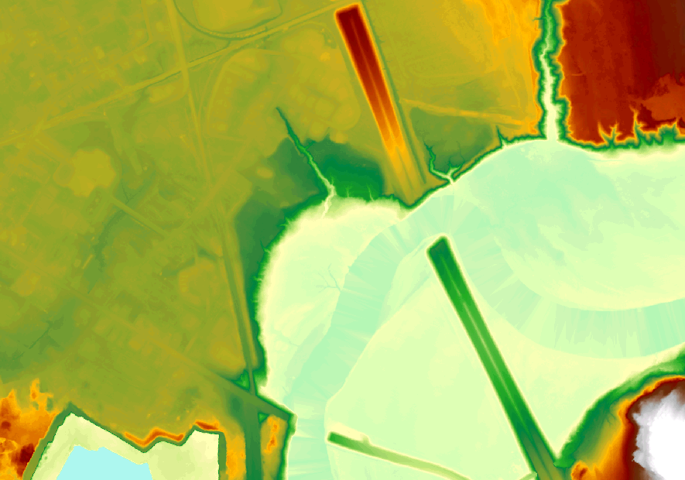
1m LiDAR DEM data
-- same place –
Still not intuitive as a planning layer!
Slide borrowed from Jarlath O’Neill-Dunne, UVM
Notes:
1meter resolution LiDAR derived Digital Elevation for the same area, displayed at the same scale. The red areas are the highest elevation, dark green areas are high elevation areas. The white and blue areas are the lowest elevation areas.
As was mentioned before, LiDAR data is a point cloud, and not always useful until we make derivatives from it. Here you see the bare-earth derivative, the last returns - which represents points that hit the ground. Software allows us to pick out sets of data points which will be useful for certain purposes. Here, we wanted to pick data points which will tell us the shape of the bare earth, the earth without vegetation.
ArcGIS was used to make a hillshade derivative from this bare-earth DEM, shown on the next slide. A hillshade is also known as a shaded relief.

Slide 4
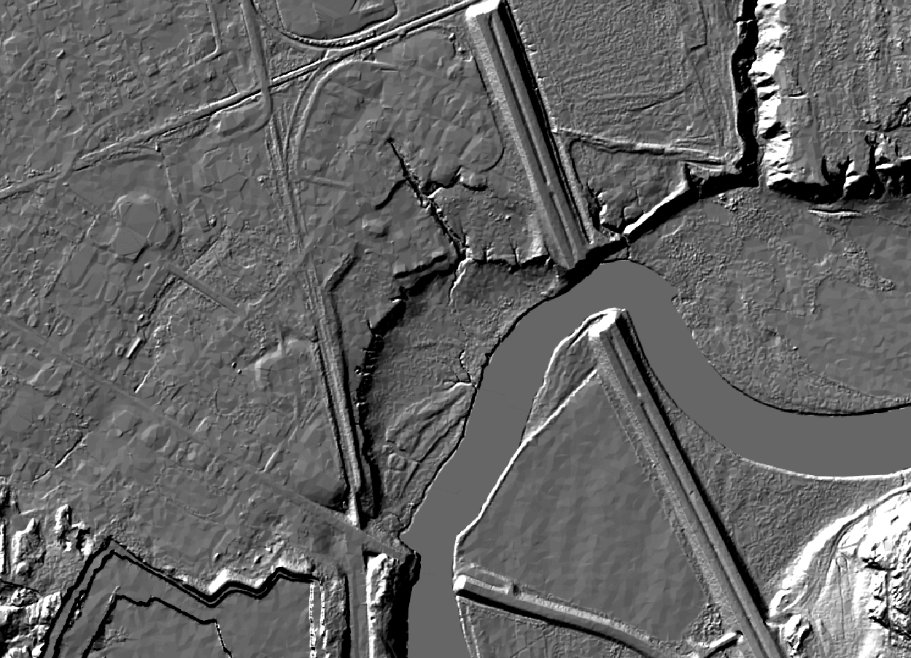
1m Hillshade
Start to see details and understand them
Cliffs
Notes:
We are still in the same area.
This is a “hillshade” derived from LiDAR.
Notice how the Cliffs pop out! Back in the previous slide, we saw shades of darker green but don’t know what that means beyond the fact that the dark green area is an area of higher elevation. With this hillshade, we can see there is an abrupt landscape change at the cliffs down to a river’s floodplain.
A hillshade is a grayscale 3D model of the surface, with the sun's relative position taken into account for shading the image. This function uses your choice of azimuth and sun angle properties to specify the sun's position. ArcGIS Help has definitions.
This hillshade was made using the following information:
1 – DEM: A Digital Elevation Model – a simplification of the real surface. It’s called a raster layer. The landscape is divided into squares called pixels. Each pixel contains a number which represents the elevation of that square area. This hillshade is using pixels which are 1 meter square – about 1 square yard.
2 – Azimuth: The azimuth is the angular direction of the sun, measured from north, in clockwise degrees from 0 to 360. An azimuth of 90º is east. The default azimuth for hillshades is 315º (NW), but you can set it differently. You could make a hillshade which shows the landscape illuminated from the Southwest or due East, in order to highlight landscape features that are all in shadow from the NW. The azimuth that seems to make sense to our eyes is the northwest, the default. Somehow that makes shadows that give us a gut-level feeling about what is up or down. This hillshade used the default.
3 – Sun Angle: This is how high the sun appears to be in the sky. Is the sun low, causing shadows behind higher elevations – like late afternoon? In this hillshade, the sun appears to be at about 45 degrees, and throws shadows that make sense for that sun angle.

Slide 5
1m Hillshade
Start to see details and understand them
Cliffs
What are these?
Notes:
What are these? Broken bridges? Actually not. This LiDAR was prepared with all bridges or other false obstacles (the water can actually run right beneath them) cut through so that software that can simulate floods or hydrology won’t encounter a fake barrier. The preparation process is called hydro-enforcement.

Slide 6
1m Hillshade
Start to see details and understand them
Gullies
Cliffs
Notes:
We also see gullies. These were visible in Slide 3 with the colorized DEM, but looked like streams.

Slide 7
1m Hillshade
Start to see details and understand them
Floodplain
Gullies
Cliffs
Notes:
We can see a floodplain which is bounded by another set of cliffs.

Slide 8
1m Hillshade
Start to see details and understand them
Roads
Floodplain
Gullies
Cliffs
I-89
Notes:
Roads show up pretty clearly in hillshades. Our engineers have used Lidar data to help with surveying near roads they can’t easily cross, like the Interstate.

Slide 9
1m Hillshade
Start to see details and understand them
Roads
Floodplain
Gullies
Cliffs
I-89
Quarry?
Notes:
In the lower left corner of the hillshade, we see an area which might be a quarry.
On the next slide, let’s look at the same areas using an aerial photo. Historically, we used aerial photos to do a lot of our landscape interpretations. We’ll see how adding LiDAR data to an aerial photo increases the information we can get from the photo.

Slide 10
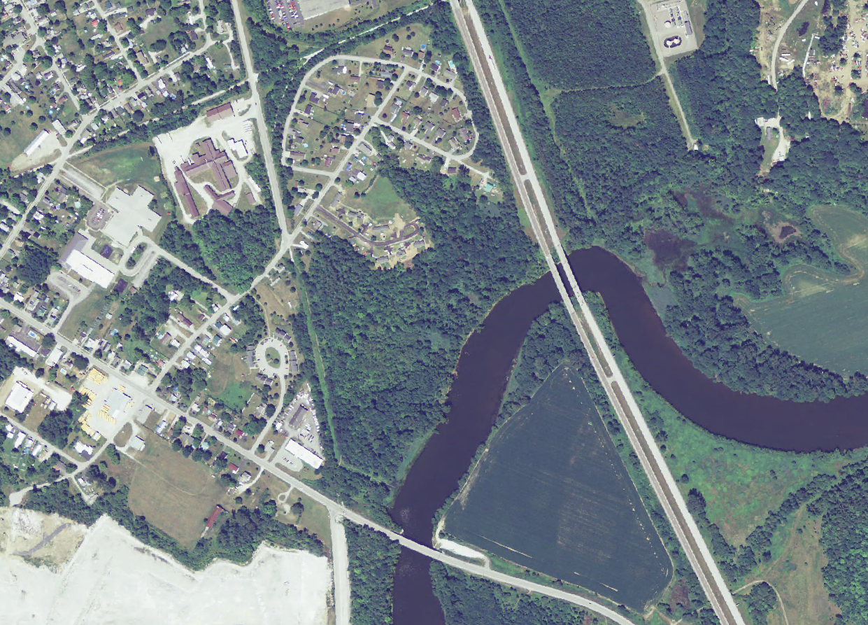
NAIP alone – see land cover details, but not topography
Notes:
The area within the red box shows lots of trees. Is this area flat? The aerial photo makes it appear flat.
NAIP is the National Agriculture Imagery Program of the Farm Services Agency (FSA) which acquires aerial imagery during the agricultural growing seasons in the continental U.S. A primary goal of the NAIP is to make digital ortho-photography available to governmental agencies and the public within a year of acquisition. More information is available from
http://www.fsa.usda.gov/FSA/apfoapp?area=home&subject=prog&topic=nai.
This NAIP image has a 1 meter resolution.
Let’s recall the hillshade.

Slide 11
1m Hillshade
Recall the Cliffs
Cliffs
Notes:
Okay, the cliff shows up again clear as day.
On the next slides, let’s look at the same area, adding an aerial photo. Historically, we used just aerial photos to do a lot of our landscape interpretations. We’ll see how adding LiDAR data to an aerial photo increases the information we can get from the scene.

Slide 12
In GIS we can overlay the aerial photo on the
Hillshade ….
Notes:
The airphoto contains geographic information. That is, we know where the houses, or the roads, or the trees are on the planet.
The hillshade also contains geographic information.
Thus, we can overlay the photo on the hillshade thereby adding elevation and shape to the photo. The white arrow shows how GIS can line-up the two datasets based on the geographic information contained in each.

Slide 13
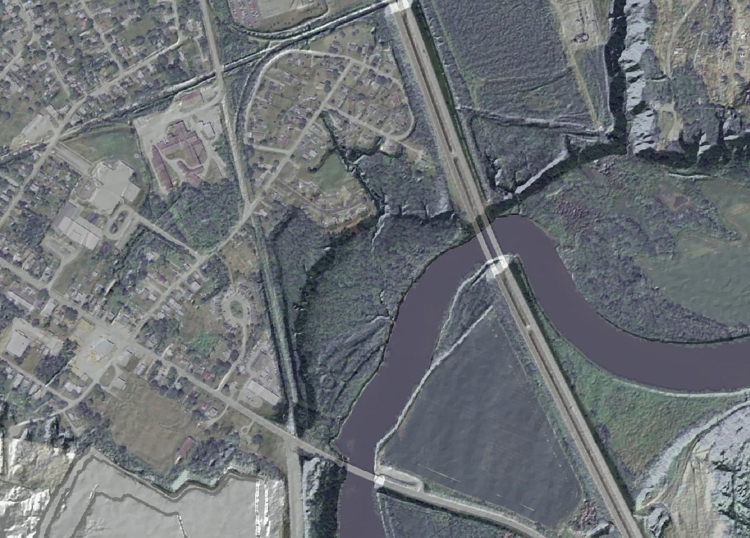
1m Hillshade plus 2012 NAIP imagery
Notes:
The result is an airphoto which has some 3D information. We can see the trees are growing on and below the cliffs. Thus, we know the shape of the bare earth, and what exists on the earth.

Slide 14
Hillshade and Encroaching Gullies
Tarte Rd
Notes:
Now, we’ll focus our attention on gullies.

Slide 15
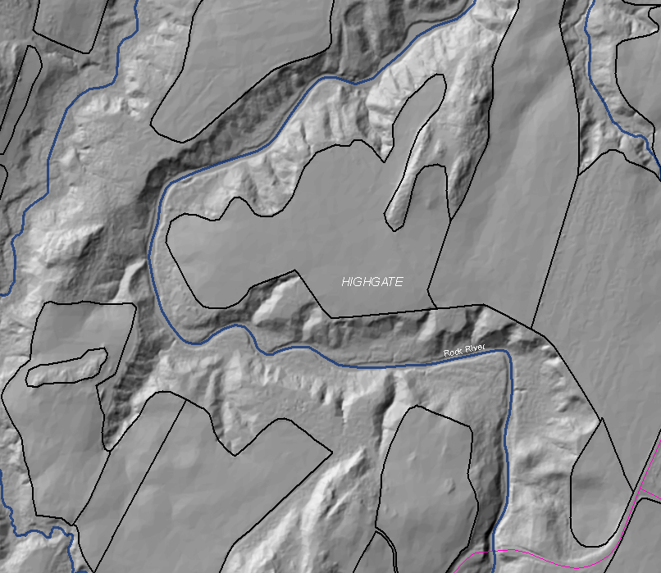
Hillshade: making sense of elevation data
Crop fields
Tarte Rd
Notes:
This is Highgate, Vermont.
The areas which are within the black-lined polygons and appear relatively flat are crop fields.
The blue line is the Rock River which winds its way between the crop fields.
A thin pink line, at lower right, is a road.

Slide 16
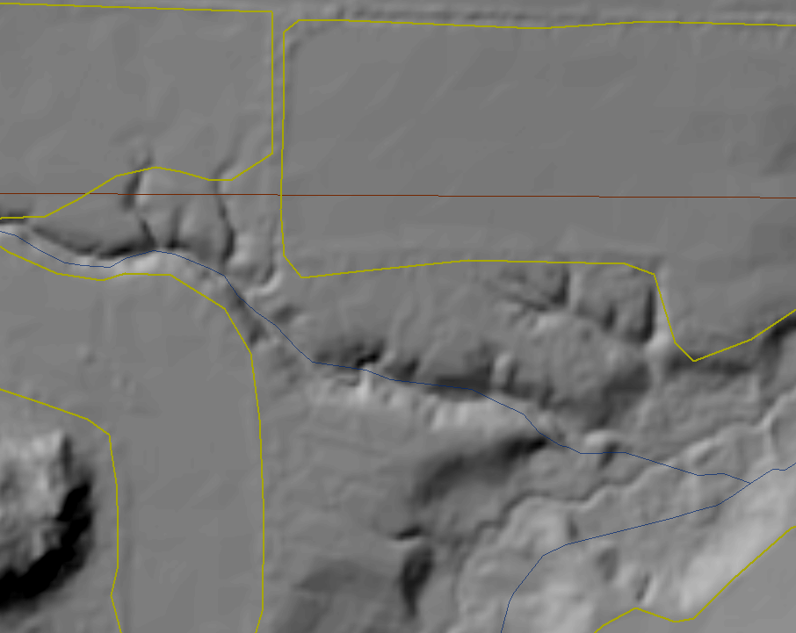
Use hillshade to find deep or ephemeral gullies
Possible gullies
encroaching on crop fields
Notes:
The Rock River stream bank has gullies which are encroaching on farm fields. Left untreated, these gullies will create significant problems for the farmers.
LiDAR allows conservationists to see the gullies earlier than they might otherwise, before the resource assessment. Seeing these encroachments in GIS enables conservationists to visit the field with GPS units, find and evaluate the specific gullies.

Slide 17
May not be visible in a field visit
without this information
Notes:
This gully is so small it may not be visible on a field visit, especially during the growing season. However, using its geographic location from LiDAR-derived hillshade and a GPS, the field conservationist can readily find the area and discuss appropriate treatments with the farmer before the gully becomes a problem for the farmer.
Also, notice the thin blue-line stream at lower right, and see if you think that is really the centerline of the river here.

Slide 18
Hillshade and Stream Location
Notes:
Now we turn to stream locations.
Stream locations are very important when helping farmers assess the need for conservation practices.
In the following case, we have a dairy farm in Vermont.

Slide 19
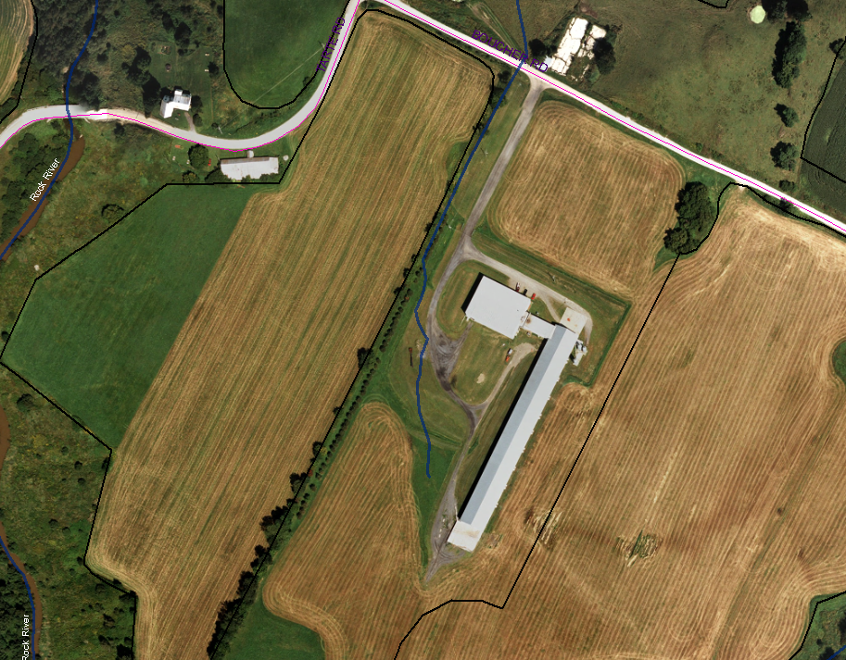
Correcting older stream data – proximity to barnyard
Blue line is the older stream data.
Does this location make sense?
Does this location seem to fit the area?
Stream data: trib of Rock R
--No indication of error
10m hillshade backdrop
Notes:
The tan arrow points to a narrow blue line which is a stream, according to older data.
This blue line cuts across the area as if it were an above-ground pipe. That is, the area around the blue line does not look like a streambank.
We can zoom-in and see this more clearly.

Slide 20
Zoomed view of a stream location that seems odd.
Stream data: trib of Rock R
--No indication of error
10m hillshade backdrop
Notes:
The narrow blue line shows where the less accurate, older data locates the stream.
It doesn’t look like the blue line is correct, but is it real clear where the stream really is in this case, or how pronounced the swale or banks are?

Slide 21
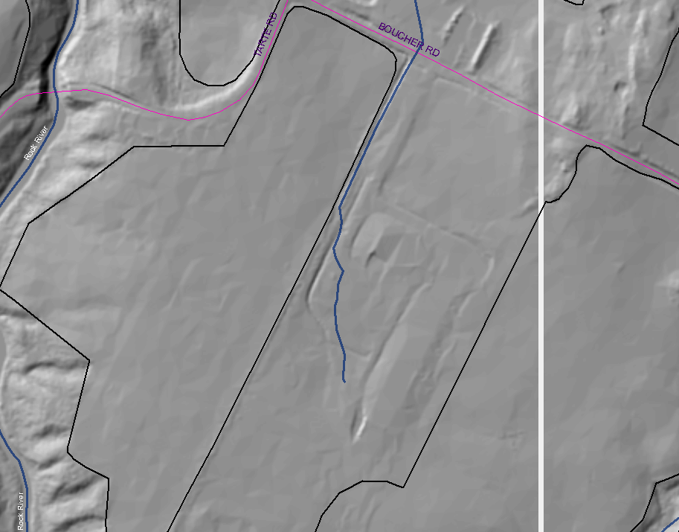
Correcting older data
Hillshade from LiDAR
-- Easy to see actual stream
Notes:
Looking just at the hillshade, same place: now the tan arrows are pointing to a depression - visible because of shadows. The depression is a stream which has been straightened. We can see that the actual stream is a bit further from the barn yard than the older hydrography (stream) data showed. It might not make a big difference in evaluating the danger from barnyard runoff in this case, but there may be farms where older digital stream data mislead us.

Slide 22
Summary
LiDAR derived hillshades make sense:
When you want to understand the landscape before visiting the field (example of cliffs)
When you want to help farmers anticipate future problems (encroaching gullies from a stream)
When older GIS data do not make sense (stream location)
Notes:
In Summary,…

