Slide 1
Using LiDAR Makes Sense
Applications of Derived Contour Lines
Aaron Dushku, GIS Specialist, MA
East NTSC Webinar, February 27, 2013

Slide 2
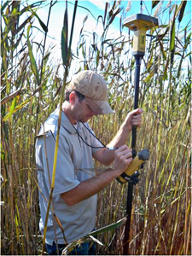


Desk-based structural design
!
!
!
!
!
Notes:
Desk-based structural design reduces field time for land surveys. First picture shows Aaron using a roving data collector for the survey grade GPS tools. The center shows the base station of the TOPCON survey tools.
For a 10-acre wetland area, the land survey would take 2 people 3-4 hours to complete the field work, and then another hour to process the GPS data into contours. With LiDAR-derived contours, the time could be reduced to

Slide 3
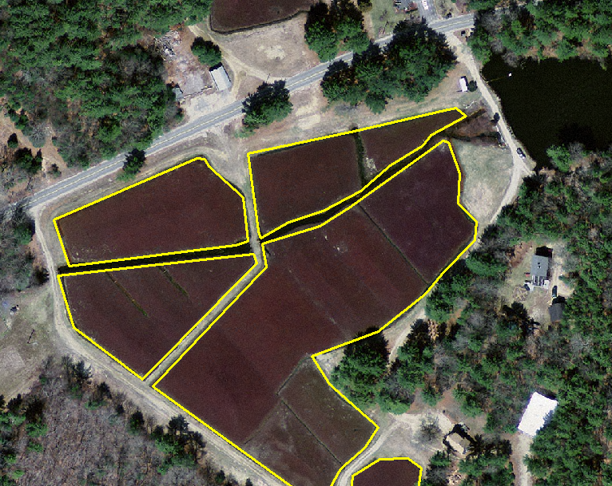
Cranberry bog with water-flow problems
Notes:
The general location of the project is in southeastern Massachusetts. These are cranberry bogs, the areas within the yellow polygons. They rely on an intricate system of canals and dikes.
The water flow problem centers on the issues of the water source. The water source here is in the top-right dark area which is a pond. The problem is that the current layout of the bogs depends on the water passing through the bogs adjacent to the water source.

Slide 4
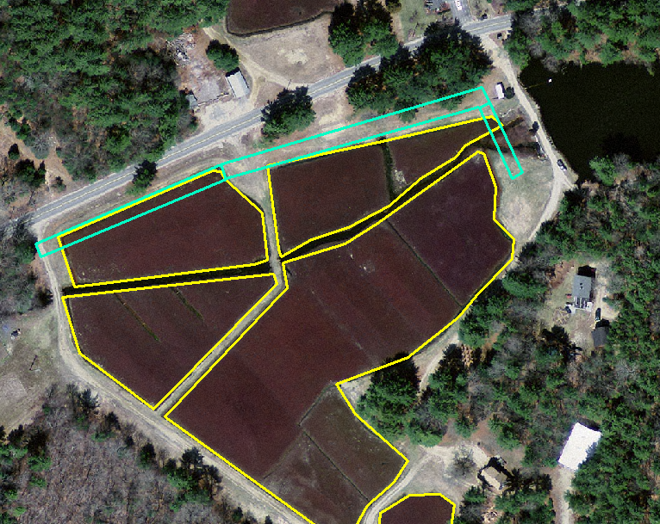
Proposed bypass (sketched)
Site of a historic mill required a cultural resource evaluation to be done quickly.
DITCH
FILL
Notes:
The proposed bypass would allow feeding water directly to the non-adjacent bog.
However, in order to build the by-pass, we had to consider an old mill which was a potential cultural resource. The preliminary design had to be completed very quickly for an archeologist review. LiDAR-derived contours enabled that speed.

Slide 5
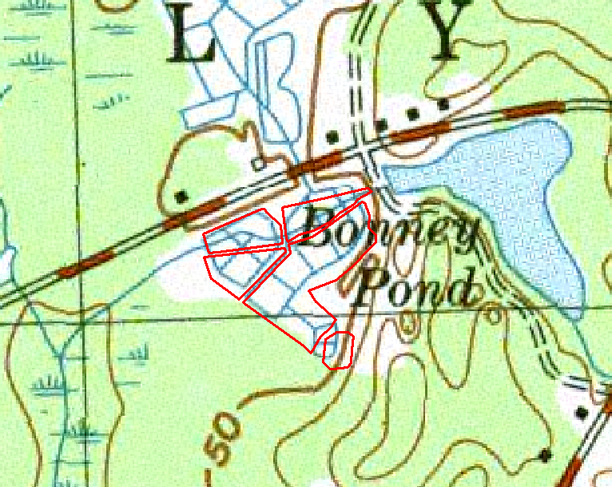
1:24k USGS topo quad
X
Notes:
Dike top elevation from the topo quad can be estimated to be somewhere between 40 and 50 feet.
Notice that our project area, the red polygons, has no contours through it. All we know is that we have 50 feet elevation in the broad area.

Slide 6
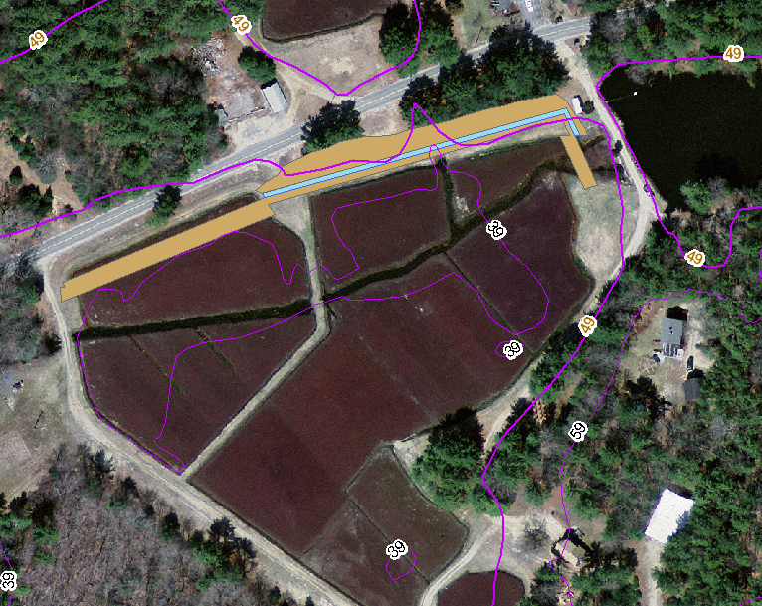
Contours from 1:5k DTM data points
49
X
39
Notes:
The state of MA provides an elevation points dataset and derived contours to the public.
This picture shows the only 2 contours that were available near the proposed work area. The contours are 39 and 49 feet. This is a huge difference of 10 feet. All we know at this point is that the dike will be between 39 and 49 feet. This is simply inadequate for designing the dike.
So, we can see from these 1:5,000 contours, we only know that the dike top (marked ‘X’) would have to be somewhere over 39 feet. Although this is very rough, it is better than many states ___ don’t even have this quality of topographic data.

Slide 7
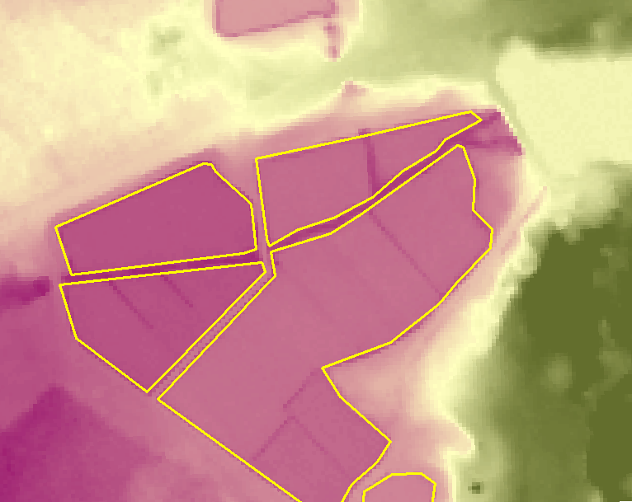
LiDAR DTM (2-meter post-spacing)
Notes:
This slide shows LiDAR elevation data. The green areas are higher than the white, and the white areas are higher than the purple. You can see how one might obtain contours from this type of data.
You can see the darker purple linear areas which are existing ditches conveying water from the pond through the two bogs on the right.
In technical terms, this slide shows a LiDAR-derived bare earth (BE), digital terrain model (DTM).

Slide 8
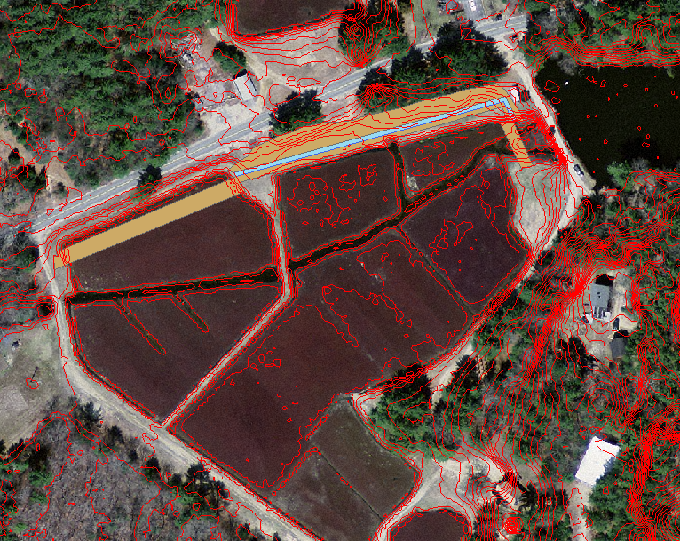
LiDAR-derived contours
Notes:
In contrast with the 10-foot contours, we see the red LiDAR-derived contours. There are many more contours here than we needed for the design. Thus, we chose only those contours which were near the proposed work areas.

Slide 9
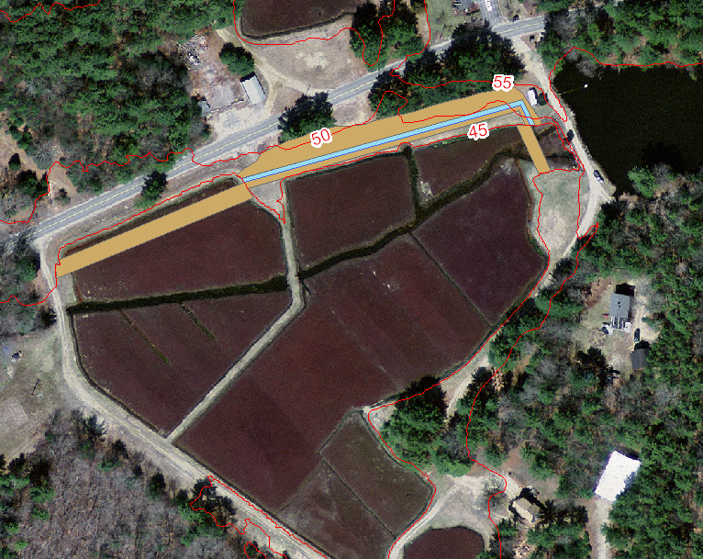
Extracted LiDAR Contours
DITCH
FILL
Notes:
The brown areas show the areas which need to be a certain elevation either by preserving the elevation or adding fill to attain the elevation. The digging and fill work required the cultural resource evaluation.
Three contours, 45 feet, 50, 55 feet, are LiDAR-derived and will be discussed.

Slide 10
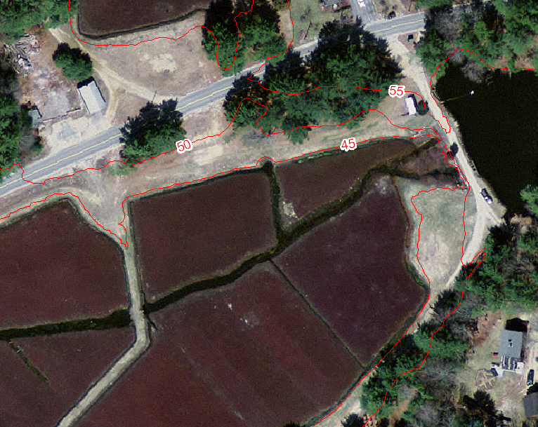
Extracted LiDAR contours, zoomed
X
Notes:
We can now see that the elevation of the ditch top is 45 feet.

Slide 11
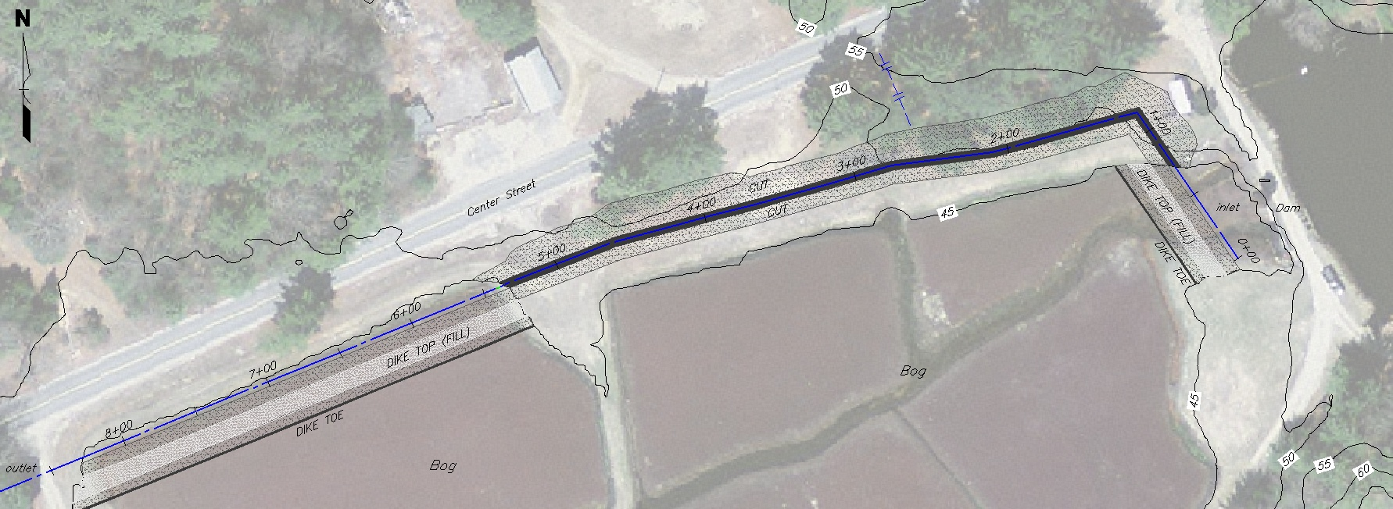
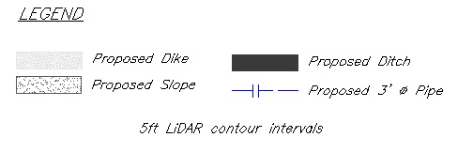
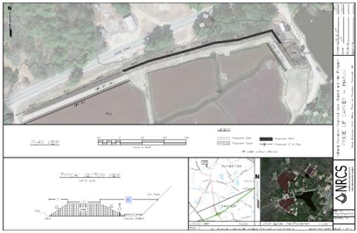
Extracted contours imported to Civil 3D
Notes:
The contour data are input to the Civil 3D software the design engineers use.
On the bottom you can see the official template they use and the green box shows a zoomed view of the project.

Slide 12
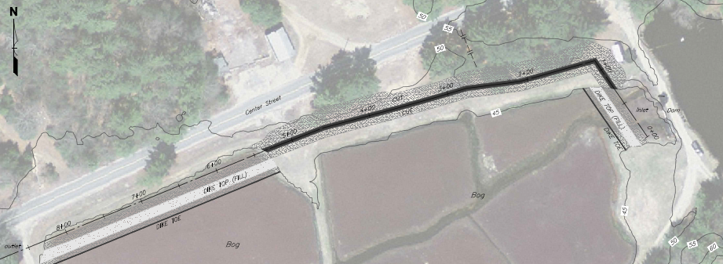
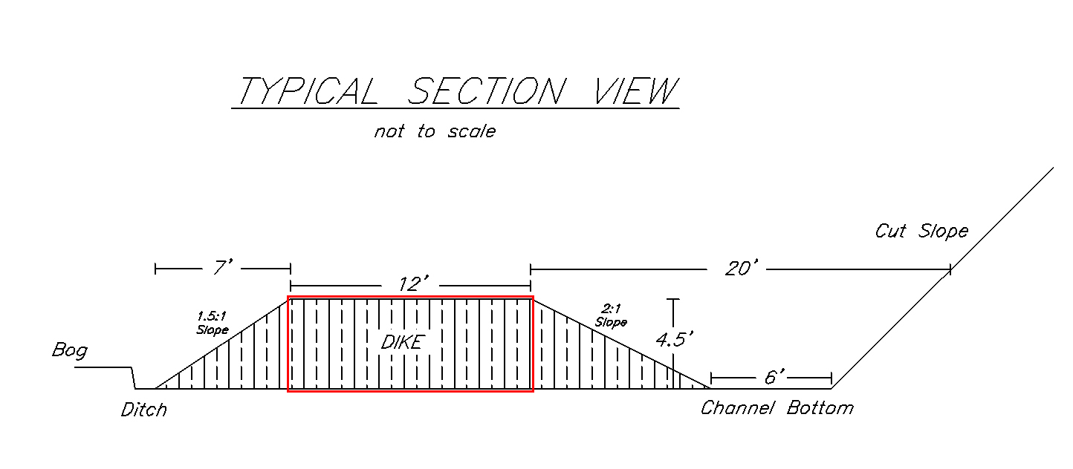
Designing the dikes
45
50
45
Notes:
The accurate contour elevations enable the design engineers to quickly obtain needed height elevations. The engineer can see s/he needs an elevation of 45 feet.

Slide 13
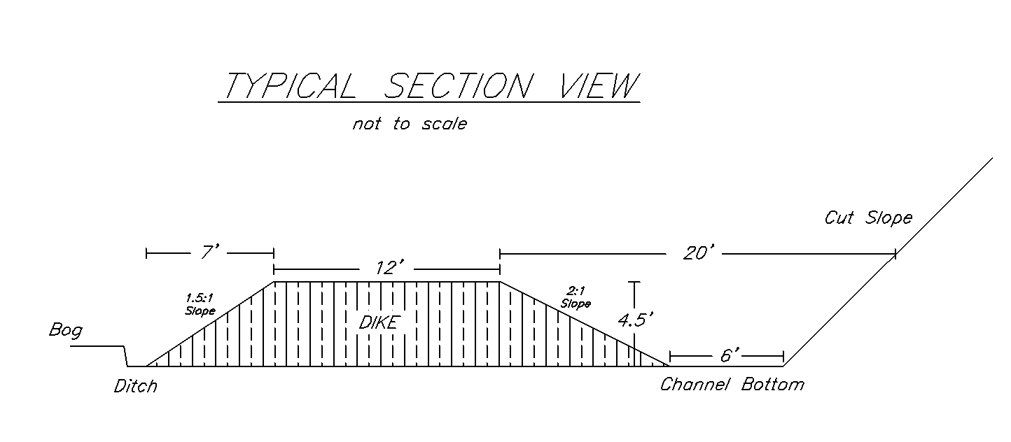
Designing the new ditch
50
45
45
Thanks to
Julie Tosten (Engineering Tech.)
Stephanie Wilsen (Cultural Res. Coordinator)
Len Reno (District Con.)
Notes:
This is the ditch part of the project.
You can see the cross-sectional view in the lower part of the slide.
No survey required to get this information.

Slide 14
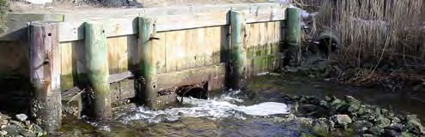
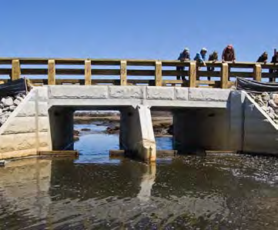
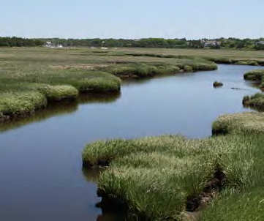
Wetland Restorations

Slide 15
Wetland Restorations
Notes:
In addition to engineering design, we have an old water management structure seen in the top picture. This needs to be redesigned in order to restore historical water/tidal flow for wildlife and vegetation. The flow is between a tidal river and a wetland.
The end product is seen in the last picture, a healthy wetland.

Slide 16
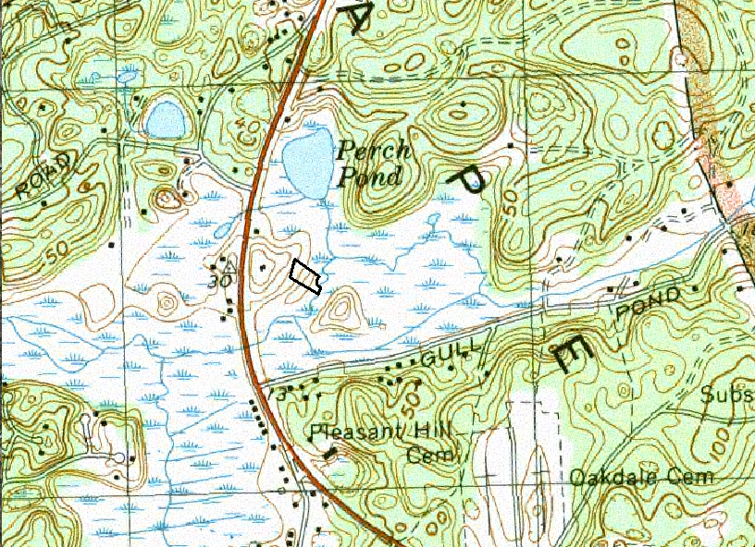
Evaluating wetland restoration impacts
USGS 1:24k topo map
Notes:
Once again, we see the type of information we previously had to use. This information can be very helpful for the broad picture.
At this scale, it’s helpful to see the landscape context of the site which is the small black polygon inside the red box.
We can see the road crossing, the brown curved line running north/south. The culvert under the road is limiting the amount of tide water that can flow back up into the marsh.
The road’s culvert has altered the ecosystem of the marsh.

Slide 17
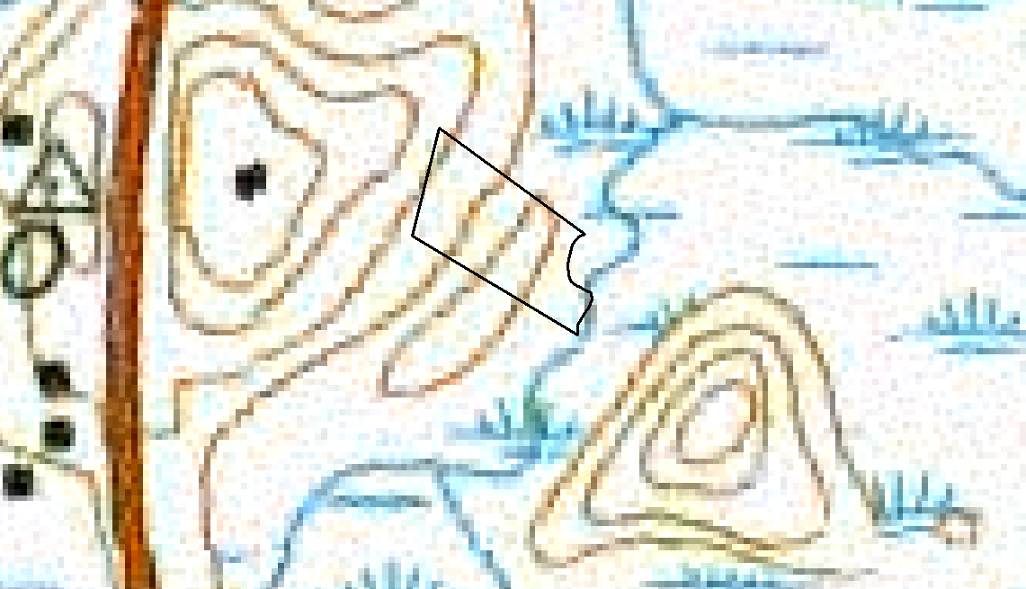
USGS 1:24k topo map
zoomed to inside the red box
Notes:
This is inside the red box.
The blue plant-like symbols show where the marsh land is. The brown polygons are the elevation contours. We can see part of the brown road on the left side.
Within the site, the black angular polygon, we have basically two elevation strata. This is not enough information for assessing the impacts of the restoration on the private properties such as houses. The old topo maps showed these properties as black squares.

Slide 18
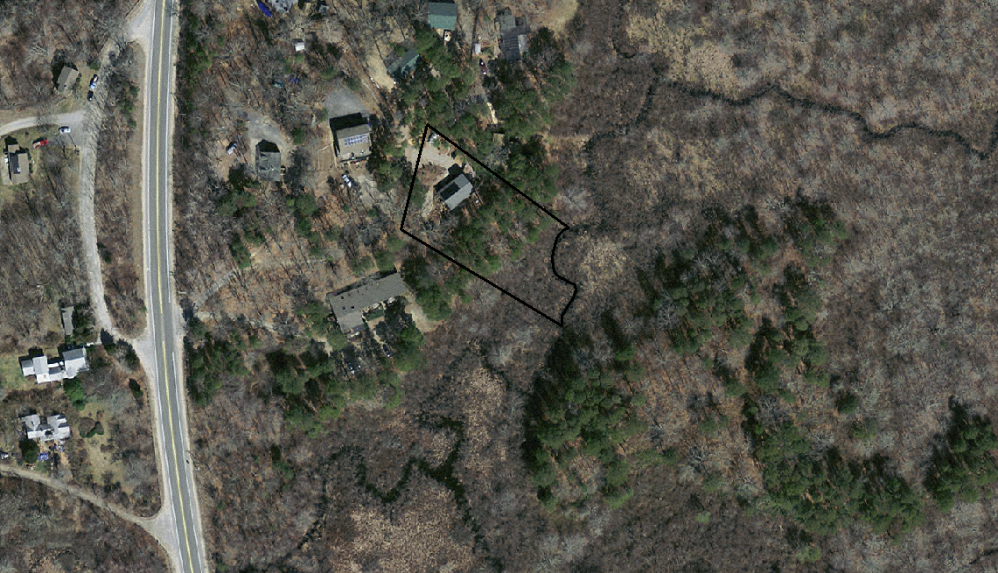
Aerial imagery
Notes:
This photo shows a house within the parcel boundary of interest. This was not seen on the old topo map.

Slide 19
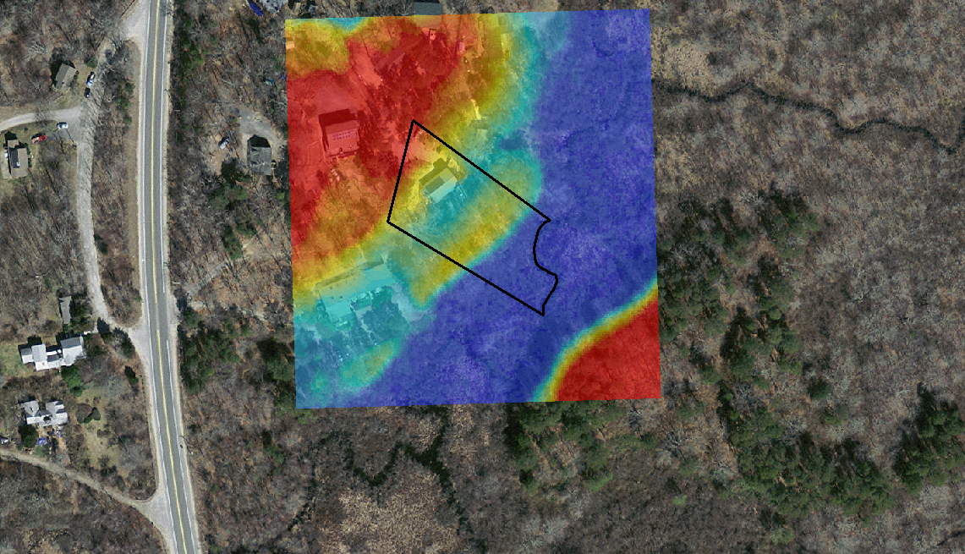
LiDAR-derived DEM (1-meter post-spacing)
Notes:
The colorful square shows many gradations of elevation. The red areas are higher than the yellow. The yellow are higher than the blue. (Hot = High, Cool = Low).

Slide 20
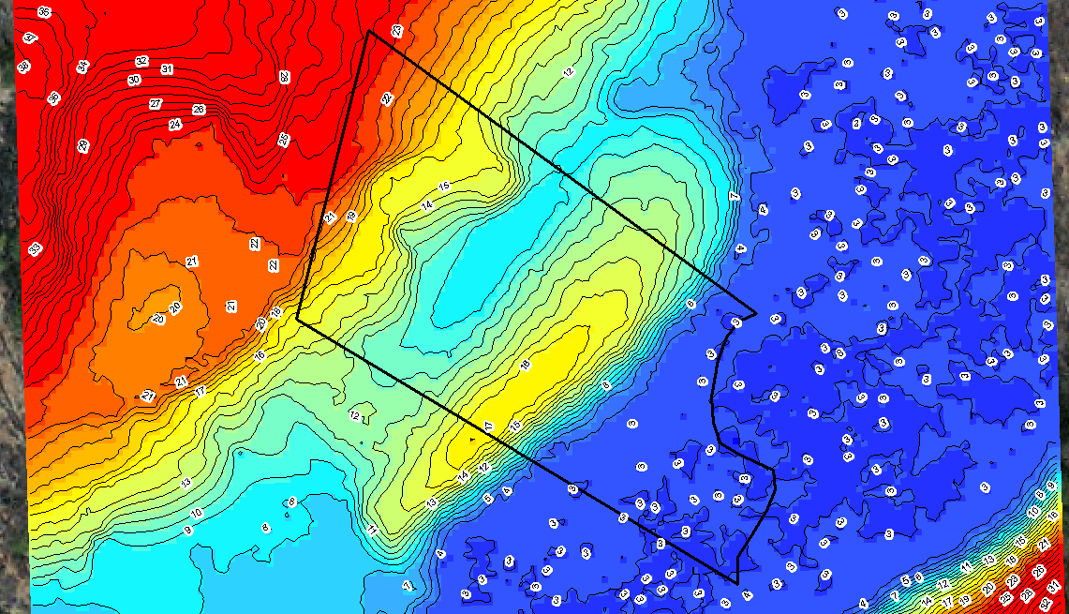
LiDAR-derived 1-foot contours
Notes:
Zoomed view of LiDAR-derived contours. Notice how many more there are!

Slide 21
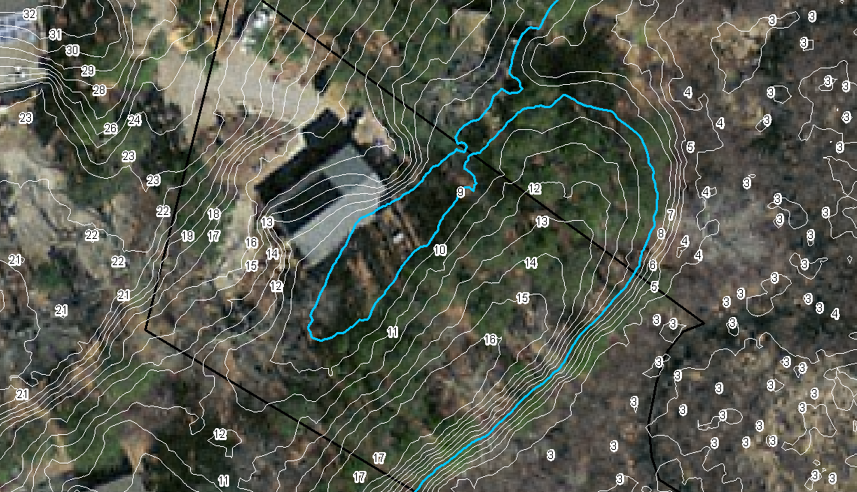
Water rise to 9-foot contour = trouble
Thanks to
Sharon Randall, Cape Cod Conservation District
No survey required to get this information.
Notes:
The restoration could increase the amount of water at certain times of the day.
The lowest point, 9 foot, which intersects with the private home is cyan-colored contour.
Thus, when designing this restoration, engineers are aware of a water elevation limit.

Slide 22
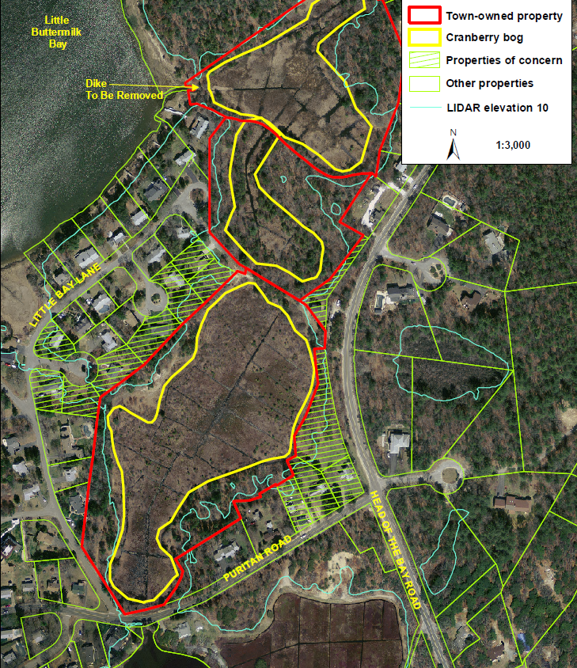
Impact assessment for WRP restoration projects
No survey required to get this information.
Thanks to
Bernie Taber, Soil Conservationist, West Wareham, MA
Notes:
This is the same type of use, however, we now see a community.
The yellow polygons are the cranberry bogs which are the planning sites for the wetlands restoration.
The red polygons are the WRP easement boundaries. When the project is complete, there will be unobstructed water flow between the three red polygons and the Little Buttermilk Bay.
The green-hatched areas are vulnerable properties that intersect 10-foot contours up to which water levels are estimated to rise.

Slide 23
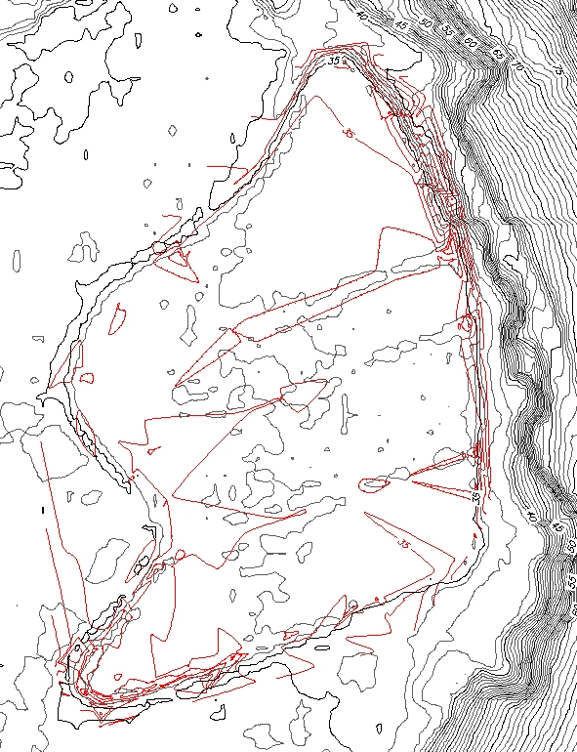
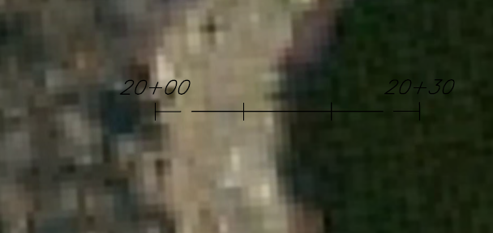
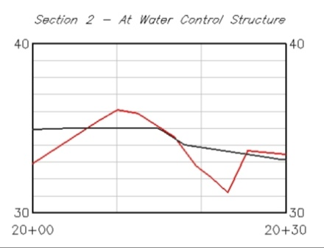
precision measurements Vs. General planning
Notes:
When are LiDAR-derived contours not useful?

Slide 24
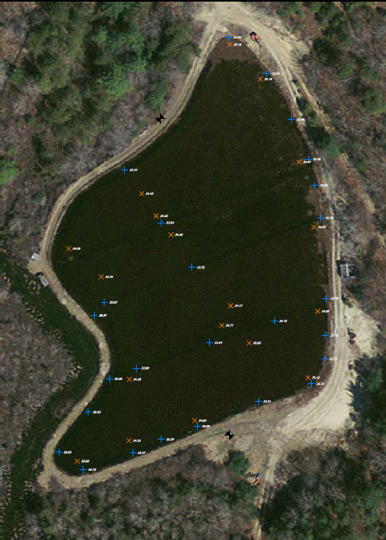
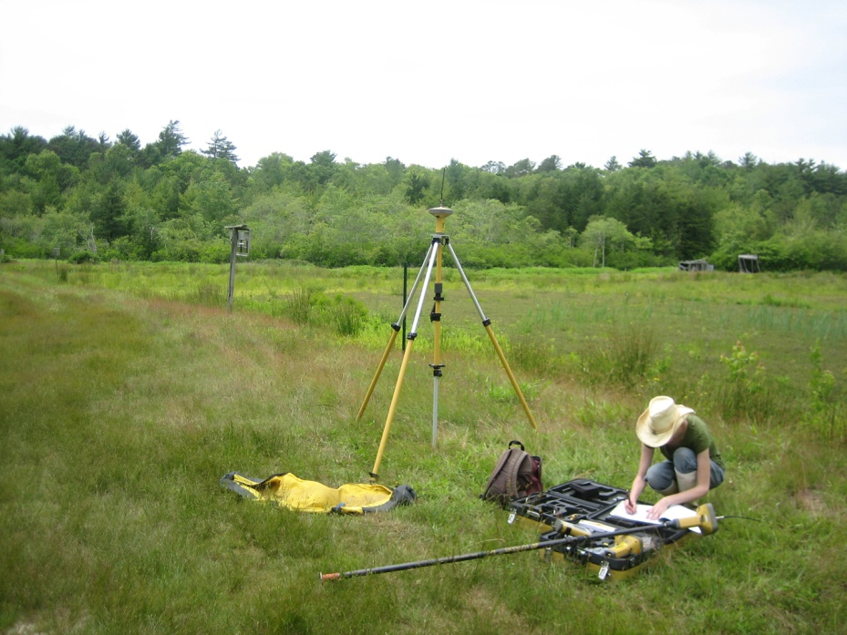
Survey points from a WRP cranberry bog
Thanks to
Julie Tosten (Engineering Tech.)
Notes:
Survey points are the blue crosses and red Xs. Each point gives an elevation.

Slide 25
Interpolated contours from survey (red) and
LiDAR (black)
Notes:
If we use the survey points to make (interpolate) contours, we’d get the red contours.
The red contours do not provide a complete picture of the whole site as do the LiDAR-derived contours.

Slide 26
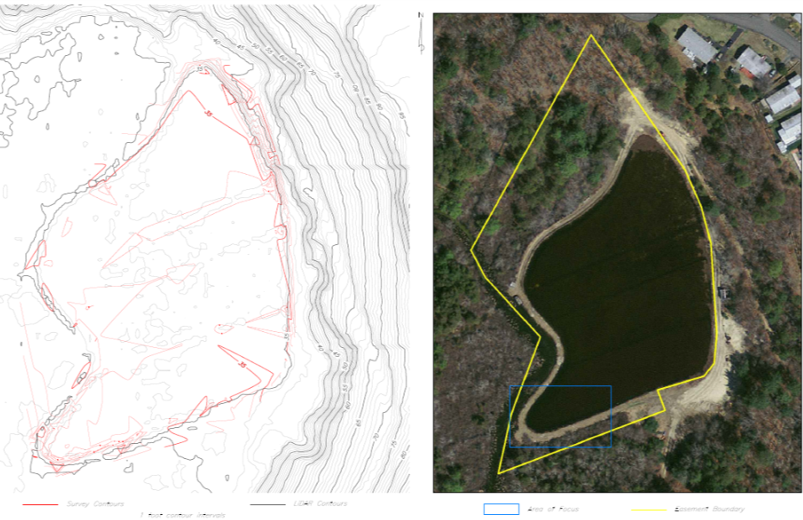
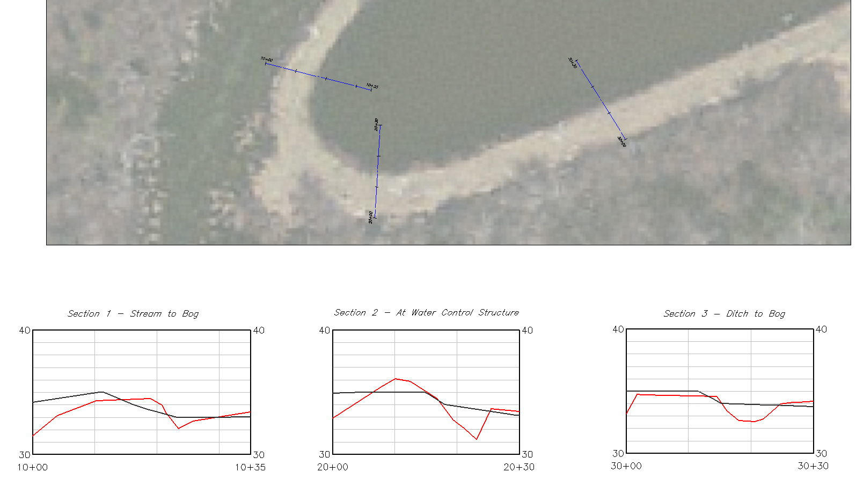
Precise observations
Survey (red) vs. LiDAR (black)
Notes:
However, the survey data at each location provide the accuracy we need to identify and evaluate the impacts of alternatives.
Lesson here is that where precise measurements are required, the survey equipment outperforms the LiDAR data.

Slide 27
Precise observations
Survey (red) vs. LiDAR (black)
1
3
2
1
2
3
Notes:
However, the survey data at each spot are represented by the
Lesson here is that where precise measurements are required, the survey equipment outperforms the LiDAR data.

Slide 28
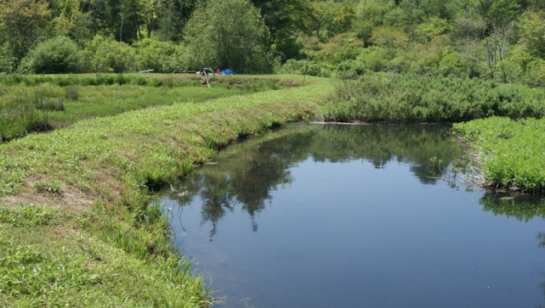
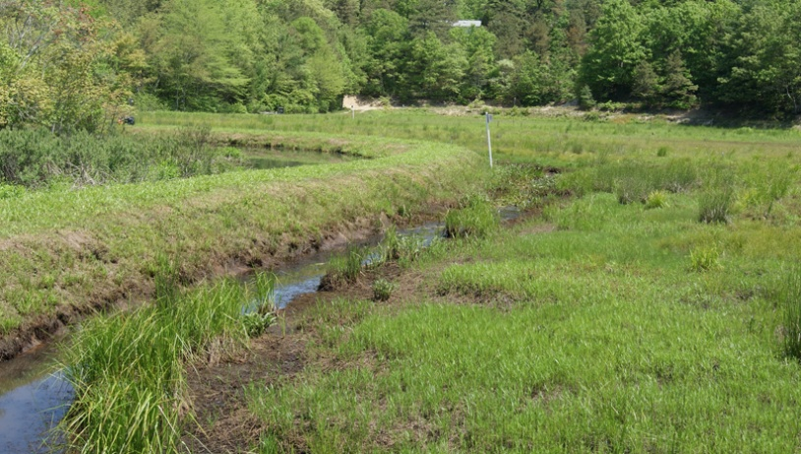
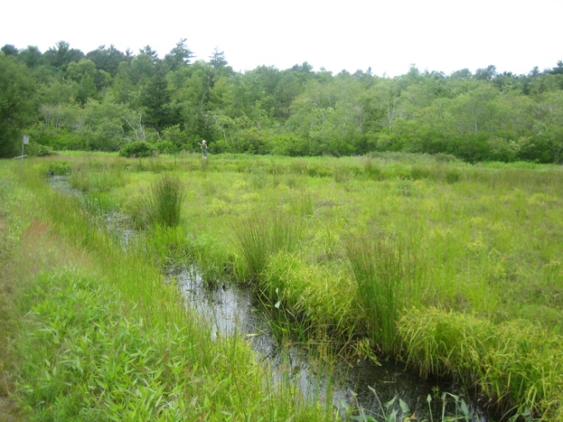
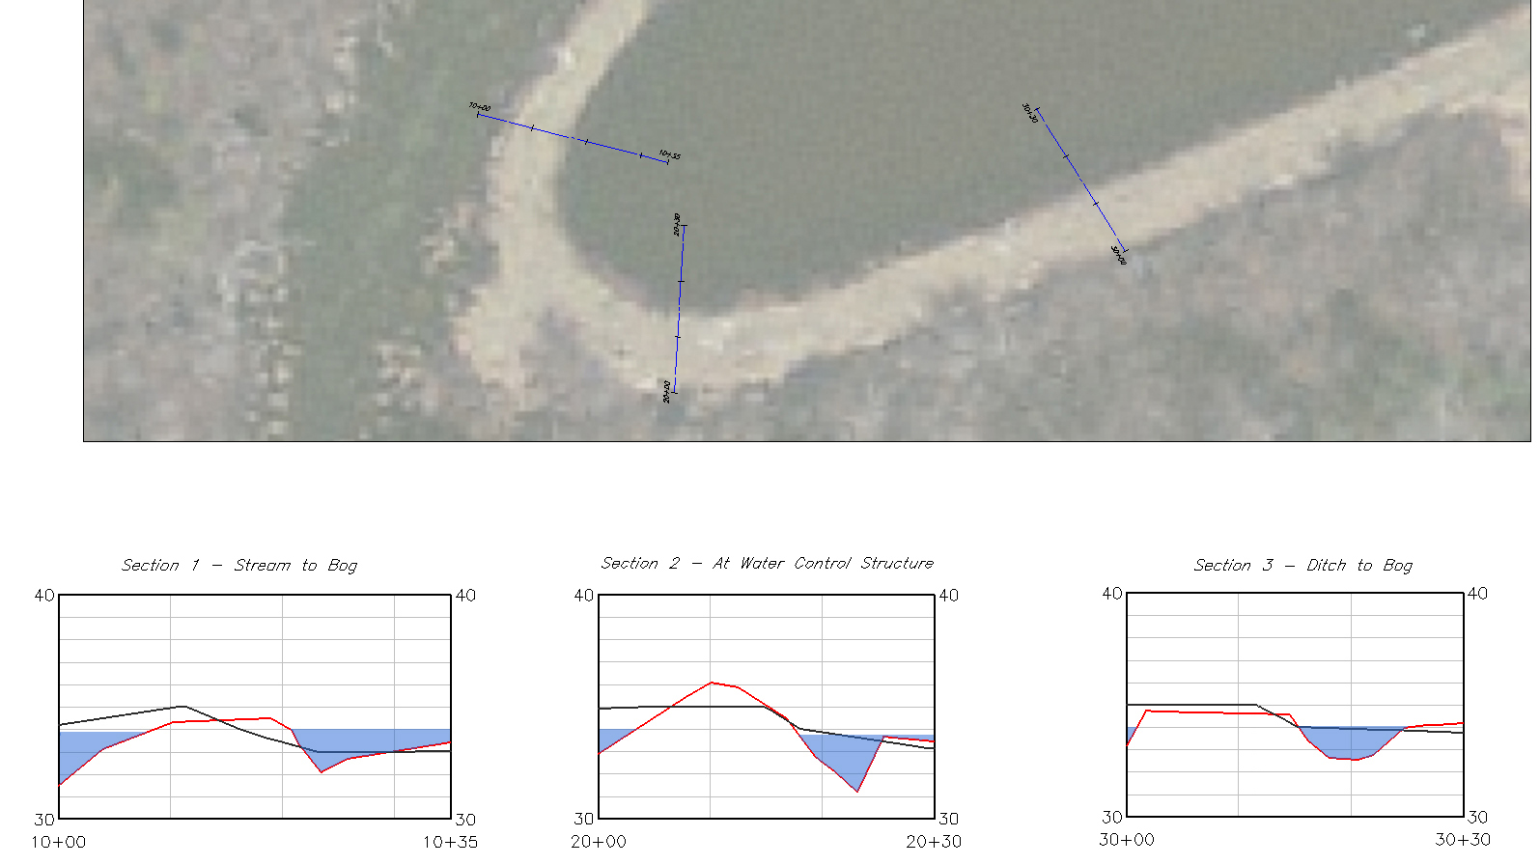
Notes:
The areas of disagreement are in the ditches or stream beds. You can see the water levels now. LiDAR signals have trouble passing through high vegetation and water so this may explain some of the errors of more than 1 ft. that we saw here.

Slide 29
Summary
LiDAR derived contours make sense:
When you need to more quickly provide accurate information (design engineers, archeologists)
When you want to help project planners identify potential impacts to or from a proposed project (higher water elevation due to wetland restoration)
When you want to identify optimal locations for the more accurate land survey data (where to do survey-grade cross-sections)

