Slide 1

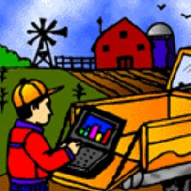
Natural Resources Conservation Service
“KY NRCS GIS Hydro Tools”
(Using LiDAR Derivatives)
Steve Crabtree
USDA NRCS
State GIS Coordinator
Lexington, KY
steve.crabtree@ky.usda.gov
859.224.7400
http://www.ky.nrcs.usda.gov
Notes:
QUESTIONS: Steve Crabtree, GIS Coordinator, USDA-NRCS, Lexington, KY. Office phone: 859.224.7400 e-mail: steve.crabtree@ky.usda.gov
Suppose we need to design a grassed waterway.
The most important piece of information is the “peak discharge”. Peak discharge is the predicted amount of water which is likely to be delivered to an area during a certain type of rain storm. The area of concern here is an area on the farm which has significant erosion.
The national practice standard defines a grassed waterway: “A shaped or graded channel that is established with suitable vegetation to carry surface water at a non-erosive velocity to a stable outlet”. See: http://www.nrcs.usda.gov/Internet/FSE_DOCUMENTS/nrcs143_026051.pdf.
There are 3 national purposes: (1) convey runoff from terraces, diversions, or other water concentrations without causing erosion or flooding, (2) reduce gully erosion, (3) protect/improve water quality.

Slide 2
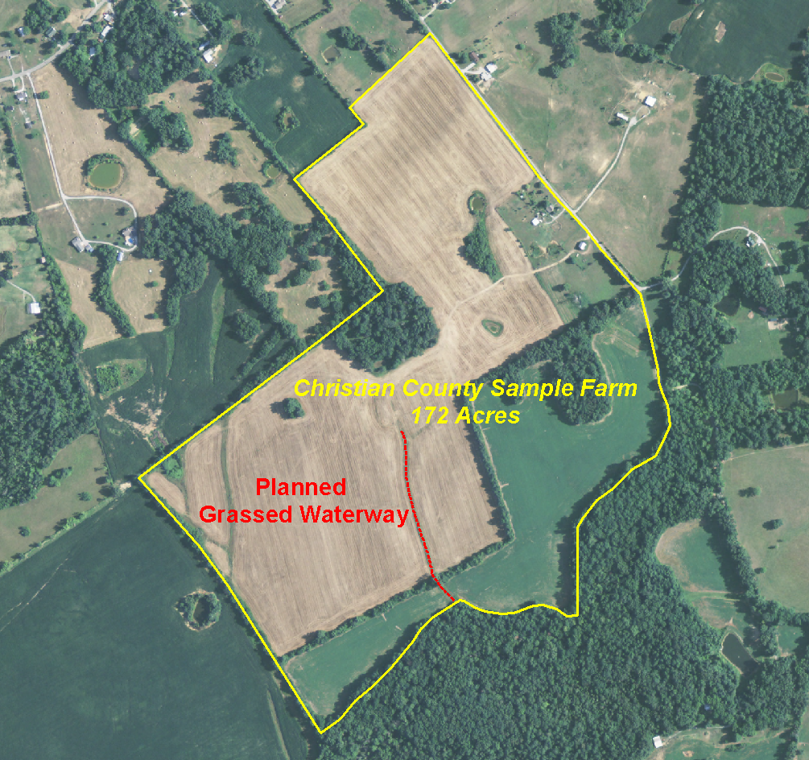
Grassed Waterway Design:
Estimating Peak Discharge
How we do it without LiDAR
1 – Determine watershed boundary.
2 – Determine watershed slope.
3 – Determine watershed flow length.
4 - Estimate watershed curve number.
Notes:
Demo Example: Making Practical use of LiDAR at the NRCS Field Office - Grassed Waterway Design
The question is: How much water are we dealing with? Without LiDAR, answering that question required the following 4 steps, which had to be performed MANUALLY.
1 – Determine watershed boundary: Work with a quad map to find watershed boundary. Find the map, trace the boundary which is relevant to this farm. That is, what is the area most likely to contribute water to this part of the farm, the eroded area, the area for the planned grassed waterway.
2 – Determine watershed average slope: Use other maps, perhaps a USGS quad map of the area or an NRCS soils map, to estimate the average slope in percent for the area within the watershed boundary. The slope is an important factor for predicting the overall peak discharge.
3 – Determine the watershed flow length: This is the distance a rain drop must travel from the top of the watershed to the outlet of the planned grassed waterway.
4 – Determine watershed curve number: This value helps us estimate peak discharge. It represents the rate of expected runoff flow based on soil hydrologic group (A, B, C, D) and land cover condition (good, fair, or poor vegetative condition or management condition). For more information about curve numbers see Part 630 Hydrology National Engineering Handbook, Chapter 10, Estimation of Direct Runoff from Storm Rainfall at ftp://ftp.wcc.nrcs.usda.gov/wntsc/H&H/NEHhydrology/ch10.pdf.

Slide 3
Grassed Waterway Design:
Estimating Peak Discharge
How we can improve it with LiDAR ?
1 - GIS Specialist sets up a GIS Model
using LiDAR derivatives
2 – Field Staff runs the Model
3 – Model provides ACCURATE Information for Estimated Peak Discharge
4 – Big time-saver
Notes:
Demo Example: Making Practical use of LiDAR at the NRCS Field Office - Grassed Waterway Design
1 - GIS Specialist gathers the digital data. There are several prerequisite data layers. The Kentucky Hydro Tools data layers are given later in the presentation.
2 - Run the Hydro Tool. In Kentucky we have used this tool for 2 years. It has been successfully used in a few other states (NJ is a recent adopter).
3 - Design the waterway. Model results provide better design information for the overall design of the waterway (drainage area, average slope, average curve number, and overall flow length).
4 – Big time-saver: This model usually takes 3 – 8 minutes, depending on the overall size of the watershed area. Manual methods can typically take 2 – 4 hours to do the same process.

Slide 4
Grassed Waterway Design:
Estimating Peak Discharge
Why does LiDAR make sense ?
1 – Accurately calculates estimated peak discharge.
2 – Provides for a BETTER design
Notes:
Demo Example: Making Practical use of LiDAR at the NRCS Field Office - Grassed Waterway Design
For LiDAR to make sense in the field for non-GIS experts, it must be provided in an easy-to-use form. The Hydro Tool for calculating peak discharge is an example.
1 - Increased accuracy: Because of LiDAR’s coverage and elevation accuracy, we have more information about the land surrounding this farm. We do not have to survey all of the surrounding land in order to have accuracy which is greater than the quad maps. Thus, we can make more accurate peak discharge calculations. Peak discharge is the maximum likely water that will come to this area of this farm.
2 - Because we have more detailed information (all those LiDAR points) about the general site for the waterway, we can more accurately estimate peak discharge (accurate LiDAR elevation, flow accumulation, and slope).

Slide 5
The Hydro Tool
Notes:
Demo Example: Making Practical use of LiDAR at the NRCS Field Office - Grassed Waterway Design
This is an aerial photo of the example farm. The yellow boundary is the farm boundary. The red line is the area requiring conservation treatment with a grassed waterway.

Slide 6
‘LiDAR’
Starting from ‘raw point data’ ….
Very ACCURATE Surface Elevation Derivative Products for Analysis:
1-meter Digital Elevation Model (DEM)
Flow Direction
Flow Accumulation
Watershed Delineation
Land Slope
Contours You saw this in Aaron’s presentation
Aspect
Hillshade You saw this in Reed’s presentation
Notes:
From KY NRCS perspective… when we refer to the term ‘LiDAR’ ---- we really mean “High-resolution Elevation Derivative products”. The products from LiDAR-collected data that we will be discussing include those listed in the slide.

Slide 7
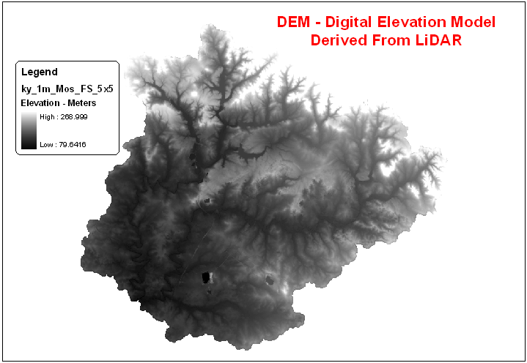
LiDAR-derived Products:
1-meter resolution DEM
Notes:
The basis of our elevation data products is the DEM derived from the detailed, complex set of LiDAR bare-earth elevation points collected. This is a 1-meter resolution raster dataset depicting ground surface elevation.
An elevation value is assigned to each 1 meter square on the ground, approximately 3 feet square.
The light colored areas are higher in elevation than the dark areas.

Slide 8
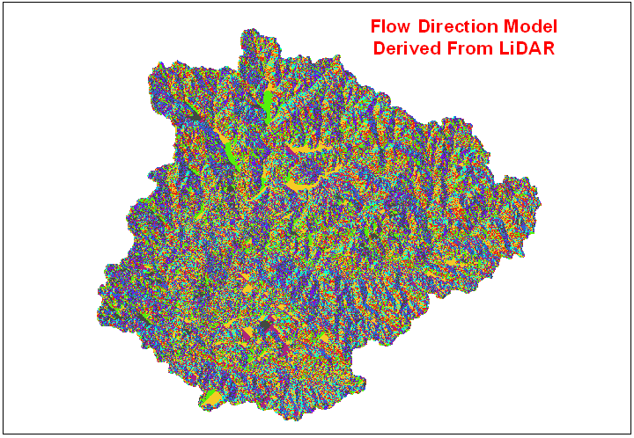
LiDAR-derived Products:
Notes:
For hydrologic modeling - From the base DEM – we must create a Flow Direction dataset (also a raster, 1-meter resolution)
Flow direction allows us to more accurately predict water flow through computer analysis. The colors represent differences in flow direction.

Slide 9
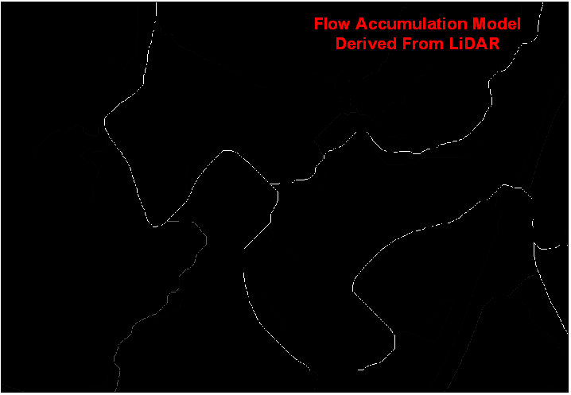
LiDAR-derived Products:
Notes:
For hydrologic modeling - From the base DEM – we must create a Flow Accumulation dataset (also a raster, 1-meter resolution). Here – we have ‘zoomed in’ to more easily visualize the areas of flow accumulation.
The light areas are computer depictions of virtual streams, areas of concentrated flow.

Slide 10
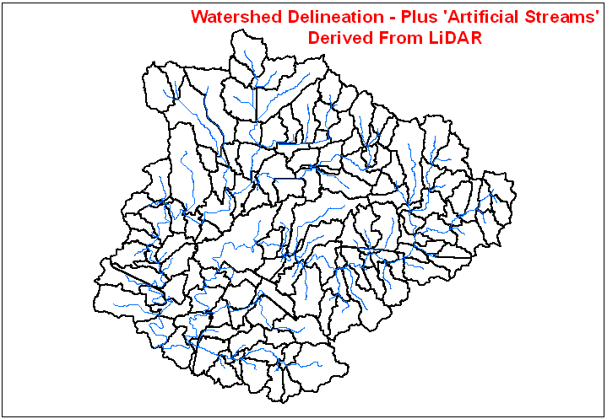
LiDAR-derived Products:
Notes:
For hydrologic modeling - From the base DEM – we also create a ‘Watersheds from LiDAR’ polygon feature dataset. For our Hydro model, these watersheds have optimum maximum size of 2,000 acres (generally 50-1,000 acre in size). The smaller watershed size allows for much faster geoprocessing of these very large GIS datafiles by limiting the ‘Analysis Extent’ to the applicable ‘sub-watershed’ area.
This is the area which contains a smaller, contributing area flowing to the planned grassed waterway.

Slide 11
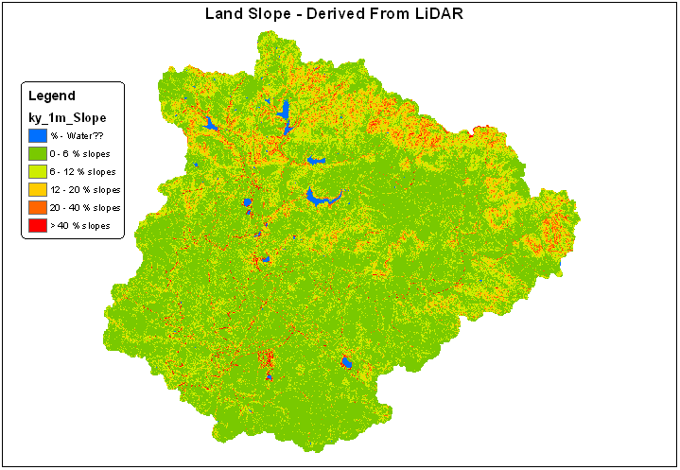
LiDAR-derived Products:
Notes:
For hydrologic modeling - From the base DEM – we must create a Slope dataset (also a raster, 1-meter resolution). Slope is expressed in percent. The ‘slope breaks’ shown in the slide are for display purposes only.
The steep slopes are displayed in red. Most of this area is rather flat with steep sections along the northern boundary.

Slide 12
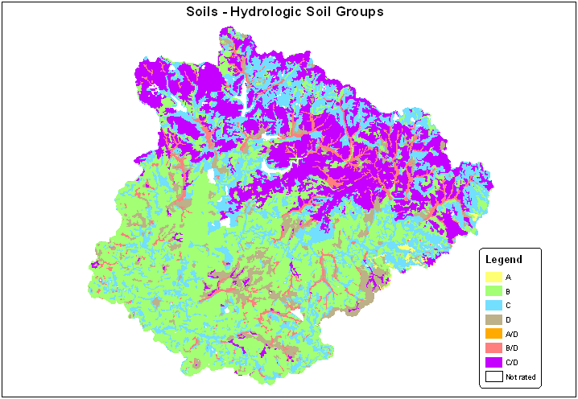
Design of NRCS Conservation Practices
LiDAR products plus: SOILS
Notes:
NRCS SSURGO (digital soils data) is another required Input dataset for hydrologic modeling.
Detail: The Soil ‘Hydrologic Soil Group’ attribute is used in the analysis process (for computation of ‘Runoff Curve Number’). The KY Tools ‘look’ for an attribute column in the Soils dataset named “HYDGRPDCD” (Hydrologic group, dominant condition).
This map shows the northern (upper) part of the watershed is dominated by Hydrologic Soil Groups C/D and C which have moderately high to high runoff potential when moderately wet. The southern part is dominated by Group B which has moderately low runoff potential when thoroughly wet. See Part 630 Hydrology National Engineering Handbook, Chapter 7, Hydrologic Soil Groups at ftp://ftp.wcc.nrcs.usda.gov/wntsc/H&H/NEHhydrology/ch7.pdf.

Slide 13
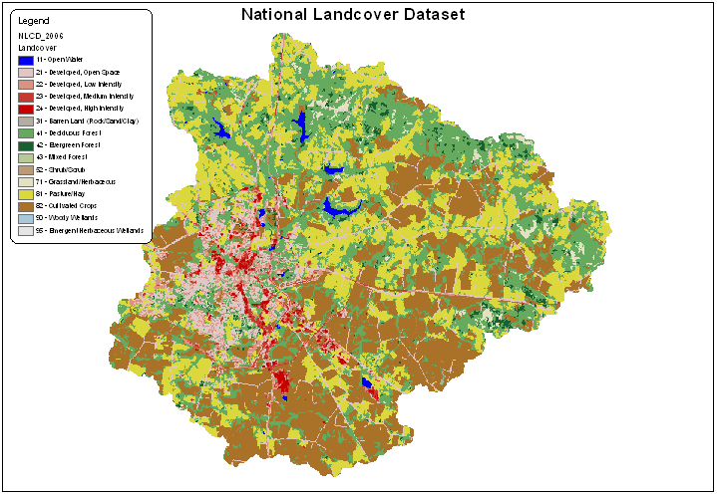
Design of NRCS Conservation Practices
LiDAR products plus: LANDCOVER
Notes:
Landcover is another required Input dataset for hydrologic modeling.
Detail: The NASS ‘Cropland Data layer’ is used as the Landcover Input for the KY hydro tools – the landuse values are ‘reclassed’ to match the values in the National Landcover Dataset – NLCD. This is used in the analysis process (for computation of ‘Runoff Curve Number’). The KY Tools ‘look’ for an attribute column in the raster landcover dataset named “VALUE” (the standard NLCD landcover type).
This type of data identify cultivated crops, pasture, hay, crop, forest, developed areas and other landcovers.
This map shows significant areas of cultivated crops (brown-ish) in the south, deciduous forest (green) in the north, developed areas along the western edge (pinks, reds), and pasture/hay (yellow) throughout.

Slide 14
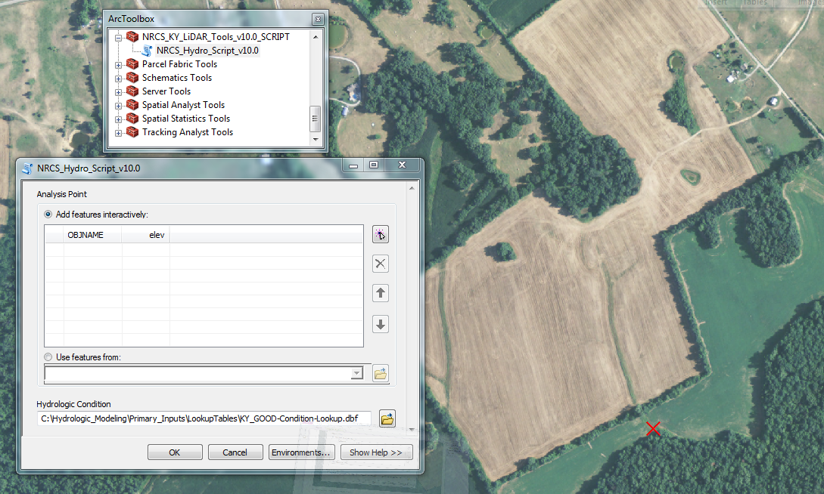
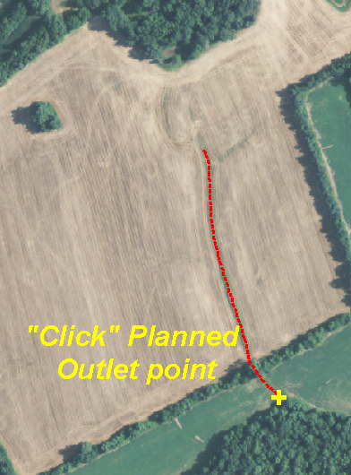
KY NRCS GIS Hydro Model
The Training slide:
‘Click & Run Model’
“Click”
Planned Outlet Point
Notes:
Training Slide : INSTRUCTIONS: 1. Mouse-click the Analysis Point (in this case, the location of the planned Grassed Waterway Outlet)
2. Accept the default for ‘Good Hydrologic Condition’ (or instead select either ‘Fair’ or ‘Poor’ for the overall condition of the upstream contributing watershed area)
3. ‘OK’
E A S Y As 1 – 2 – 3 !!!

Slide 15
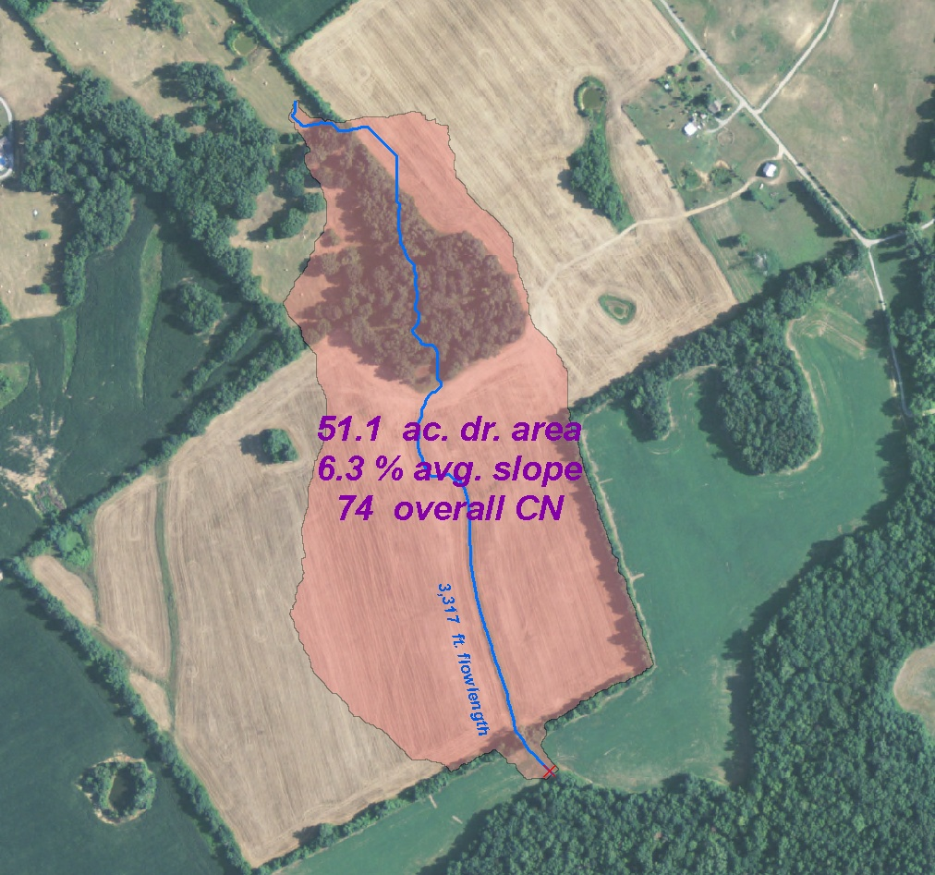
KY NRCS GIS Hydro Model
Model runs in 3-5 minutes, depending on size of ‘extent’ sub-watershed
Model OUTPUTS: delivered to ArcMap screen (labels, etc):
On-screen
Results:
drainage area
watershed slope
curve number
watershed length
Notes:
‘The Wow Factor Slide’ (Self-explanatory)
This shows the ease of results: The field staff did not have to draw anything or label the map. They get the answer they need directly on-screen.

Slide 16
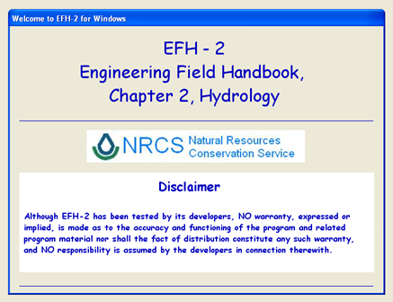
KY!! Conservation Practice – Engineering Design
Notes:
KY NRCS Field Offices utilize this standard EFH-2 software tool for assistance in Computing Peak Discharge (water runoff). Obviously, this is a critical component of the Conservation Practice Engineering Design.

Slide 17
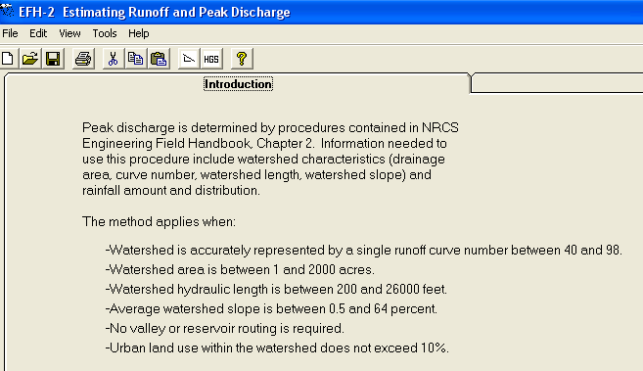
KY!! Conservation Practice – Engineering Design
LiDAR: Accurate design information
Notes:
The Field Office User now has the ACCURATE information needed by the EFH-2 software tool for assistance in Computing Peak Discharge (water runoff).

Slide 18
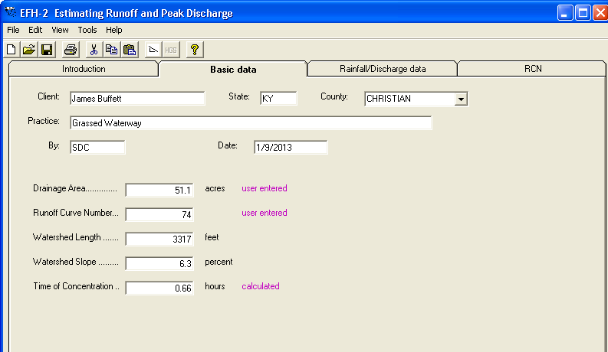
Engineering Design –
simply enter the calcs from the Model:
*
*
*
*
* (user entered – the 4 values
* from ArcMap screen!)
*
*
Notes:
The EFH-2 software tool requires the 4 values just delivered to the ArcMap screen after running the KY NRCS GIS Hydro Model!

Slide 19
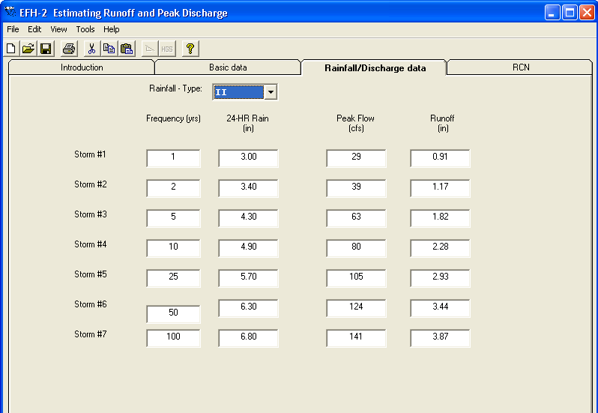
Engineering Design – Final Results:
Peak flow: 80 cfs
Complex GIS Analysis: Easy – Accurate – Practical
Notes:
After entering the Basic data – the next screen provides the final Peak Flow (for the Engineering design). A Complex task – done within GIS – Easy/Accurate/Practical!!

Slide 20
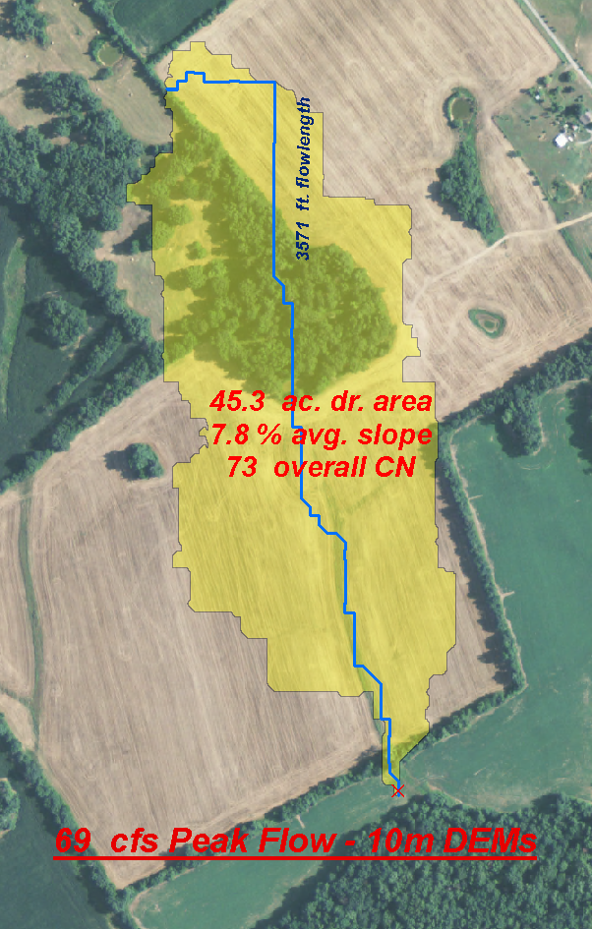
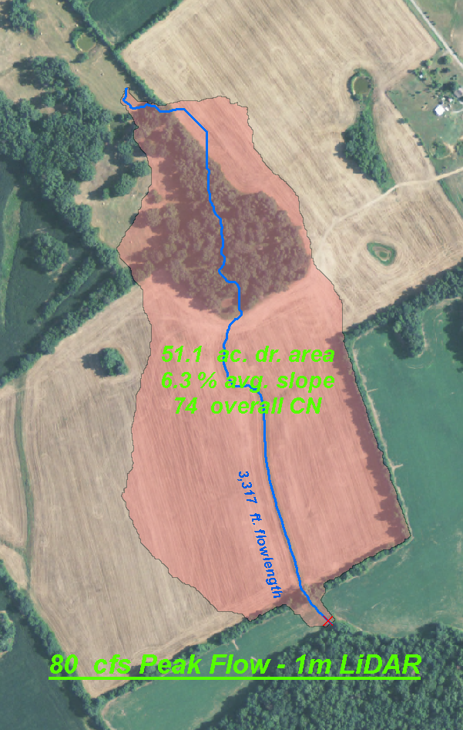
Older DEMs vs. LiDAR DEMs
Comparison
With 10-m Standard DEM
With 1-m LiDAR DEM
Notes:
Extensive testing of the Model: We ran the same Model using elevation derivatives from standard 10-meter USGS DEMs.
See the differences? The 10-m resulted in 69 cfs (cubic feet per second) peak flow. The 1-m LiDAR resulted in a higher 80 cfs peak flow.

Slide 21
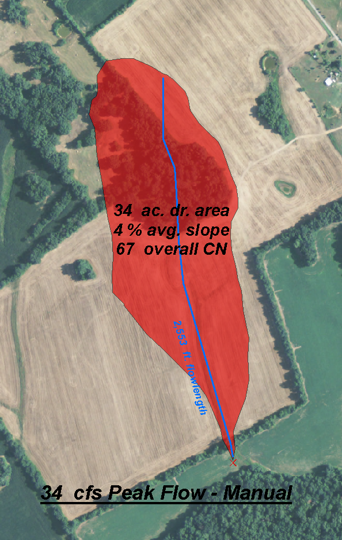
Manual method vs. LiDAR DEMs
Comparison
Manual Method
With 1-m LiDAR DEM
Results using LiDAR derivatives vastly different from ‘Manual’ methods!
Notes:
See the differences? The manual method resulted in 34 cfs (cubic feet per second) peak flow. The 1-m LiDAR resulted in a higher 80 cfs peak flow.
This is an actual NRCS-assisted grassed waterway. It was designed to carry 34 cfs using manual methods. But with LiDAR analysis – we would now design the grassed waterway to carry 80 cfs. Quite a difference!
We manually designed a waterway which needs to actually carry approximately 3-times the amount of water. The manually designed and built waterway may fail? The erosion problem may not be solved long term.
Obviously a design based on LiDAR GIS analysis is BETTER! For the investment, the LiDAR-designed practice will last longer than the manually-designed grassed waterway.

Slide 22
Conservation Practice : Engineering Design
Easy – Accurate – Practical
FUTURE??? Web Server-based mapping applications/analysis
Notes:
We believe that a design based on LiDAR GIS analysis is BETTER! House these LARGE datasets in the cloud – run the geoprocesing tools Remotely from with the Field Office Desktop!!

Slide 23
The taxpayer is getting
more performance
for the conservation dollar.

Slide 24
The End
Steve.Crabtree@ky.usda.gov
State GIS Coordinator

