Slide 1
NC Foresters for Healthy Waters Part 7 A & B
Jonathan Murray, NCRF # 1739
North Carolina Forest Service
Forest Stewardship and Forest Legacy Coordinator

Slide 2
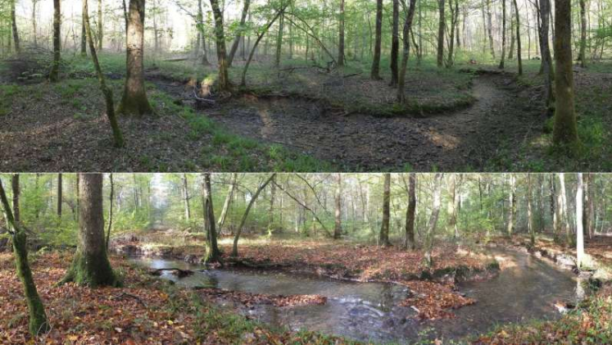
Part 7A: Basic Plan Elements
Landowner name(s) and contact information.
Plan writer’s name(s) and contact information, including any professional certifications.
Landowner’s objectives for the harvest.
Describe the current condition of the harvest area.
Desired outcome for the harvest area.
Pre-Harvest
Post Harvest
Photo by: Pensoft Publishers

Slide 3
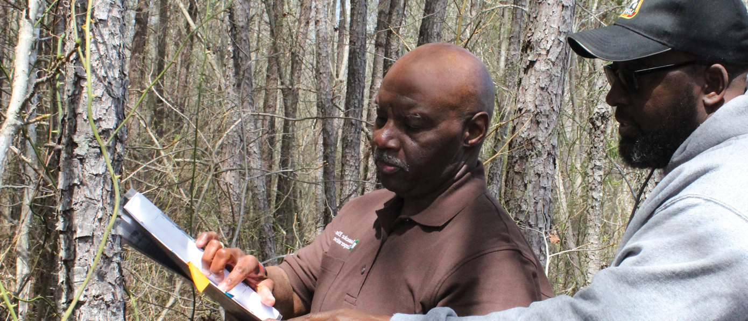
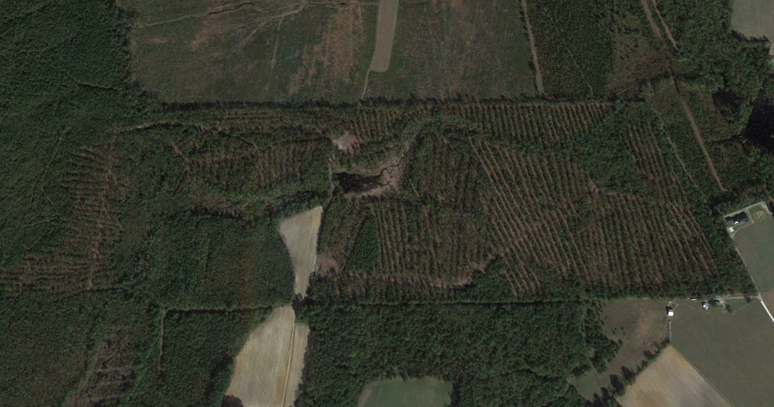
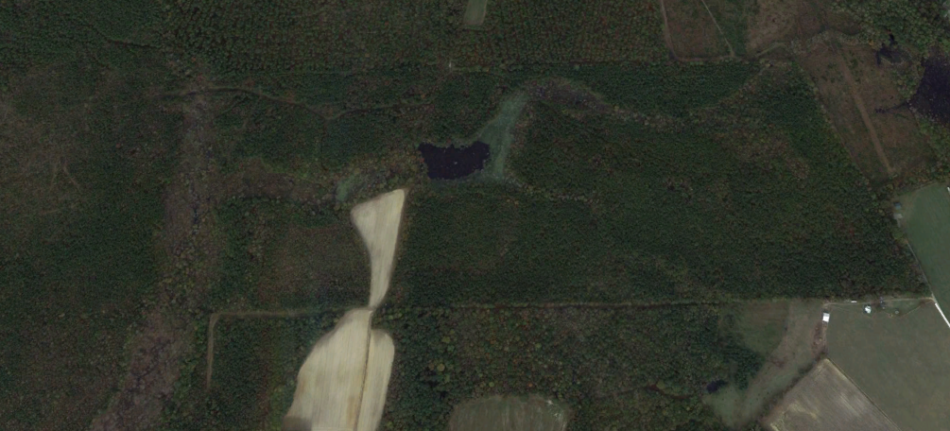
Strategic Planning and Execution
Photo By: NCFS
Google Earth Pro Image
Google Earth Pro Image

Slide 4
Part 7B: Required Map Features
The harvest boundary must be digitized over an aerial photo.
  NOTE: Acres within the harvest area must be on the map.
Harvest boundary outlined with all intermittent and perennial streams.
  NOTE: This will likely require a site visit.
Soils mapped within the harvest boundary.
  Any soil mapping reference source is acceptable. (NOTE: For the Riparian Buffer Rule, you must reference the most-recently published/printed soil survey manuscript book.)
Topography (contour lines)
  Any contour line source is acceptable. (NOTE: For the Riparian Buffer Rule, you must reference the most-recently published USGS 7.5-Minute topo quad.)

Slide 5
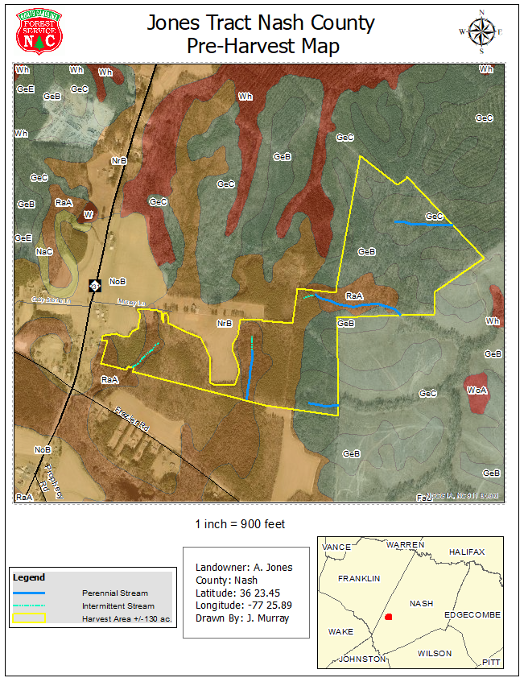

Slide 6
Questions?
Learn more at www.ncforestservice.gov
Jonathan Murray
919-857-4833 jonathan.murray@ncagr.gov

