Slide 1
Part 3
Bald and Golden Eagle Protection Act
Notes:
The bald eagle will continue to be protected by the Bald and Golden Eagle Protection Act even though it has been delisted under the Endangered Species Act.

Slide 2
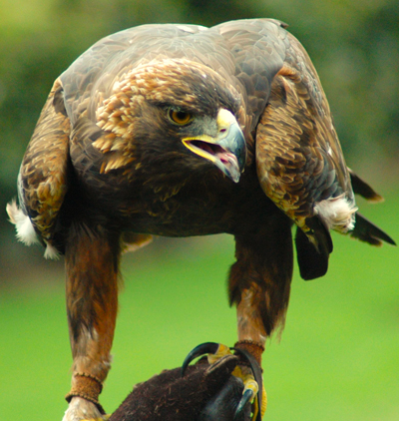
Prohibits TAKE
Any eagle, alive or dead, or any part, nest, or egg thereof
Notes:
The Bald and Golden Eagle Protection Act (16 U.S.C. 668-668c), enacted in 1940, and amended several times since then, prohibits anyone, without a permit issued by the Secretary of the Interior, from "taking" bald eagles, including their parts, nests, or eggs. The Act provides criminal penalties for persons who "take, possess, sell, purchase, barter, offer to sell, purchase or barter, transport, export or import, at any time or any manner, any bald eagle ... [or any golden eagle], alive or dead, or any part, nest, or egg thereof.“
A violation of the Act can result in a fine of $100,000 ($200,000 for organizations), imprisonment for one year, or both, for a first offense. Penalties increase substantially for additional offenses, and a second violation of this Act is a felony.

Slide 3
BGEPA Definition of “Take”
Includes: pursue, shoot, shoot at, poison, wound, kill, capture, trap, collect, molest, or disturb”
Disturb – to agitate or bother to a degree that causes injury, decrease in productivity, or nest abandonment
Notes:
Note that this definition includes “Disturb” which is not found in the ESA or MBTA
"Disturb" means: “to agitate or bother a bald or golden eagle to a degree that causes, or is likely to cause, based on the best scientific information available, 1) injury to an eagle, 2) a decrease in its productivity, by substantially interfering with normal breeding, feeding, or sheltering behavior, or 3) nest abandonment, by substantially interfering with normal breeding, feeding, or sheltering behavior."

Slide 4
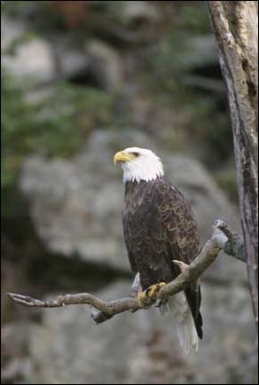
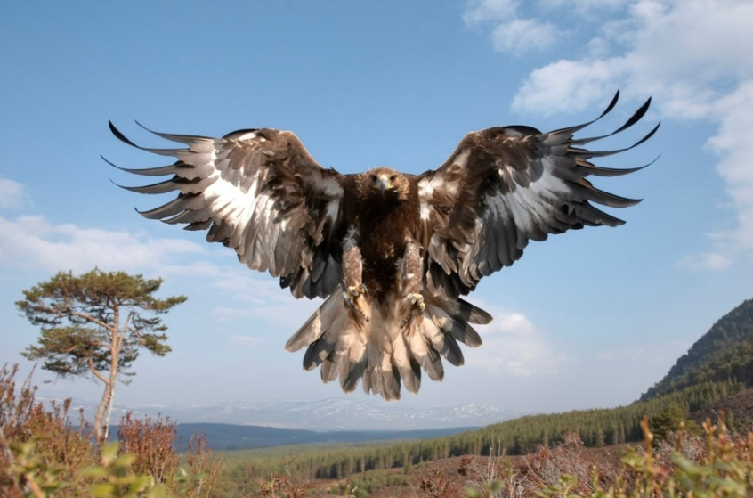
BGEPA & Habitat
  Habitat impacts that
  result in disturbance
  are unlawful
Notes:
In addition to immediate impacts, disturb also covers impacts that result from human-induced alterations initiated around a previously used nest site during a time when eagles are not present, if, upon the eagle's return, such alterations agitate or bother an eagle to a degree that interferes with or interrupts normal breeding, feeding, or sheltering habits, and causes injury, death or nest abandonment.

Slide 5
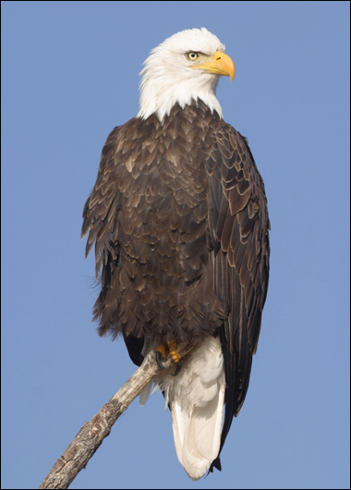
Eagle Take Permits
50 CFR 22.26 –
Take associated with, but not the purpose of, an otherwise lawful activity (i.e., Incidental Take)
Notes:
The main eagle take permits that would interest NRCS is 22.26
Many other permits – scientific collection, Depredation, Falconry, Native American use, etc

Slide 6
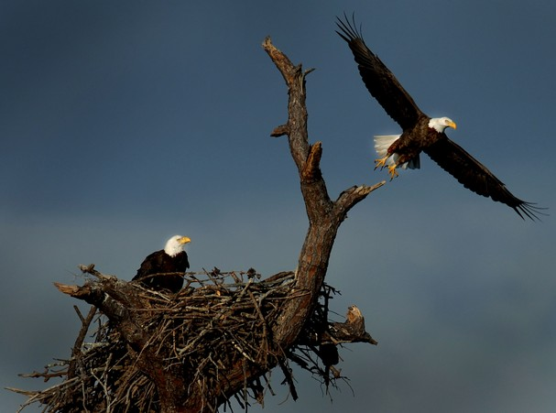
Non-purposeful Take Permit (22.26)
Only for take that cannot practicably be avoided
Permittees must avoid and minimize to the maximum degree practicable
Covers disturbance and incidental lethal take
Notes:
This permit type is also referred to as the “nonpurposeful” take permit.
Example: Disturbance at a nest due to residential construction or dam maintenance.
Examples of lethal nonpurposeful take include collision with and electrocution on power lines, collisions with wind turbines.

Slide 7
Eagle Nest Take Permits (22.27)
Nest removal permits can be issued under very limited circumstances
Only inactive nests may be taken except in safety emergencies
Notes:
The second new permit type established in 2009 is for nest removal.
These permits can be issued under 4 basic scenarios:
Safety emergencies (people or eagles)
General health and safety
To restore operability to a human-made structure
For any reason if there is a net benefit to eagles
Only INACTIVE nests can be removed unless it is a safety emergency.

Slide 8
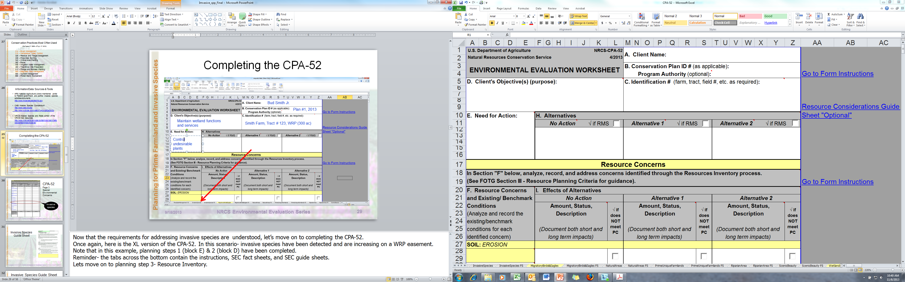
Completing the CPA-52
Bud Smith Jr.
Plan #1, 2013
Smith Farm, Tract # 123, WRP (300 ac)

Slide 9
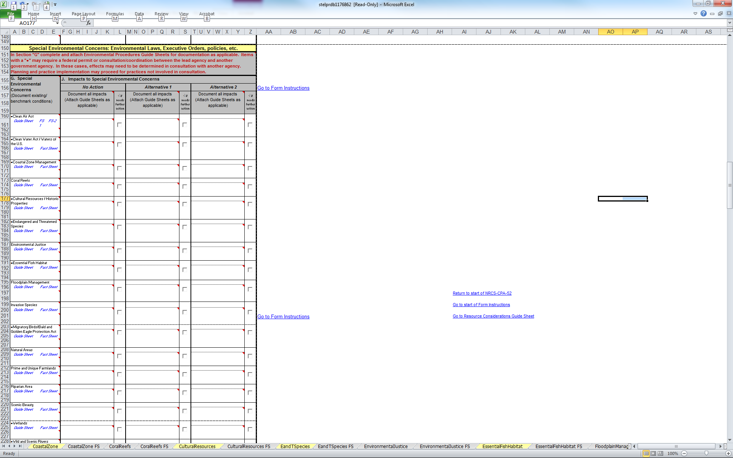
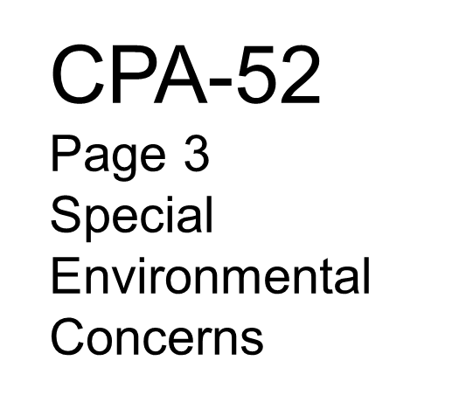
Migratory Birds/Bald and Golden Eagle Protection Act
Notes:
Located on page 3, section I of the CPA-52; we find the SEC for MB/BGEPA. As a reminder, the benchmark condition is documented in section G and the effects of each alternative on the SEC in section J. Planning step 3 & 4

Slide 10
Bald and Golden Eagle Protection Act Guide Sheet

Slide 11
Bald and Golden Eagle Protection Act Guide Sheet

Slide 12
National Bald Eagle Management Guidelines
http://www.fws.gov/midwest/eagle/pdf/NationalBaldEagleManagementGuidelines.pdf

Slide 13
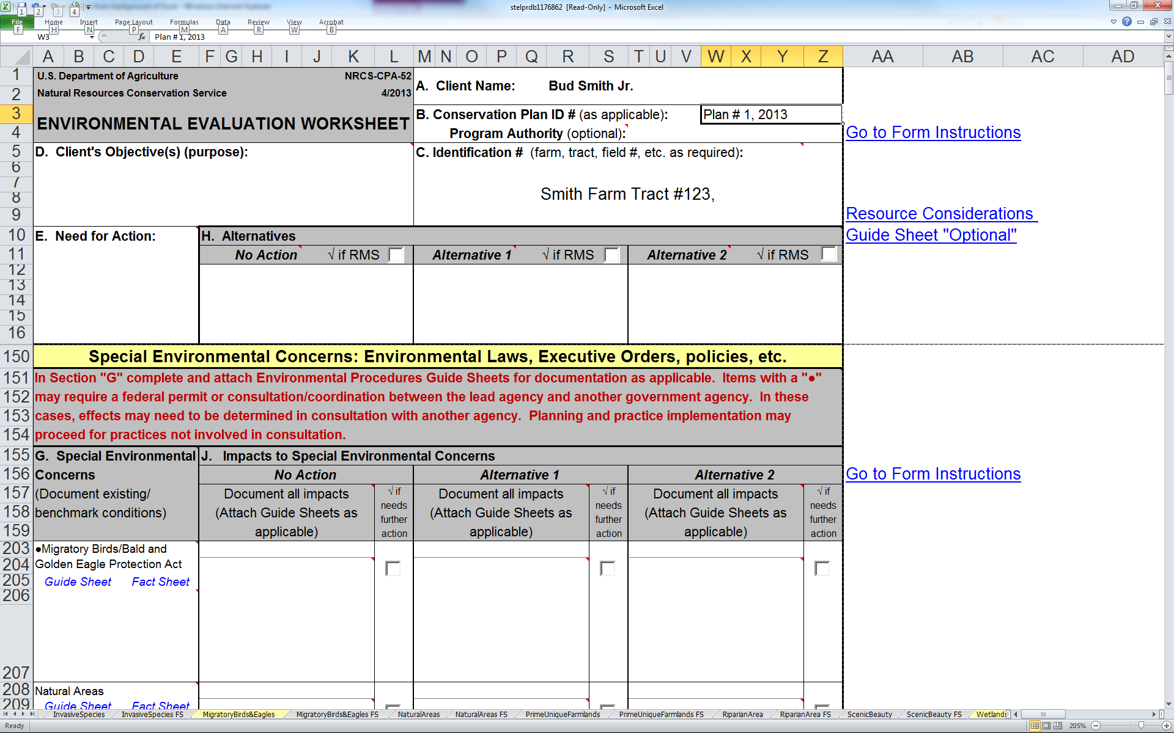
To manage the 340 acre woodland for wildlife habitat and income production.
Control stocking density/ increase understory vegetation.
Continued no-management other than fire suppression.
FSI (666), Firebreak (394), Prescribed Burn (338), UWHM (645).
No Effect- No actions taken
No Effect- operations compliant w/ NBEMG (see mitigation)
Active Bald eagle nest site in NW portion of tract 123.

Slide 14
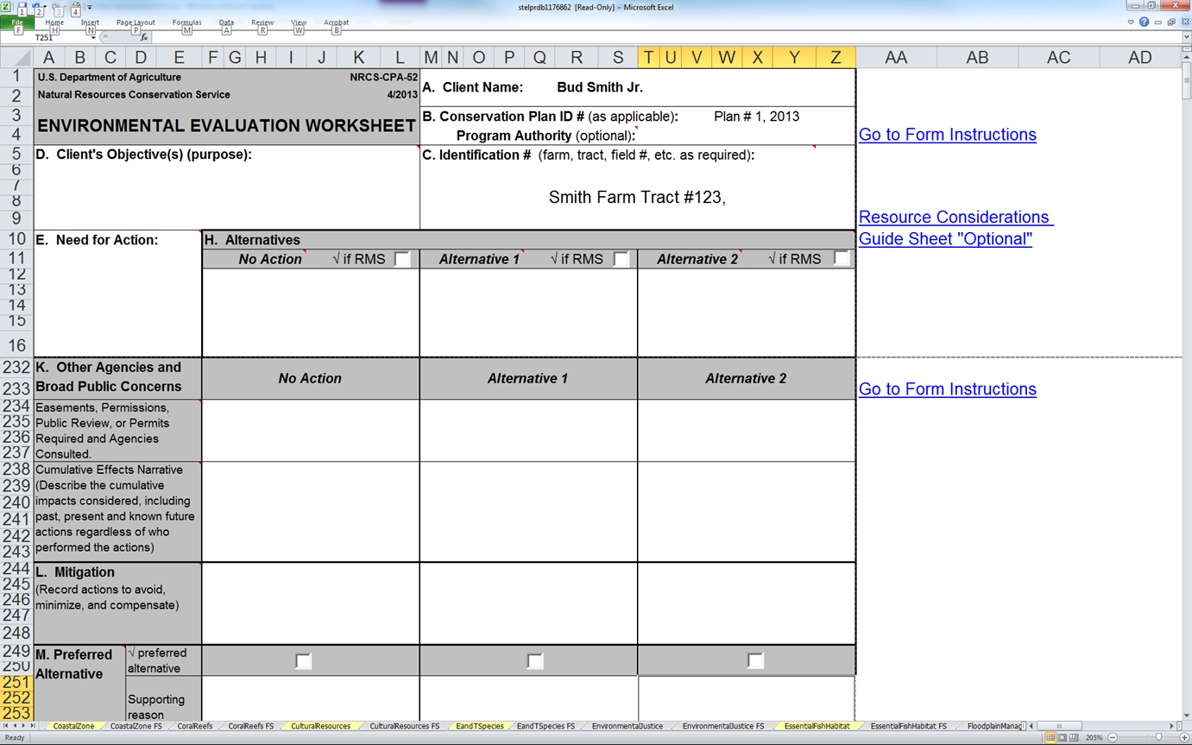
To manage the 340 acre woodland for wildlife habitat and income production.
Control stocking density/ increase understory vegetation.
Continue no-management other than fire suppression.
FSI (666), Firebreak (394), Prescribed Burn (338), UWHM (645).
Thinning operations and 338 after June 1. Harvest buffer 660ft.

Slide 15
Take at a Glance
ESA | MBTA | BGEPA
pursue, hunt, shoot, wound, kill, trap, capture, or collect, harm harass | pursue, hunt, shoot, wound, kill, trap, capture, or collect | pursue, shoot, shoot at, poison, wound, kill, capture, trap, collect, molest or disturb
Notes:
Harm- significant habitat modification or degradation which actually kills or injures fish or wildlife by significantly impairing essential behavioral patterns, including, breeding, spawning, rearing, migrating, feeding or sheltering.
Harass- likelihood of injury to listed species to such extent as to significantly disrupt normal patterns which include, but are not limited to breeding, feeding or sheltering.
Disturb- means to agitate or bother a bald or golden eagle to a degree that causes, or is likely to cause, based on the best scientific information available, 1) injury to an eagle, 2) a decrease in its productivity, by substantially interfering with normal breeding, feeding, or sheltering behavior, or 3) nest abandonment, by substantially interfering with normal breeding, feeding, or sheltering behavior."

Slide 16
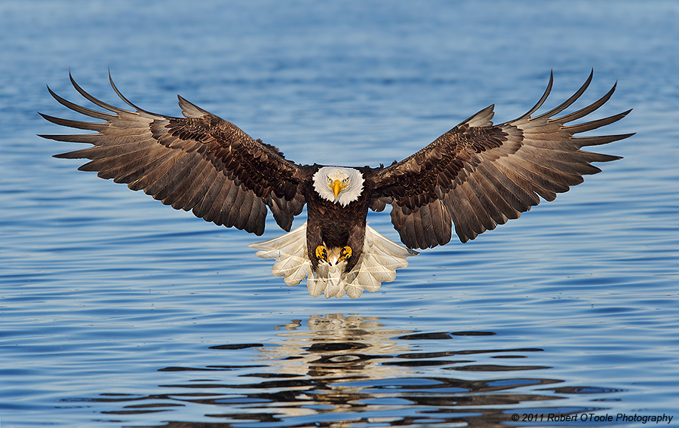
Questions?

Slide 17
For Additional information…
  Danielle Flynn, danielle.flynn@wdc.usda.gov 202 690-0856
  Matthew Judy, matthew.judy@ftw.usda.gov 817/509-3291
  Andree DuVarney, andree.duvarney@wdc.usda.gov 703/235-8091
  conservationwebinars.net
Notes:
If you have additional questions or comments about this webinar, please contact me, Andree, or either of today’s presenters. I want to thank Danielle for a fantastic job, as well as all ### of you for attending. I also want to extend a special thanks to Colin Lee for providing the excellent example on invasive species planning and control… pls contact Colin if you have additional questions. This webinar has been recorded and will be posted along with the .ppts for replay on conservationwebinars.net.
We’ll be taking December off, but stayed tuned for the next webinar in this series in mid January.
This concludes today’s webinar, good day.

