Slide 1
Part 2
Migratory Bird Treaty Act
Notes:
Part 2 of todays webinar will discuss NRCS responsibilities under the MBTA.

Slide 2

Migratory Bird Treaty Act of 1918
Black-necked Stilt
Notes:
In 1916, motivated by fears of extinction and population decline of several migratory bird species, the United States entered into a treaty with the United Kingdom, which was acting on behalf of Canada, “for the protection of migratory birds in the United States and Canada.”
Two years later, Congress enacted the MBTA to give effect to this convention, prohibiting the taking, killing, or possessing of migratory birds covered by the treaty, except as otherwise permitted by regulations to be promulgated by the Secretary of the Interior.
The United States subsequently entered into similar agreements with Mexico in 1936, Japan in 1972, and the Soviet Union in 1976, which were thereafter incorporated into the provisions of the MBTA.

Slide 3

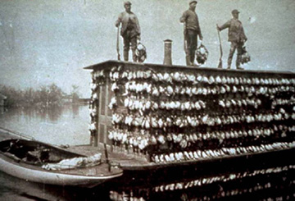
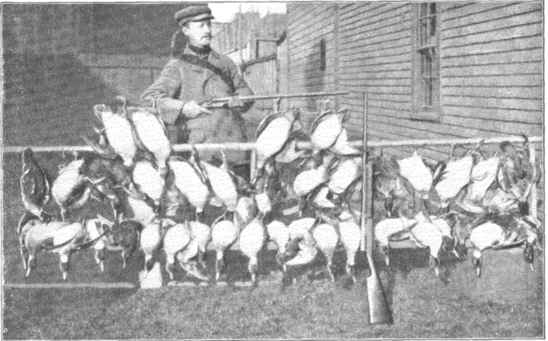
Goldfinch Pie and Batches of Bobolinks?
Notes:
Early Americans typically understood wildlife in terms limited to its utilitarian and human value: as a source of food and clothing, as a force of agricultural labor and service, as a method of pest control, and as the lively object of sport. In other words, early American society “viewed wildlife as a ‘bottomless pit’ from which it could take indiscriminately.”
Markets and cottage industries encircled this bottomless pit. In the nineteenth century, market hunting became popular, and wildlife merchandise became readily available to public markets for consumption and fashion. For instance, urban restaurant menus were eager to feature a wide range of fowl, and consumption was not limited to game birds: “many songbirds also were viewed as appropriate food for humans. Robins, for example, were served in soups, while cedar waxwings and goldfinches made ‘hearty’ pies. Also available for purchase were batches of bobolinks, bundled and tied together like carrots.” The tastes and customs of fashionable women created much demand for the killing of non-game birds, and “[s]o extensive was the use of feathers as well as whole birds on women’s hats that . . . ‘church gatherings and other social events often resembled aviaries.’”

Slide 4
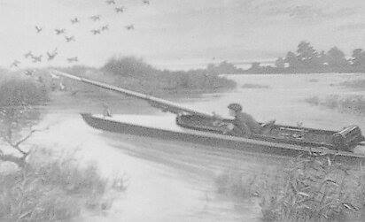
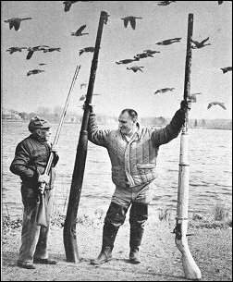
Pothunters/ Market Hunters
Notes:
The MBTA served diverse purposes. First, Congress wished to regulate commercial and recreational hunting, especially targeting the villain of the act, the notorious “pothunter.” As one Senator declared, “this law is aimed at the professional pothunter.” The MBTA was to “keep pothunters from killing game out of season, ruining the eggs of nesting birds, and ruining the country by it.” While the Act singled out the hunter who refused to play by the rules of the game, it did purport to regulate recreational hunters as well.
Pothunter was a person who hunts for food or profit, ignoring the rules of sport. You may have heard the phrase “taking a potshot”
Market hunters were commercial hunters, who exploited animals as a natural resource, for both money and economic development.
Shown here is a punt gun… an extremely large shotgun used in the 19th and early 20th centuries for shooting large numbers of waterfowl for commercial harvesting. A single shot could kill over 50 waterfowl resting on the water's surface. In the United States, this practice depleted stocks of wild waterfowl and by the 1860s most states had banned them. The Lacey Act of 1900 banned the transport of wild game across state lines, and the practice of market hunting was outlawed by a series of federal laws in 1918 including the MBTA.
The MBTA also contemplated agricultural benefits. Not only was there value in saving birds from the reckless slaughter of unrestrained hunting, but there was also value in keeping birds alive to do what they did so well: eat crop-damaging insects. Congress took notice of annual food losses caused by insects and proclaimed the need to protect the birds, and finally, Congress recognized the aesthetic value of migratory birds

Slide 5

MBTA Prohibitions:
pursue, hunt, take, capture, kill… any migratory bird, any part, nest, or egg of any such bird, or any product . .. (if the bird is included in the four Conventions). (16USC§703)
take any migratory bird by the aid of baiting… (16USC§704(b)(1))
Costa’s hummingbird
Notes:
It Is A Crime To “Take” A Migratory Bird Or Its Nest, Except As Authorized By An MBTA Permit – The MBTA is a criminal statute. One section of the MBTA makes it unlawful to “kill” or “take” a migratory bird, nest, or egg, except as permitted under regulations.
Unless and except as permitted by regulations, the Act provides that it is unlawful at any time, by any means or in any manner, to pursue, hunt, take, capture or kill; attempt to take, capture or kill; possess, offer to or sell, barter, purchase, deliver or cause to be shipped, exported, imported, transported, carried or received any migratory bird, part, nest, egg or product, manufactured or not…. this is also the law that makes it unlawful to hunt migratory birds over a baited area.
Persons found in violation of the MBTA can be arrested without a warrant and charged with a misdemeanor carrying a $1500 maximum fine and/or a six-month maximum jail term. If the violation was committed knowingly, a felony conviction can result, carrying a $2000 maximum fine and/or a two-year maximum jail term.

Slide 6
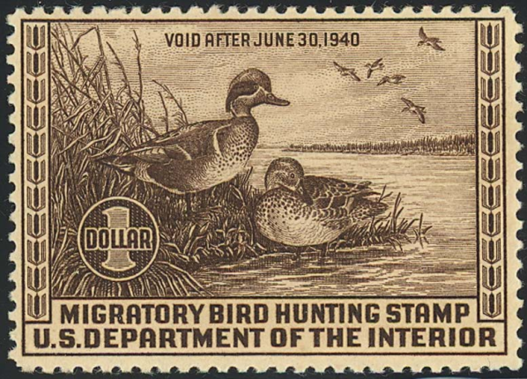
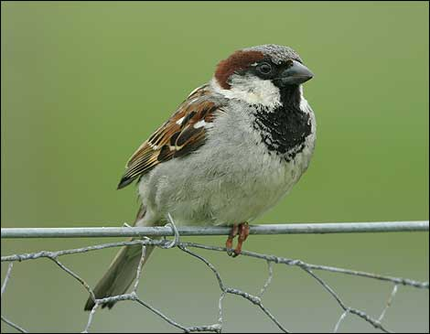


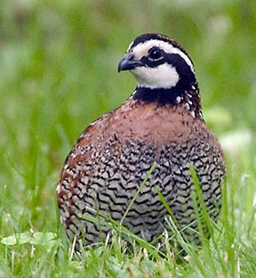
What Birds are Protected?
50CFR§10.13
Not covered-
  Non-native human introduced species
  Resident game birds
  Pigeons
  European Starling
  House Sparrow
Notes:
Some 800+ species of birds are protected. The list is published in the FR @ 50CFR§10.13
The Act authorizes the Secretary of Interior to determine when and to what extent hunting, taking, capture, killing, possession, sale, purchase, shipment etc. is allowed…
…as well as adopting regulations to permit such activities
Because of this law, migratory birds are Federally regulated, that’s why you have to buy a federal duck stamp.
Almost All Bird Species In The U.S. Are Covered By The MBTA – FWS regulations include most native birds found in the United States as species protected by the MBTA – even species that do not migrate internationally. See 50 C.F.R. § 10.13. “The MBTA now protects nearly all native birds in the country, of which there are millions if not billions, so there is no end to the possibilities for an arguable violation.”

Slide 7
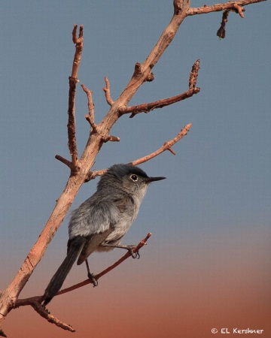
TAKE AUTHORIZED by PERMIT
Permits can allow TAKE if it is “compatible” with the four migratory bird treaties
INTENTIONAL TAKE
  Agricultural pests
  Human health & safety
  Scientific collecting
Blue-gray Gnatcatcher
Notes:
Permits can be used to Take birds in some circumstances
INTENTIONAL TAKE
Where the action is to TAKE the BIRD

Slide 8

MBTA & Habitat
Does NOT cover habitat impacts
Notes:
MBTA prohibits Take – which means it is unlawful to “take” any migratory bird, at any time, by any means, or in any manner or any part, nest, or egg of any such bird.
Habitat is not covered unless it involves direct mortality of birds, nests, eggs or parts thereof

Slide 9
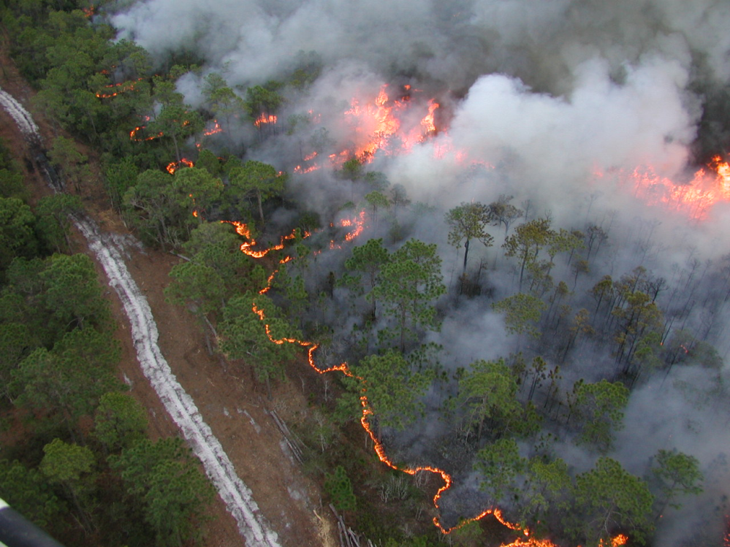
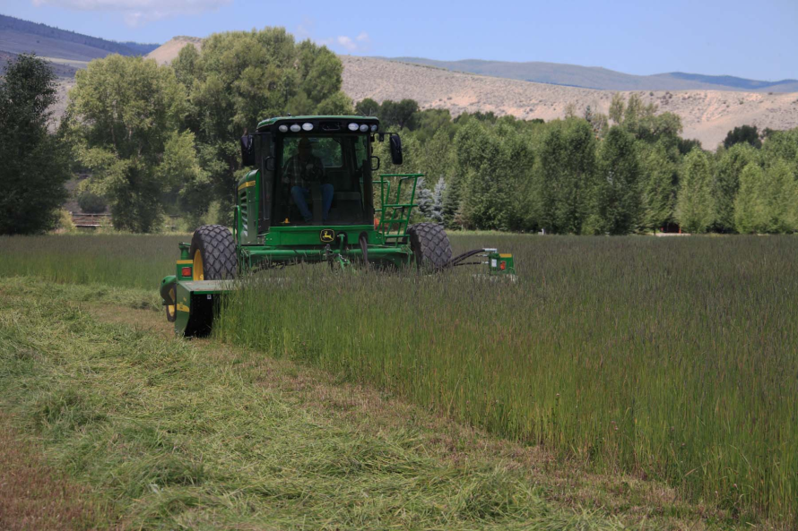
UNINTENTIONAL TAKE
Currently NO expressed authorization
Notes:
NO expressed authorization to permit Unintentional Take (Incidental)
Take that is not the action – but results as a result of an otherwise legal activity
Anyone who causes the death of a migratory bird, even if unintentionally, is technically in violation of the act.

Slide 10

MBTA Case law
Notes:
The Uncertain Scope Of The MBTA’s “Take” And “Kill” Prohibitions – As previously described, the MBTA makes it unlawful to “take” a migratory bird (or its nest or eggs).
FWS’s rules define “take” for MBTA purposes to mean to “pursue, hunt, shoot, wound, kill, trap, capture, or collect.” 50 C.F.R. § 10.12. This definition clearly covers activities directed against wildlife, such as hunting or killing a migratory bird without a permit. FWS has developed regulations for hunting and permits for intentional take, but not for unintended take.
Do the MBTA terms “take” and “kill” extend beyond such activities directed against wildlife to the wide set of activities that may inadvertently cause a migratory bird death (e.g., operation of oil and gas production facilities, construction and operation of wind turbines and telecommunications towers, conduct of commercial forestry and agriculture, operation of automobiles and airports) and, if so, how far? Unfortunately, there is no clear answer among the courts and legal commentators. The law varies circuit-by-circuit.

Slide 11
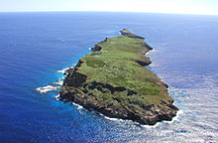
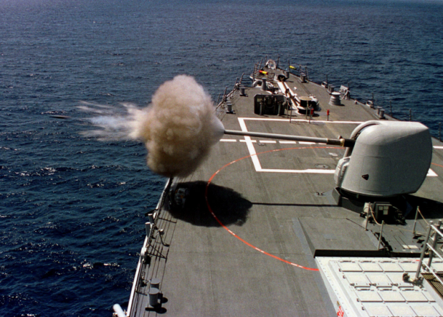

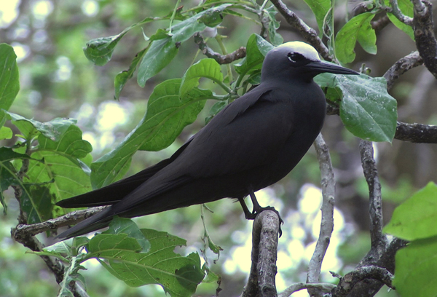
Earthjustice v. United States
Black noddy
Notes:
How tough is the MBTA? …. It stopped the US Navy from live fire training.
On a small uninhabited island in the Pacific Ocean known as Farallon de Medinilla located 150 miles north of Guam is the United States Pacific Fleet’s range for live-fire training. In addition, the air and sea space in the Farallon de Medinilla area provides sufficient room for the many different attack profiles which need to be rehearsed. During the peak of Vietnam War operations, ordnance delivered on the island was estimated at 22 tons per month.
The Navy has far more mitigation procedures to prevent environmental damage in the present day than they did in the 1960s. In compliance with the National Environmental Policy Act of 1969 they prepared an Environmental Impact Statement.^{[9]} However, the Navy could not guarantee that no bird protected by the MBTA would be killed, despite the precautions. The Fish and Wildlife Service could not grant a permit without such a guarantee, and no permit has been issued. The Navy argued that it had done its best to comply with environmental laws, and should be permitted to operate under the Impact Statement prepared for NEPA.
Earthjustice sued for a temporary restraining order of tests because the navy did not comply with the MBTA, although they did comply with the other environmental laws. As a result a law was introduced by congress (H.R. 4546) to amend the Migratory Bird Treaty Act of 1918 to make it lawful for the Department of Defense to "take" (kill) migratory birds during a "military readiness activity".

Slide 12

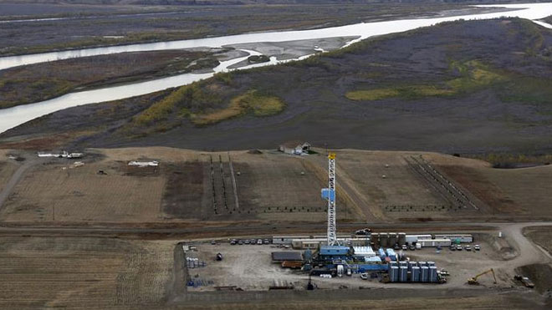
United States v. Brigham Oil and Gas, L.P., (2012)
Notes:
In a recent North Dakota case, United States v. Brigham Oil & Gas (2012), the Federal court rejected the expansive interpretation of criminal liability under the MBTA.
The distinction between intentional activity criminalized by the statute and lawful activity that incidentally results in bird death was central to the courts decision.
The court held that the government’s interpretation of the statue would lead to absurd results” by criminalizing everyday behaviors… citing statistics from the USFWS identifying major sources of bird deaths, the court reasoned the to be consistent the government would have to criminalize driving a car, constructing buildings, flying airplanes, farming, electricity, and wind turbines which cause bird deaths, and many other everyday lawful activities.

Slide 13
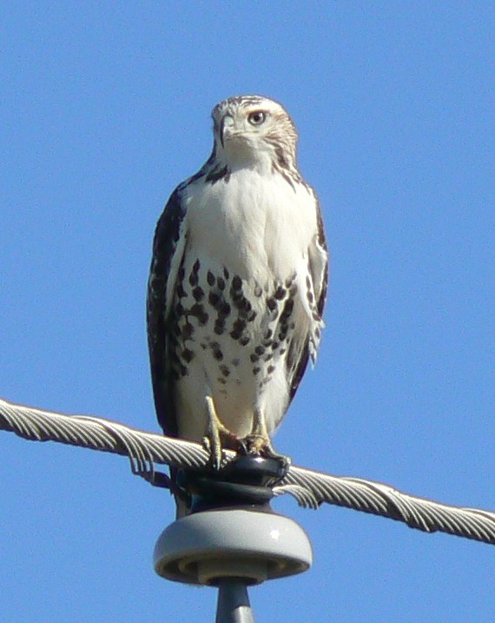

United States v. Moon Lake Electrical Ass’n, Inc. (2009)
Red-tailed hawk
Notes:
Moon Lake Electric Association, Inc., was jointly investigated by the U.S. Fish and Wildlife Service, the Colorado Division of Wildlife, and the Utah Division of Wildlife Resources for illegally killing protected raptors, was placed on probation for three years and ordered to retrofit its utility lines. The company was also ordered to pay $100,000 in fines and restitution for the electrocution of eagles and other raptors that landed on its powerlines and poles in northwest Colorado and eastern Utah.
Moon Lake had failed to respond to Service requests to correct repeated problems with power structures that killed at least 17 raptors at an oilfield in Rangely, Colorado.
Moon Lake pleaded guilty in April to three misdemeanor charges of violating the Bald and Golden Eagle Protection Act and three charges under the Migratory Bird Treaty Act. That plea, however, came after the company unsuccessfully argued to the court that the prohibitions against killing protected birds in the two laws referred only to illegal hunting and did not apply to "unintentional" avian deaths caused by contact with powerlines or other company equipment.

Slide 14
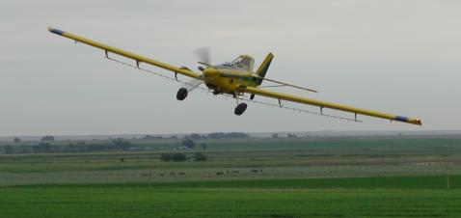


United States v. Corbin Farm Service (1978)
American widgeon/ Baldpate
Also found guilty of FIFRA- improper application of pesticide.
Notes:
In this case, United States v. Corbin Farm Service (Corbin Farm), in which FWS applied the MBTA against a commercial farm that spread pesticide over its alfalfa field. FWS argued that the language preventing killing and taking of birds “at any time, by any means or in any manner” includes birds dying after ingesting pesticide. The defendants were each involved in various capacities with the application of Furadan 4, a registered pesticide, to an alfalfa field which allegedly caused the death of more than 1,000 American Wigeons.
Defendants Corbin Farm Service (the dealer and distributor of the pesticides), an employee of Corbin Farm Service that provided advice to the farmers, the owner of the alfalfa field, and the aerial operator who sprayed the field were all prosecuted under the MBTA. In their defense, they argued that there was a requirement of guilty intent, to be found guilty. After thoroughly examining the MBTA, the district court held that “the legislative history of the Act reveals no intention to limit the Act so that it would not apply to poisoning.” Moreover, the court declared that “it is clear that Congress intended to make the unlawful killing of even one bird an offense.” Simply because American widgeons were “taken” and “killed” as a result of eating the sprayed alfalfa, all the defendants were found guilty of violating the MBTA. The California district court maintained that this crime was a “public welfare offense,” and that “when dealing with pesticides, the public [was] put on notice that it should exercise care to prevent injury to the environment and to other persons.”

Slide 15


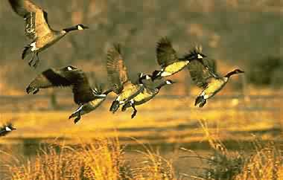
United States v. Rollins (1989)
Notes:
This case began on May 21, 1988, when the defendant, Ronald Rollins, applied a mixture of registered pesticides (Furadan and Di-Syston) to approximately fifty acres of seed alfalfa growing on his farm at West Lake Island in the Snake River between Oregon and Idaho. Thereafter, a flock of geese alighted on the field, ate the alfalfa, and died from ingestion of the pesticides. Rollins was charged with a violation of the Migratory Bird Treaty Act (MBTA).
The Magistrate then issued memorandum decision on October 19, 1988, finding the defendant guilty of violating the MBTA. In that decision, the Magistrate identified the "primary fact in dispute at the trial" as "whether or not the island was a known feeding area for geese." The Magistrate ultimately concluded that "a reasonable person would have been placed on notice that alfalfa grown on West Lake Island in the Snake River would attract and be consumed by migratory birds.
But in reaching this conclusion the Magistrate also found that
the defendant had used Furadan on his alfalfa fields in the past and "never experienced a problem with birds."
other farmers in the area could not recall "any prior incidences where large numbers of geese had been killed following a pesticide application.“
the pesticides had been used "by the farming community in the Weiser area for a number of years without major incident."
The defendant Rollins did not apply the pesticide in a reckless manner. Indeed, Rollins and a farm helper "inspected the field during the spraying and there was no sign of geese feeding on the alfalfa."
Rollins applied the chemicals "in the recommended quantities at the appropriate time."
Once the pesticides were applied, "there is no effective way to keep them [the geese] out of their [the farmers'] fields....“
As the Magistrate and other courts have accurately pointed out, the MBTA is a strict liability statute without a criminal intent requirement. Thus, a homeowner could be pursued under the MBTA if a flock of geese crashed into his plate-glass window and were killed. An airplane pilot could be prosecuted if geese were sucked into his jet engines. A farmer like Rollins is exposed to sanctions because he tended his crops in the same manner as other area farmers.
The court declared that farmers have a right to know what conduct of theirs is criminal, especially where that conduct consists of common farming practices carried on for many years in the community. While statutes do not have to be drafted with "mathematical certainty,", they must be drafted with a "reasonable degree of certainty." The MBTA fails this test.
The Court reverse the memorandum decision of the United States Magistrate issued October 19, 1988, and l further order that the charges against the defendant be dismissed.

Slide 16
What’s a Planner to Do?
Use common sense
Be aware of surroundings and affected resources
Understand ecosystem function
Identify and analyze impacts/ risks
Identify appropriate mitigation
Document the findings/ results
Exercise due diligence
Notes:
So as we have seen, the courts are split on what constitutes a violation of the MBTA. I believe that there are some common denominators that we can take away from these cases that will serve to protect NRCS and our clients from legal entanglements.

Slide 17
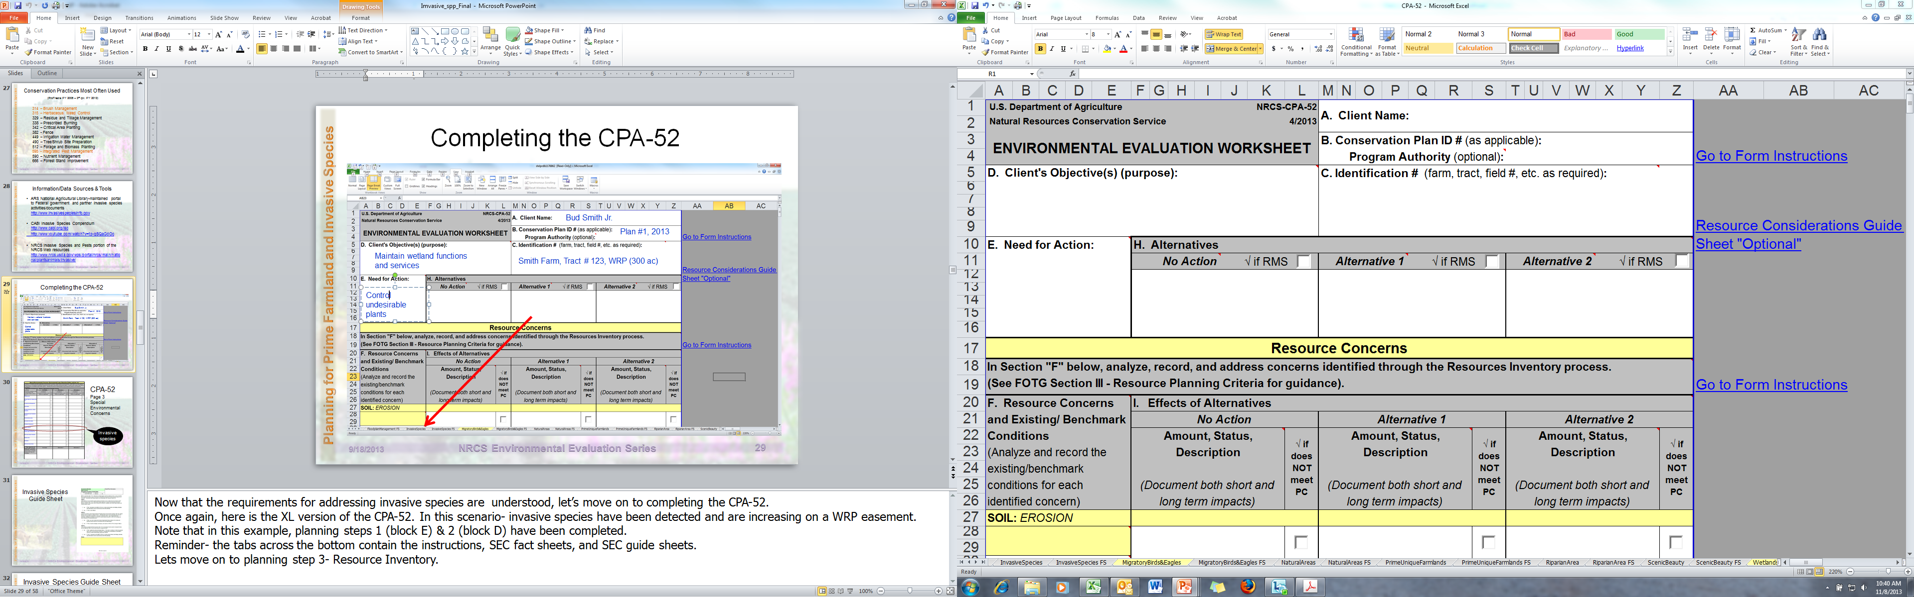
Completing the CPA-52
Bud Smith Jr.
Plan #1, 2013
Smith Farm, Tract # 123, WRP (300 ac)
Notes:
Shown here is the first page of the XL version of the CPA-52. Note the tabs for MB/BGE Fact Sheet and Guide Sheet on the bottom.

Slide 18
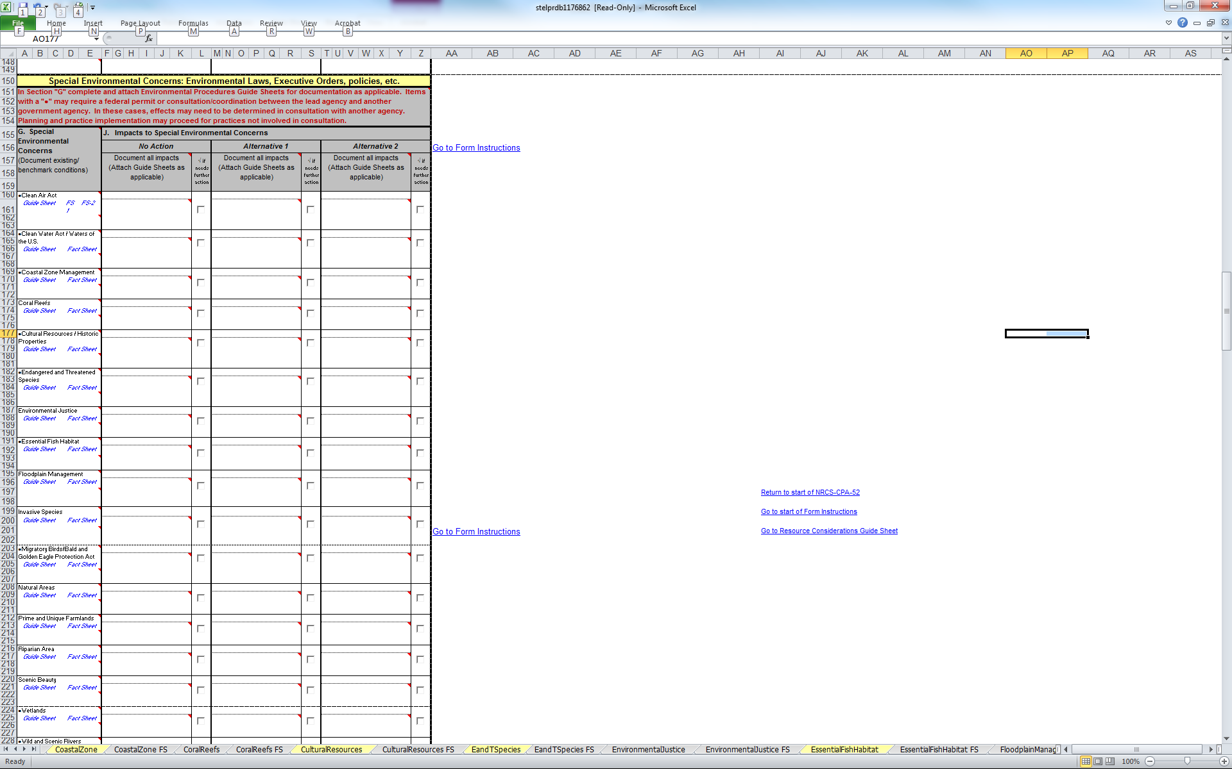
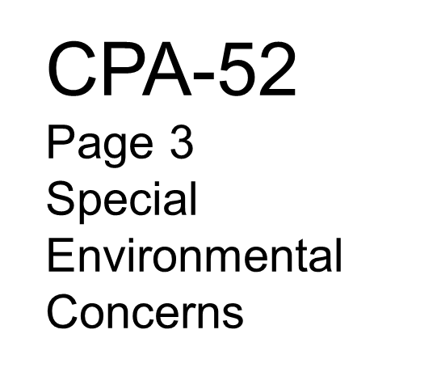
Migratory Birds/Bald and Golden Eagle Protection Act
Notes:
Located on page 3, section I of the CPA-52; we find the SEC for MB/BGEPA. As a reminder, the benchmark condition is documented in section G and the effects of each alternative on the SEC in section J. Planning step 3 & 4

Slide 19
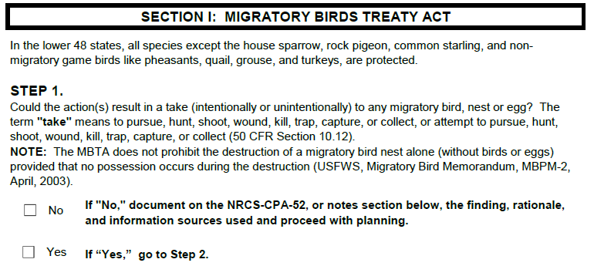
Migratory Bird Guide Sheet
Notes:
As we review the guide sheet for Migratory Birds, we see that the first question asks if the proposed action has the potential to take a migratory bird.
Note the definition of take.
If no…
If yes…

Slide 20
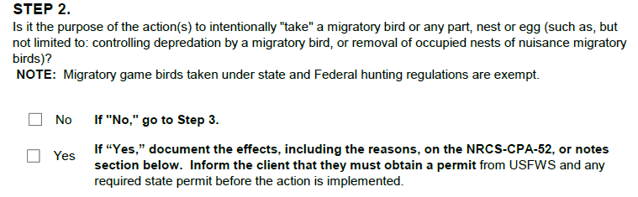
Migratory Bird Guide Sheet
Notes:
Question 2 asks, is the purpose of the action to take a migratory bird?
If no, ….
If yes, ….

Slide 21
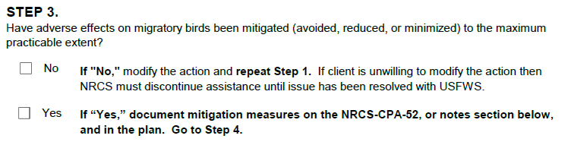
Migratory Bird Guide Sheet
and proceed with planning.
Notes:
Question 3 asks, to the extent practicable, have adverse impacts been mitigated?
If no, …
If yes, …

Slide 22
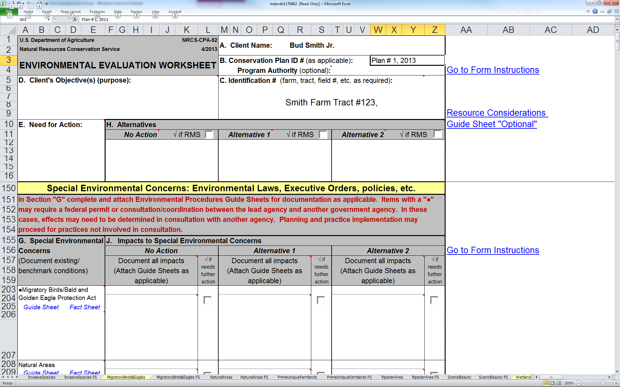
Improve rangeland health and increase calving %
Increase forage yield / diversity,
Increase livestock BCS
Continue current mgt.- continuous grazing w/o brush mgt.
Brush Management (314)
Prescribed Burning (338)
Prescribed Grazing (528)
LT decline in grassland bird spp. as brush encroaches
Improved 1575 ac grassland bird habitat. No take of MB anticipated
(See mitigation)
1575 ac poor quality grassland bird habitat (pastures 3,4,5)
Notes:
In this scenario, the client’s objective is to improve rangeland resources and increase calving percentages.
The problems identified are limited forage diversity and yield… resulting in less than desirable livestock body condition score.
Identified MB habitat in the planning area consists of 1577 acres in pastures 3,4, and 5.
Alternatives include:
No action- continuing to continuously graze all pastures with no rest period and no management of increasing brush, and
Alternative 1- mechanically reducing brush density, increasing forage vigor and yield by conducting prescribed burning and effectively managing livestock grazing.
The taking no action on MB’s are… long-term decline in grassland bird species due to the overgrazing and encroachment of brush in the pastures.
The effects of the planned actions on MB’s will result in improved habitat quality due to increased plant diversity and structure.

Slide 23
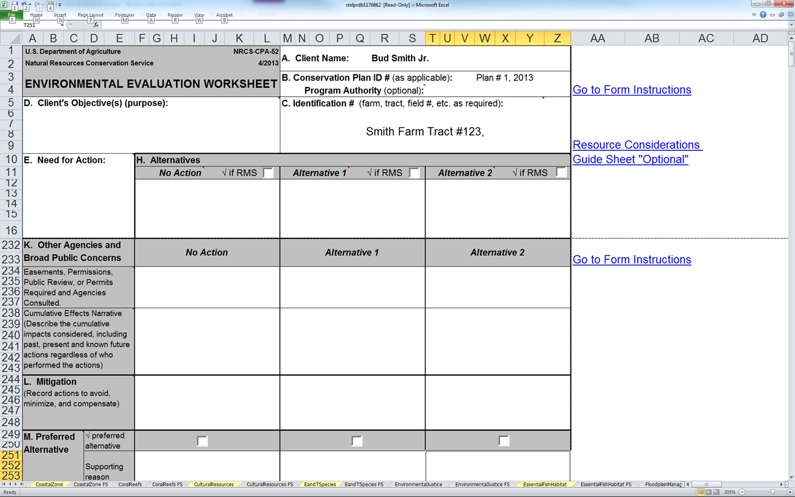
Improve rangeland health and increase calving %
Increase forage yield / diversity,
Increase livestock BCS
Continue current mgt.- continuous grazing w/o brush control
Brush Management (314)
Prescribed Burning (338)
Prescribed Grazing (528)
Annual patch burns and brush mgt. scheduled outside nesting season
Notes:
Documented mitigation supporting the “No Take “ determination involves implementing the conservation measures outside of the MB nesting season.

Slide 24

Questions?

