Slide 1


Natural Resources Conservation Service (NRCS)
Jerry D. Walker, P.E.
Agricultural Engineer (Water Management)
Natural Resources Conservation Service
Central National Technology Support Center
Fort Worth, TX
USDA is an Equal Opportunity Employer & Provider
Notes:
Jerry D. Walker, P.E.
Agricultural Engineer (Water Management)
NRCS, CNTSC
501 West Felix Street, Bldg 23
Fort Worth, TX 76115
Office - (817)509-3387
fax - (817)509-3337

Slide 2
Pumping Plant Analysis and Upgrade
Pumping Plant Analysis - Purpose
Data Gathered in Pumping Plant Evaluation.
Information Gained From an Evaluation.
Pumping Plant Analysis (Computations)
System Troubleshooting
System Modification\Upgrades
Notes:
Purpose of a Pumping Plant Analysis (evaluation or test): A Pumping Plant Analysis provides for a measurement of energy use rate, power produced by pumping plant components (e.g. motor, engine, pump), and an assessment of pumping plant performance relative to a standard pumping plant efficiency with associated potential energy and cost reductions (when applicable).
Why this is important now: Recent NRCS program and agency policy changes have made it likely NRCS personnel will need to be understand interpret and develop statements of work for pumping plant assessments, analysis, and reports conducted by TSPS, and A&E services.
Recent Developments:
Water Quantity Enhancement Activity – WQT03 - Irrigation pumping plant evaluation :
Enhancement Description - This enhancement consists of the evaluation of the pumping plant performance and efficiency using the Nebraska Irrigation Pumping Plant Performance Criteria.
Agricultural Energy Management Conservation Activity Plan, AgEMP(122) = Farm Energy Audit: A farm energy audit records and analyses energy used on the farm and recommends actions to reduce energy usage while maintaining (or at times) increasing farm production. NRCS personnel will need to review energy related reports and analysis conducted by TSPS, and A&E services on irrigation systems.
Energy was added as an NRCS Natural Resource Concern by Chief White in 12/10. Energy related purposes were added to a number of NRCS Conservation Practice Standards with NHCP Notice 154 in 6/2011. This included a number of irrigation practices. One of the primary ways energy reduction will be achieved on irrigation systems will be modification or changes in operation of irrigation pumping plants.
Questions?? contact
Agricultural Engineer (Water Management)
NRCS, CNTSC
501 West Felix Street, Bldg 23
Fort Worth, TX 76115
Office - (817)509-3387
fax - (817)509-3337

Slide 3
Pump Tests and Safety
Tests should be performed by qualified techs
1. Noise:
2. Moving Parts:
3. HEAT: => where most of inefficiency goes:
4. Oil and Water Slick Surfaces:
5. Danger of Overloaded Engines or Drive shafts:
6. Gas Leaks:
7. Electrical Shock on Electric Pumping Plants:
Hazardous conditions will be present
Notes:
1. When around any electric powered irrigation component , always check motors, pumps, control panels, generators, etc. with a volt meter before touching anything (this includes pivot sprinklers):
Electrical Shock on Electric Pumping Plants: Please note the following caution concerning testing electrically powered equipment with a volt meter. Note these go-no go limits are different from some values you might have previously used or seen in other sources.
Caution: Before opening a control panel, use a voltmeter to make one of the following two types of checks. 1) Check for voltage between any metal component you will work with (control panels, pumps, structural components, etc) and the systems electrical ground rod. Any voltage greater than 0.5 volt measured between a motor, control panel exterior, or structural component to the rod is not normal and could indicate a problem with the electric equipment or wiring. If the voltmeters leads are not long enough to measure from the metal component to the ground rod; 2) measure voltage from the metal components to earth (soil), commonly called stray voltage. Depending on conditions around the system, a measurement above 5 volts to the earth (soil) could be an indication of a potential problem with the electrical supply system, on-site electrical wiring or equipment. If the voltage to earth (soil) is above 5 volts, contact the power supplier or an electrical professional to check the system before any further testing is done. If you have any doubts about the safety of the control panel or other equipment, WALK AWAY AND CALL A QUALIFIED ELECTRICIAN. If necessary, have the power supplier or utility disconnect the power. Always play it safe!
2. Noise: Always wear hearing protection when working around internal combustion engines. Be extra watchful since you cant hear. In some areas rattlesnakes like to hang around pumping plants were its cool. Always be looking for possible hazards.
3. Moving Parts: Drive shafts are extremely dangerous. Don’t wear lose clothing and always wear hat. Watch your hair.
4. Heat: Locate and avoid exhaust pipes. If you are around the pumping plant at night you can sometimes see the flames coming out the exhaust that you cant see during the daytime.
5. Oil and Water Slick Surfaces: Areas around pumping plants are often wet and have spilled oil present. This makes things slick. Don’t want to take a tumble anywhere close to a driveshaft.
6. Danger of Overloaded Engines or Drive shafts: Drive shafts and engines do experience catastrophic failures without warning. Get the information you need to measure and get away from the pumping plant as soon as possible.
7. Gas Leaks: Very low efficiency on natural gas pumping plant may be a sign of gas leak. Kill engine listen and sniff.

Slide 4
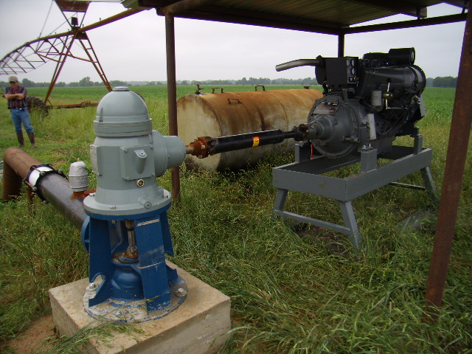
Notes:
new air cooled diesel powered pumping plant.

Slide 5
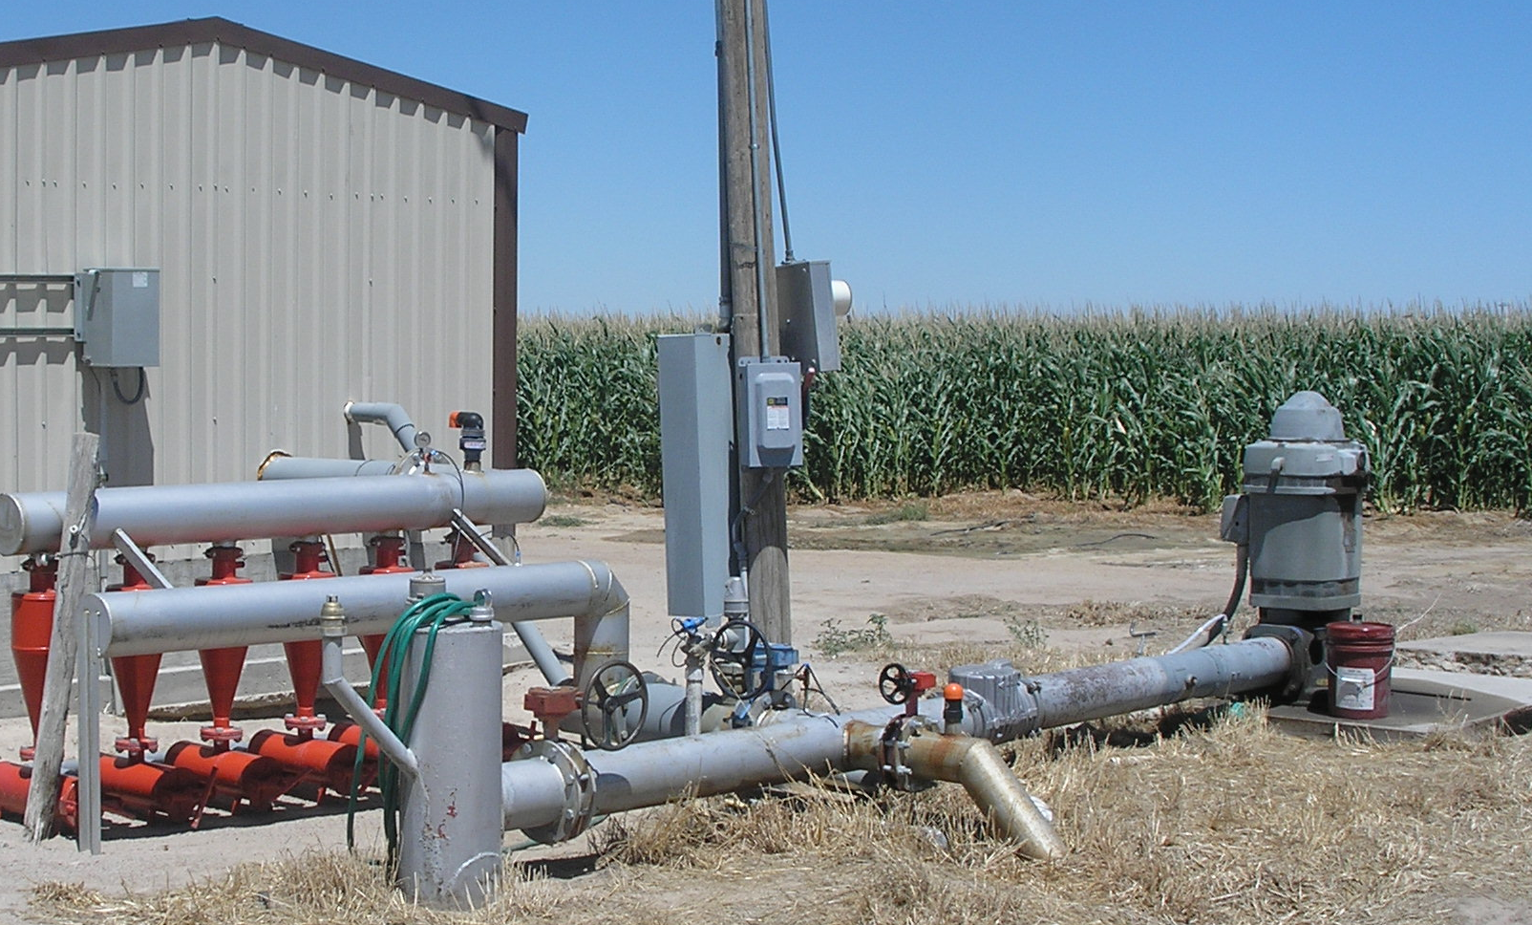
Notes:
electric pumping plant using turbine pump an vertical mounted electric motor. This system would be representative of the Nebraska pump plant criteria.

Slide 6
Discharge Pressure Gauge
Motor
Discharge Pipe
Pump Head
Ground Surface
Static or Standing
Water Level
Pumping Lift
Ground Water
Pumping Water Level
Pump
Slide from Blaine Hanson
University of California, Davis
Notes:
Data gathered during a pumping plant evaluation:
Pumping plant discharge (flowrate) => gal/min
Pumping Lift (ft)
Discharge Pressure => normally measured in (psi) and converted to ft of head ( psi x 2.31 ft/psi)
Friction loss in discharge pipe from pump to ground surface is another component of Total Dynamic Head TDH. This is often neglected but should be examined in a particular area and an informed decision made to do so or not).
Fuel or electricity use rate => units depend on type of fuel used. Use farmer on site gas or electric meter if available:
Pump rpm => not used for energy computations but needed to compare results to pump curve, or if multiple rpms are tested. Fuel Cost/energy unit
Information available after testing a pumping plant and completing computations :
Cost/hr to operate pumping plant
Cost / ac-in of water pumped
Cost / ac to supply a specified application depth
Estimated Cost/season to operate well
5. Well Flow rate (gpm)
6. Discharge pressure pump is working against
7. Pumping water level in well.
8. Fuel use rate
9. Overall Pumping plant efficiency
10. Pump efficiency on electric powered pumping plants or internal combustion powered plant if a torque cell is available
11. How much money an irrigator could save per season if pumping plant efficiency
was brought up to a standard (field attainable) efficiency.
12. Horsepower into pumping plant.
13. Horsepower out of pumping plant.
14. Whether the electric motor on an electric pumping plant is over or under loaded.

Slide 7
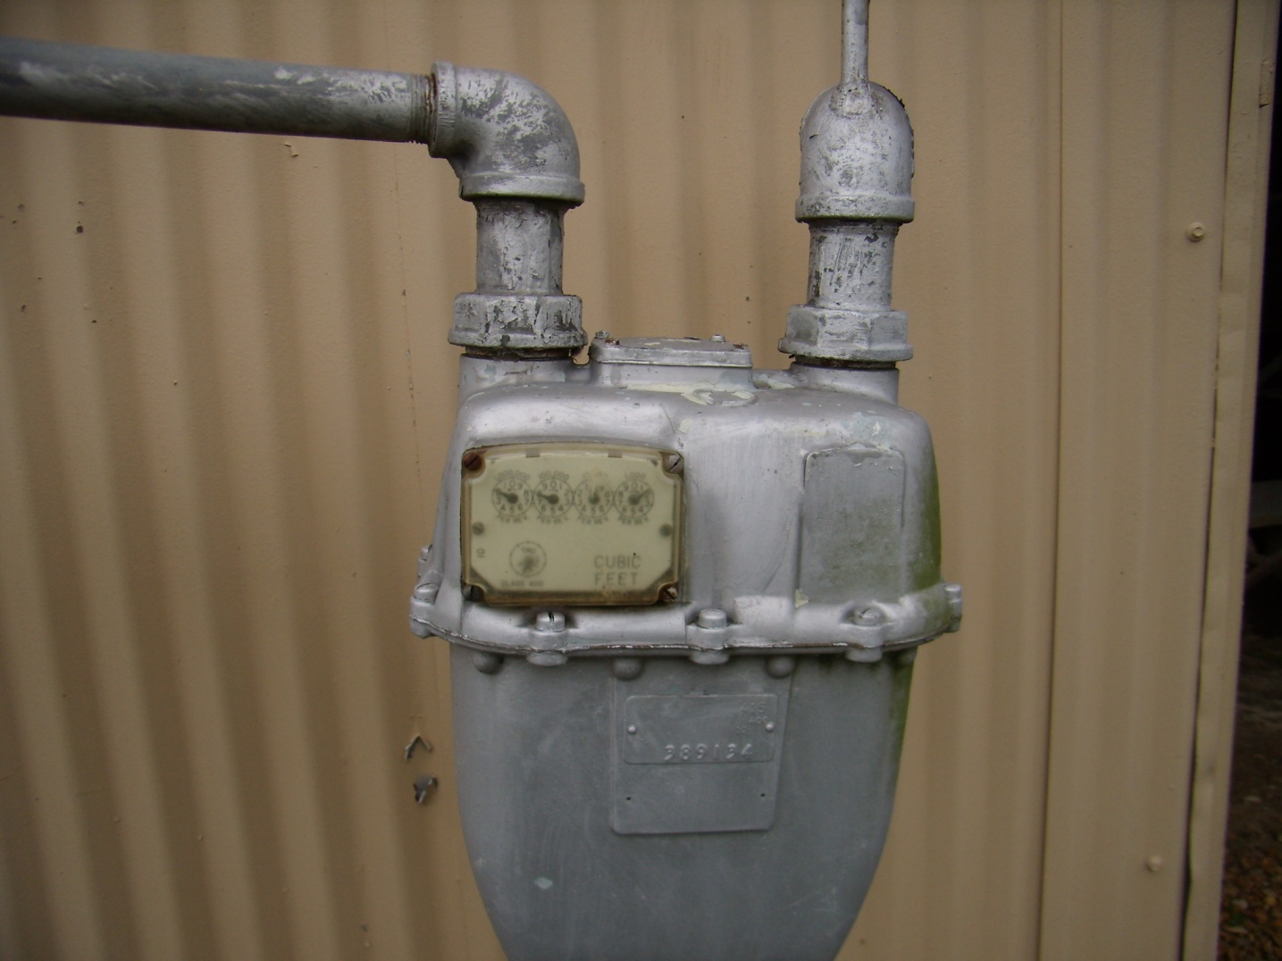
Notes:
Natural Gas Meter: read test dial with stop watch and convert to MCF/ hour.
1 MCF = 1000 cu ft of Natural Gas
If farmer or gas company starts talking about dekatherms call me. This wont be a major problem but will likely require adjustment of =>
HP-hr/MCF content of gas => contact Walker if you have questions.

Slide 8
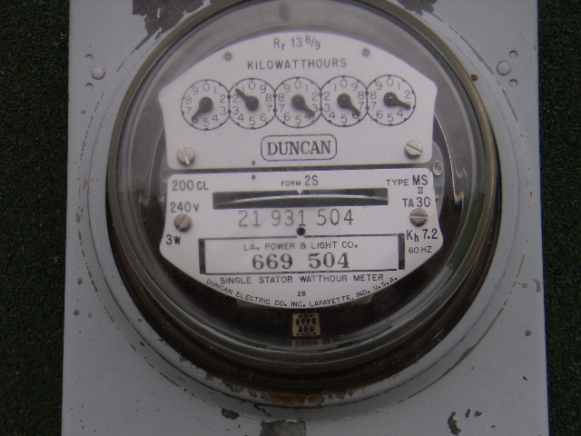
Notes:
Old style disc Watt meter.

Slide 9
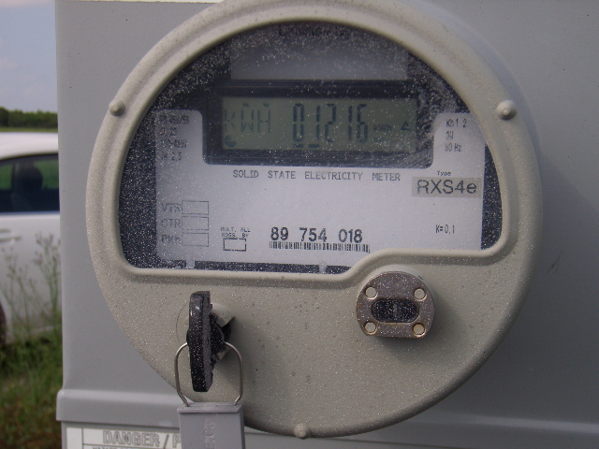
Notes:
Newer style Electric Meter: Talk to local utility person responsible for electric meter maintenance. That individual will be probably be able to tell you how to use a stop watch with a test bar on the meter to read the meter in the field.

Slide 10
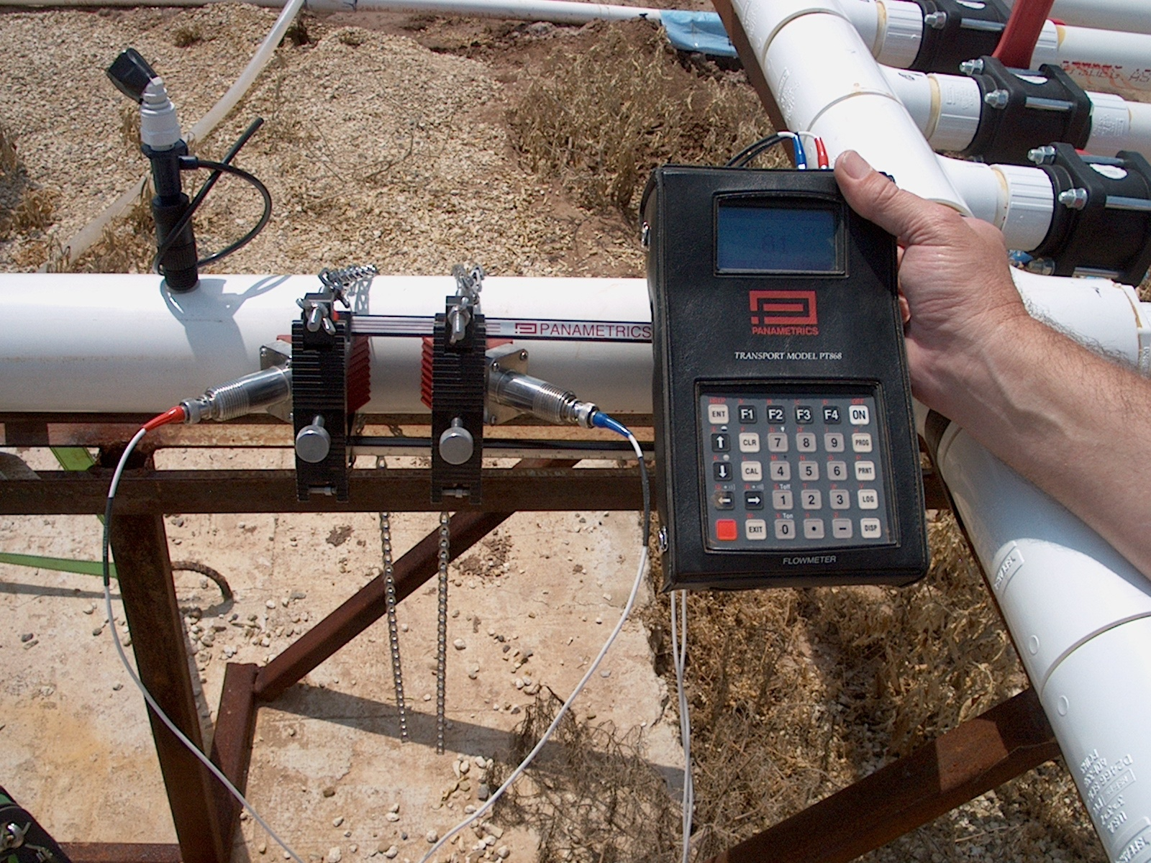
Notes:
Flow measurement Ultrasonic Flow meter

Slide 11
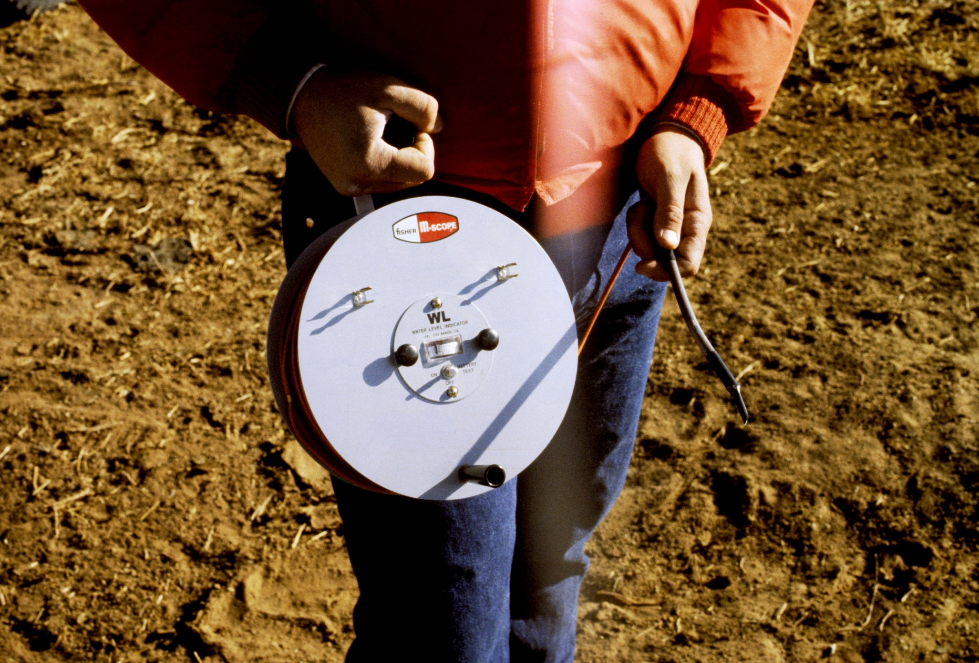
Notes:
draw down gage=> well sounder
gage has battery.
when tip encounters water circuit is completed and needle jumps, light shines, or audible alarm sounds.
Audible alarm isn’t much use around an internal combustion engine powered plant.
Cable tagged in 5 and 10 ft increments. Read water depth while pumping plant is operating.
Know where the pump is set.
Training should be obtained before using a draw down gage.
A permanently installed airline draw down gage is much preferred but rarely in place.

Slide 12
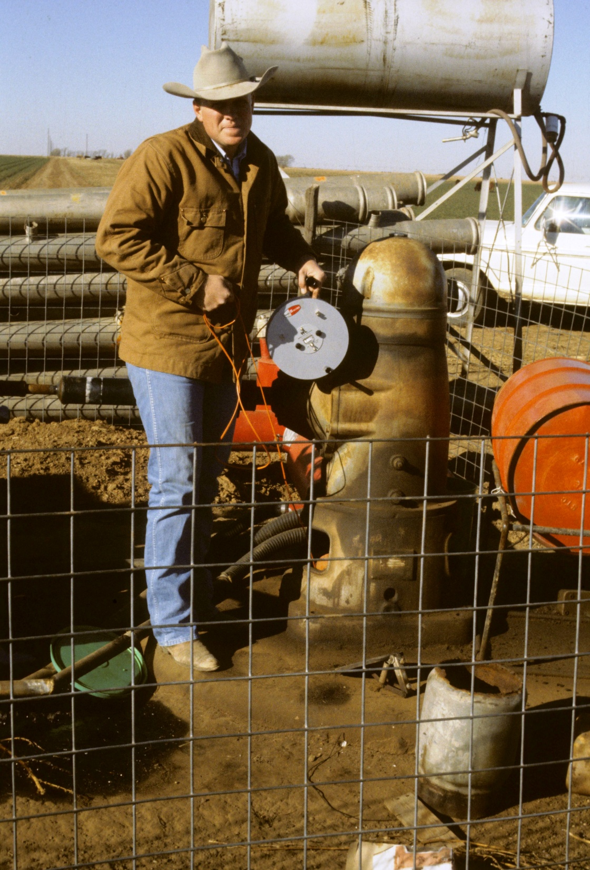
Notes:
using well sounder
Know where the pump is set before using gage. Sounder cable wrapped up in pump impellors reduces pump capacity significantly.

Slide 13
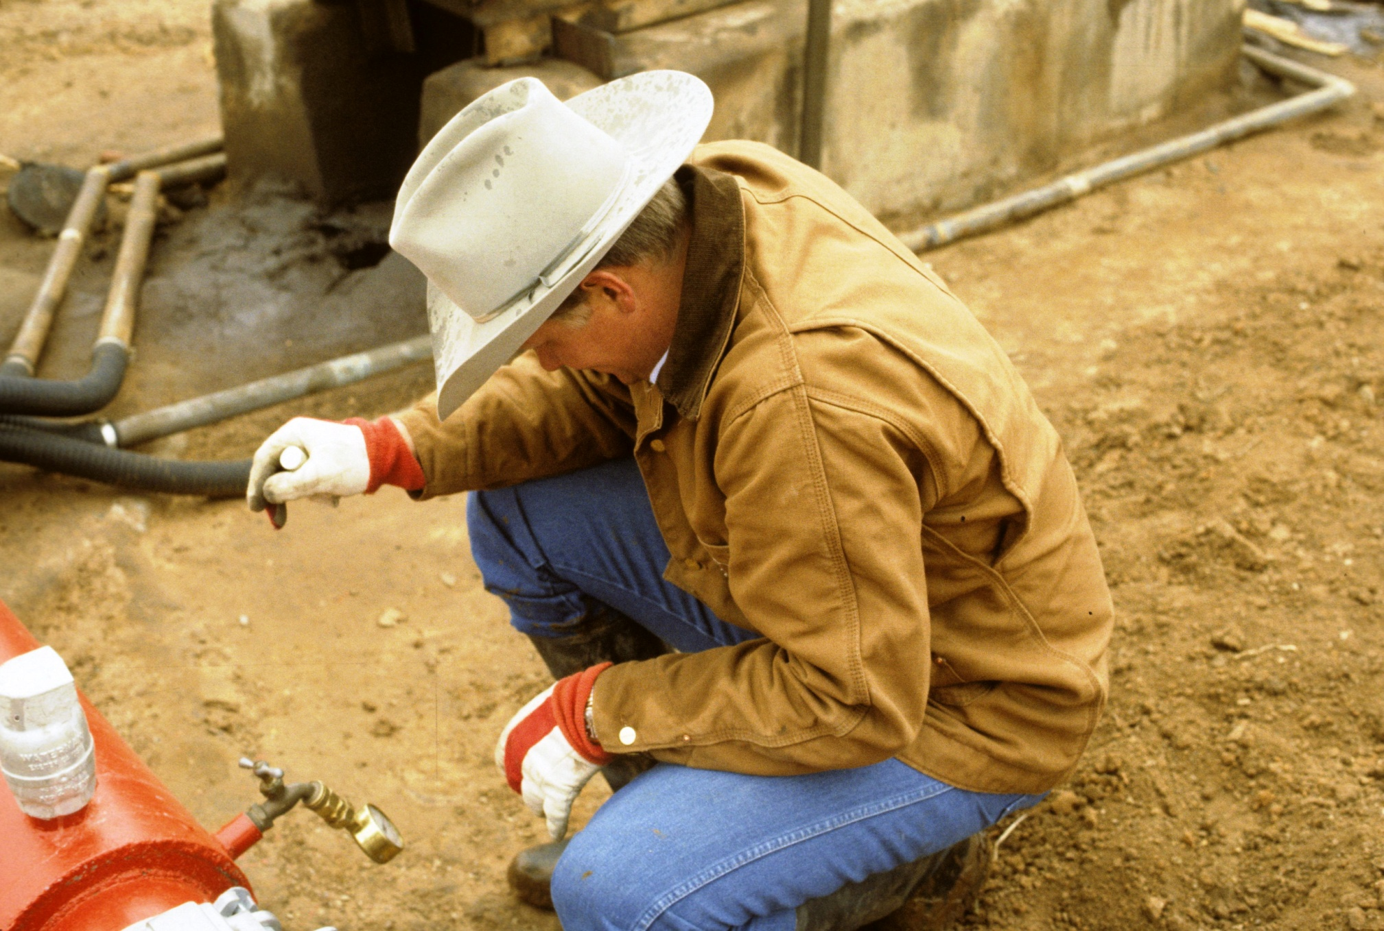
Notes:
Reading discharge pressure in psi

Slide 14
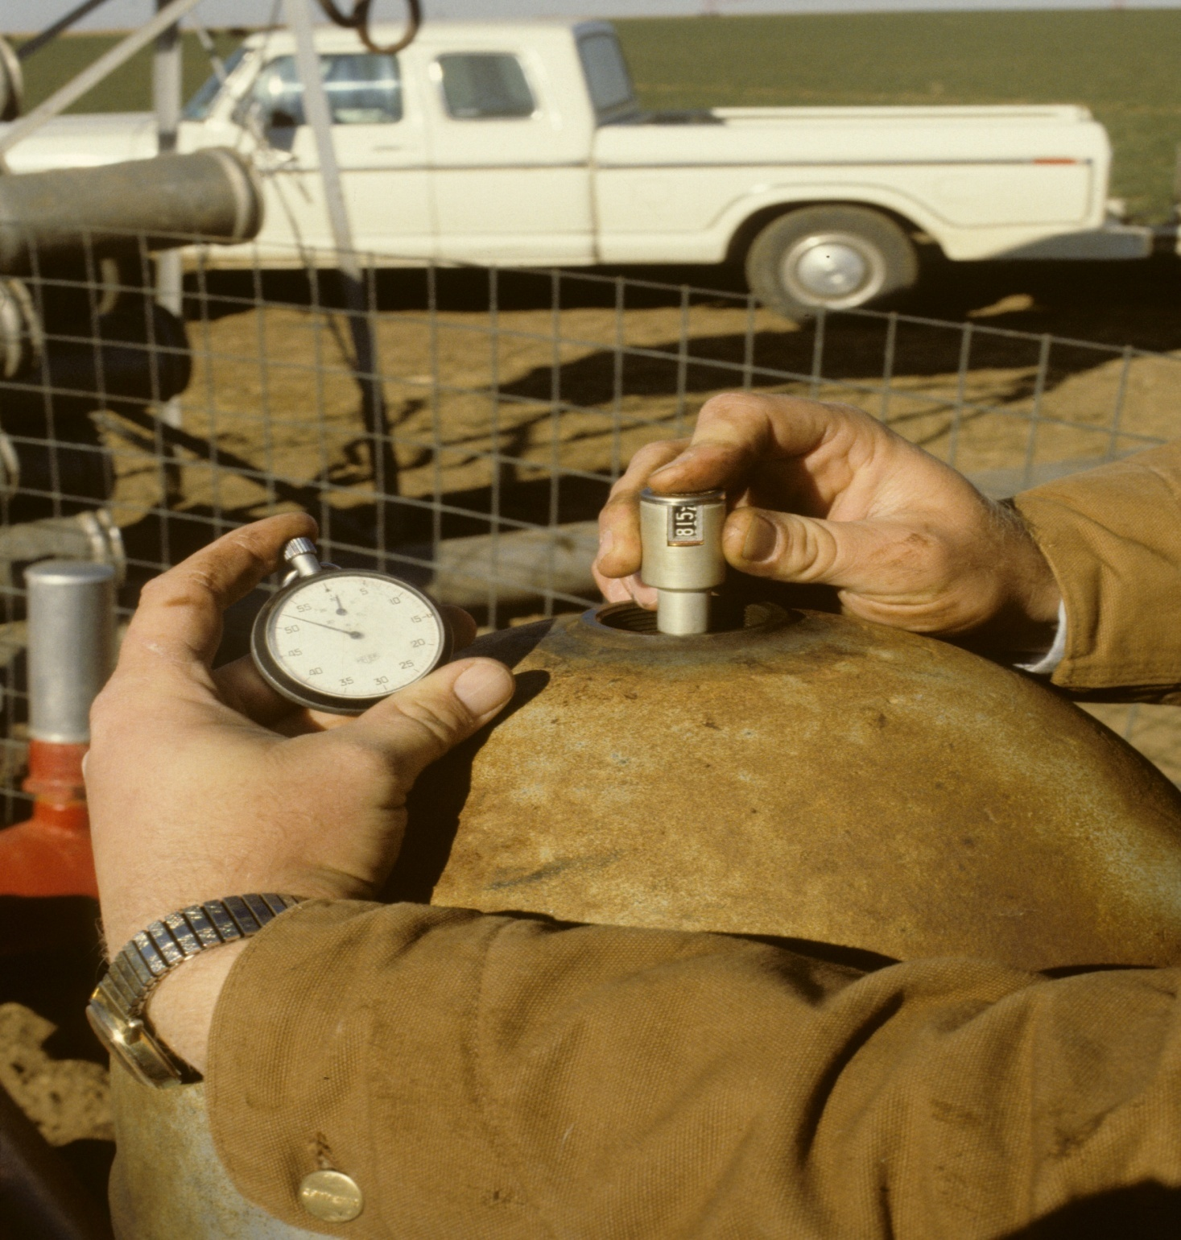
Notes:
Using counter tach with stop watch to get pump rpm.
Take right angle gear drive cover off, if cant reach shaft easily with tachometer. If you drop tachometer duck quick.
Gear drive ratio on right angle gear drive will give engine speed. Ratio = driver to driven , (engine rpm)/(pump rpm)

Slide 15
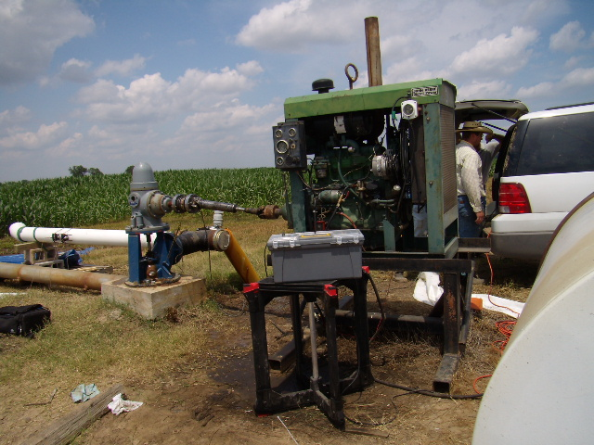
Pumping Plant Tests, Louisiana NRCS, 6/09
Notes:
Pumping plant Test in Louisiana 6/09
note flow meter sensors attached to discharge pipe
torque cell in line with drive shaft, instrument reading torque cell in back of vehicle.
diesel fuel meter plumbed in and meter index in tool box
One of most efficient pumping plants tested:
Engine and Pump RPM – 1374
flowrate - 1236 gpm
Diesel Fuel use - 1.37 gal/hr
Input HP – 72.8 HP
Output HP – 16.9 HP
Overall efficiency - 23.2%
Engine Efficiency – 33 %
Pump Efficiency – 74.1%
Right Angle Gear Drive - 95% (assumed)
@ $4.00/Gal diesel = $5.48/hr fuel cost to operate

Slide 16
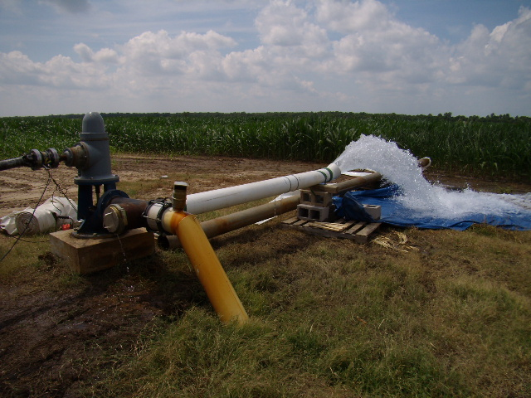
Notes:
during test

Slide 17
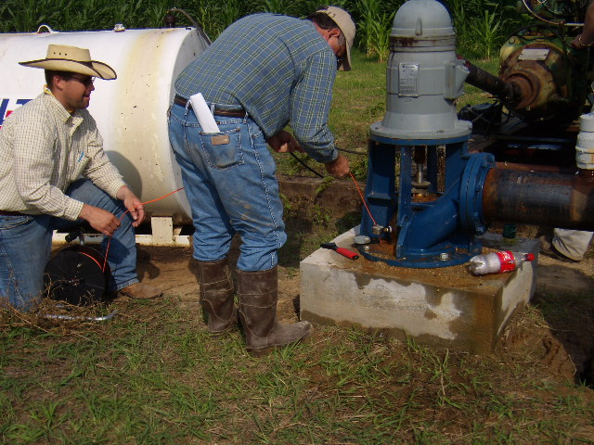
Notes:
measuring pumping lift (depth of water below surface) while plant is pumping water.
Note pressure gage attached to well head to measure discharge pressure (by sounder cable)

Slide 18
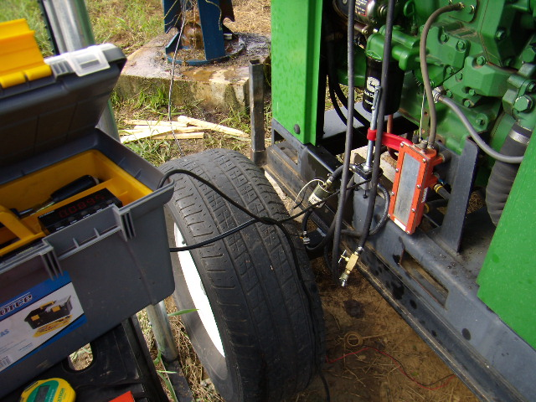
Notes:
diesel fuel meter is small silver box with black top being held in place on trailer frame with large C-Clamp.
Meter index is in toolbox.

Slide 19
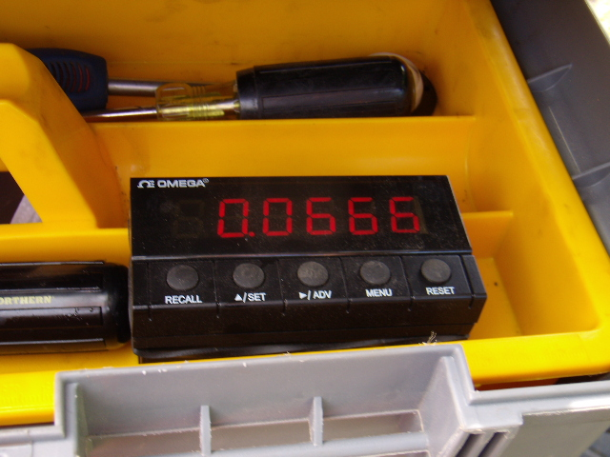
Notes:
diesel fuel meter index
I believe this one was read to read cumulative gallons. To get rate, stop watch timed differences in gallons were used => then average of multiple measurements were used to get fuel use rate.

Slide 20
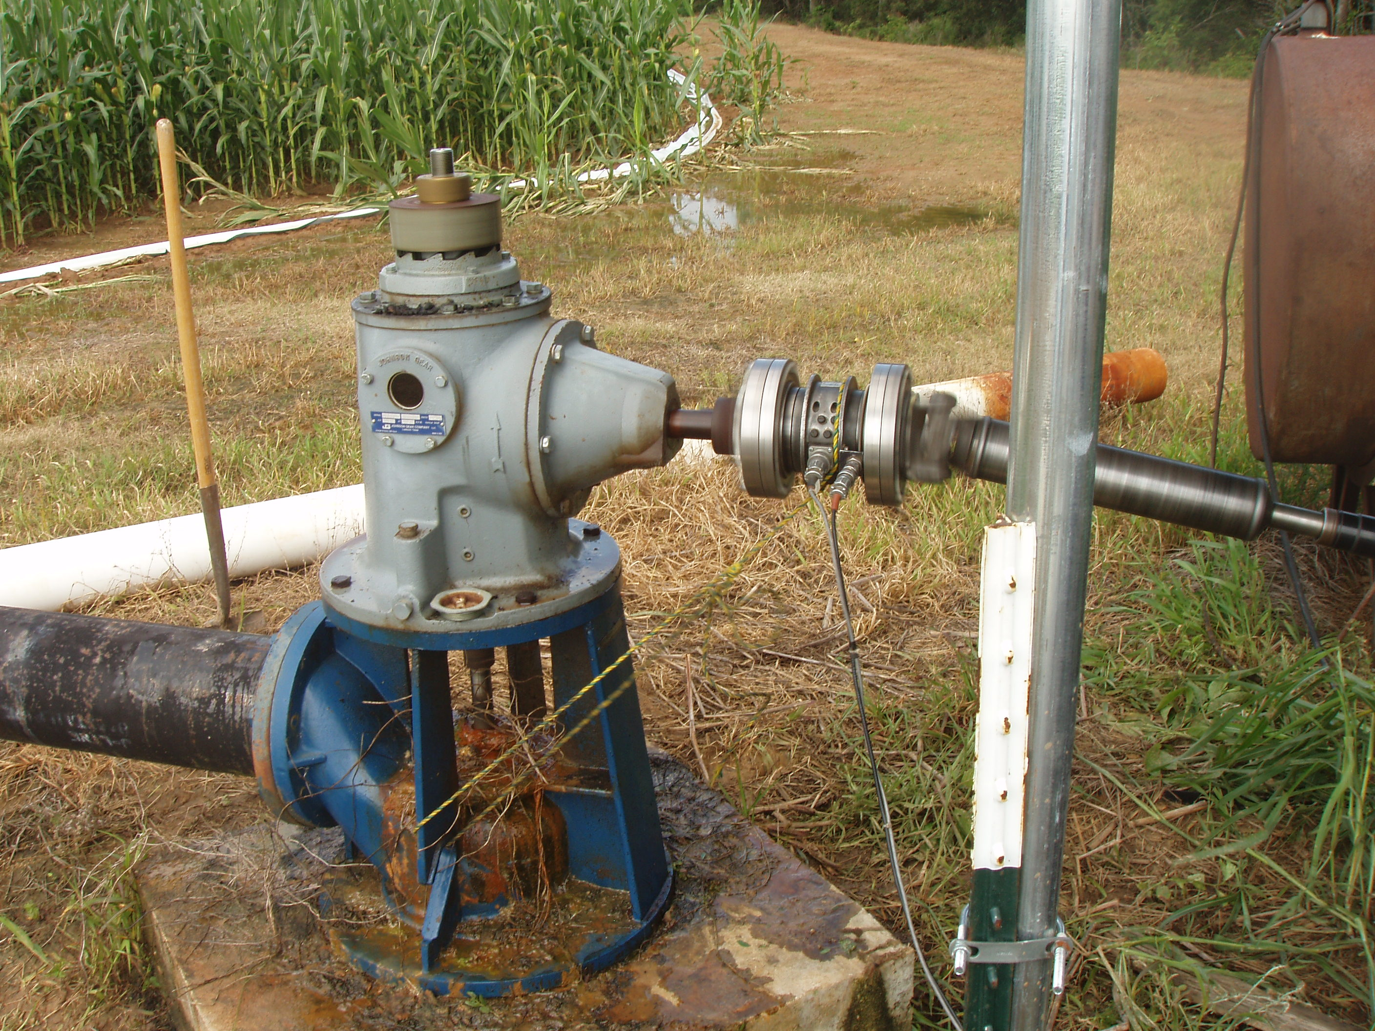
Notes:
torque cell in operation. Note drive shaft spinning and gear drive but torque cell exterior is stationary (see small poly rope holding it in place). Cover is off right angle gear drive to make rpm easier to measure.

Slide 21
Pumping Plant Efficiency (PPE) Evaluation Computations
Output or Water HP
  = Q (gpm)X TDH(ft)/3960
Input HP
  = fuel use (units/hr)/energy content of fuel (hp-hr/unit of fuel)
  1.34 hp-hr/kwh; 54.62 hp-hr/gal diesel
Overall PPE = Output HP/Input HP
Efficiencies expected vary with pumping plant components
  Standard Overall PPE electric pump plant =>68%,
  Standard Overall PPE diesel pump Plant =>23%
Compute actual costs and potential energy cost savings if pumping plant were brought to a standard PPE.
Notes:
Evaluation computations can be carried out using assumed or estimated data values to provide estimated energy use rates, seasonal values, and costs. Interviews will be required with producer to secure accurate seasonal application depths and or annual operating hours.
Before the producer spends a lot of money on repairs or modifications he would likely want an analysis based on measured values.
Actual field data input provide a more accurate assessment of field pumping plant performance.
TDH is head pump is working against = Pumping lift (ft) + Discharge Pressure converted to ft of head + column pipe friction (ft).
Column pipe friction is often neglected but in areas may be significant enough to require estimation and inclusion.
Standard Overall Efficiency = (Pump Efficiency- 0.75 )x (Motor eff. - decimal) x (Right angle gear drive eff - decimal) x (belt drive efficiency - decimal) x (100) = ___________ %
Standard overall efficiency is really a moving target based on the components in the drive system (and the features they have).
Nebraska Standard values for electric Pumping plants assume 75% pump efficiency, motor efficiency of 88%, no right angle gear drive, no belt and no drive (assume 1’s for any drive components not present) = 0.66 = 66 %. These values must be adjusted if additional components are present.
See National Engineering Handbook, PART 652, National Irrigation Guide, Chapter 12, Energy Use=> for information and discussion concerning Nebraska Performance Standards for irrigation pumping, Tables 12-2 and 12-3.

Slide 22
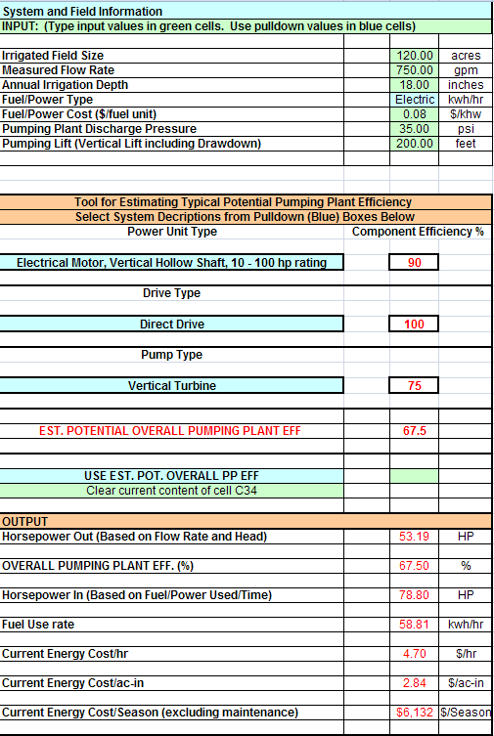
Notes:
Sheet 1. “EST_PPEff_N_getcost” of Spreadsheet “finalpumpplant_eval_and_energyuse_est.xls” => To Estimate Fuel or Energy Use Rate and Pumping Cost based on Nebraska Standard or User Input Pumping Plant Component Efficiencies. These computations are very simple and can be done by hand. If anyone would like blank data sheets contact Walker.
Sheet 2 is “Field Eval_N_GetCost” Use this sheet if you are conducting an evaluation and have measured field data.
This Spreadsheet can be downloaded from: https://nrcs.sc.egov.usda.gov/st/wntsc/coreteam/engineering/WME/energy/WQT03/default.aspx
These computations are very simple and can be done by hand. If anyone would like blank data sheets contact Walker.

Slide 23
Nebraska Performance Standards for Irrigation Pumping
None of values in WQT 03 are energy input values all are output values |  | Motor or engine output at nebraska standard power unit efficiency | Pump output at assumed 75% pump efficiency
Energy Source | Energy Unit | HP-HR/unit energy | Water HP -HR/unit energy
Diesel | Gallon | 16.7 | 12.5
Gasoline | Gallon | 11.5 | 8.66
Propane | Gallon | 9.2 | 6.89
Natual Gas | 1000 cu.ft. | 88.9 | 66.7
Electricity | kWh | 1.18 | 0.885
Divide field measured output values by table values x100 to determine percent potential energy reduction (hourly, annually, etc.)
Notes:
See National Engineering Handbook, PART 652, National Irrigation Guide, Chapter 12, Energy Use=> for information and discussion concerning Nebraska Performance Standards for irrigation pumping and Overall Pump Plant Efficiency, Tables 12-2 and 12-3.
This table was put together before everyone had computers. It is in my opinion currently unnecessary now and causes confusion. It is however simple to use if your pumping plant components are exactly like the assumptions made (components). Electric motor efficiencies of newer horizontal and vertical mount electric motors will likely be higher than the assumed 88 %. Submersible motors will be lower.
I did not have time to get the footnotes below added to the slide before the presentation. You can view the footnotes properly place on the reference Table 12-2 in the National Irrigation Gide, as well as, on the Pumping Plat Evaluation, WQT103 CSP Enhancement Fact Sheet.
These footnotes go on the Nebraska Performance Standards for Irrigation Pumping:
(1) Horsepower-hours is the work being accomplished by the power unit with losses considered.
(2) Water horsepower-hours is the work being accomplished by the pumping plant, engine or motor and pump, at the Nebraska Performance Criteria.
(3) Based on 75 percent pump efficiency.
(4) Taken from Test D of Nebraska Tractor Test Reports. Drive losses are accounted for in the data. (Assumes no cooling fan)
(5) Manufacturers' data corrected for 5 percent gear-head drive loss and no cooling fan. Assumes natural gas energy content of 1,000 Btu per cubic foot
(6) Assumes 88 percent electric motor efficiency.
(7) Direction connection, assumes no drive loss.

Slide 24
System Troubleshooting
System Troubleshooting:
  Overloading
  Underloading
  Worn pump
  Engine needs maintenance or service (tuneup)
  Power supply problems
  Fuel filter issues
  Fuel input pressure problems if natural gas
  Fuel leaks
Notes:
A. Possible Causes of System Problems and Low Pumping Plant Efficiencies:
1. Under loading natural gas engines.
Example: Moline 6 cyl. Pumping 85 gpm.
2. Overloading of electric motors.
Most common on pivots and submersibles.
3. Impellor adjustment may be needed. Caused by:
a. sand pumping => watch for sand on surfaces subjected to flow during test
or catch some water in a white bucket and see what settles.
b. farmer adjustment of impellors impellor adjustment should only be done by trained individuals.
Raising or lowering impellors inside bowls too much can severely damage impellors.
c. shaft tightening after pump installation
d. initial impellor adjustment may have been incorrect
4. Improper natural gas pressure at carburetor. Caused by:
a. pressure drop in gas line when multiple users being supplied by the same gas delivery line.
b. farmer adjustment of pressure regulator on gas meter. Engine runs too lean will burn valve. Gas delivery
pressure regulators have on occasion been tampered with in attempt to insure plenty of pressure.
If farmer has to disconnect gas line to start engine then replaces line this could be cause.
c. need 4- 6 oz/square inch at carburetor
3 - 5 lb/in2 w/ turbocharger
5. Improper timing, carburetor adjustment, or worn spark plugs
6. Gas leaks – sniff and listen when you can. Kill the engine and check if you show a very low efficiency.
B. Possible Errors in Data Gathering:
1. Incorrect gas or electric meter reading. Usually easy to spot on electric system; not so easy on natural gas systems.
2. You can run into problems when several wells are on one gas meter. Check discharge pressure with all wells running then run evaluation on one well at a time: putting the same discharge pressure on the running well that it had when all wells were running. Use a squeeze down valve to do this.
3. Water meter errors
a. insure all of underground line is full and flow has stabilized before taking readings.
b. watch for air in discharge flow or sand in discharge water.
C. Recognize situations which could effect accuracy of results and correct data
acquisition methods which will insure accurate results.
1. Well flow rate
a. Propeller meters
(1) Make sure pipe is full
(2) Make sure flow is stable – try to check at highest point of underground pipeline
(3) Don’t haul a propeller meter in back of pickup without propeller blocked, so it won’t turn. Wind going through meter turning propeller will wear out bearings.
(4) When measuring flow use odometer and stopwatch rather than needle.
2. Energy being used by pumping plant
a. Reading natural gas meter
(1) Time revolutions of test dial. This will be the one which is 10, 5, or 2 ft3/ rev.
(2) Be aware that a pressure correction factor may be needed to get an accurate measurement.
Pressure correction factor = Gage (psi) + Atmos. pressure (psi)
Calibration pressure (psi) + Atmos. pressure (psi)
(3) If a farmer or gas company starts talking about dekatherms or dekatherms, call me. jdw
b. Reading electric meter
(1) Time 10 revolutions of disk
(2) Record Kh
(3) Additional multipliers that will more often be present on larger motors (maybe 40 hp) and over
(a) CTR – current transformer ratio – 200:5
(b) PTR – potential transformer ratio – 4:1
(4) Use equation on forms to calculate Kwh/hr.
3. Total head pump is working against
a. Pumping lift measured with draw down gage
(1) Types of draw down gages
(a) airline
(b) electric
(2) Get easement form signed.
(3) Know where top of pump is
(4) Be sure you are in the right hole.
(5) Copper tubing bender spring and washer to protect sliding tags.
(6) Well Gremlins
(7) If you get one hung, tie it off and leave it there – do not break the line.
(8) Techniques of lowering line. Beware cascading water and oil on water surface.
b. Discharge pressure
(1) Pressure gage on faucet x 2.31 = ft of head.
(2) Feel of stand pipe and measure
(3) If felling stand to get discharge pressure watch for air entrapment in stand if capped
c. Column pipe friction
(1) Estimate
(2) Use friction tables
d. Total head = Pumping depth (ft) + discharge pressure (ft) + column pipe friction.
4. Pump rpm – measure with counter tachometer – be careful.

Slide 25
System Modification\Upgrades
If system is below standard efficiency, try everything possible above ground first.
  Maintenance/tune up,
  Discuss possibility of power supply problems with utility supplier,
  Electrician to check system and verify current to each leg of 3 phase system.
  For internal combustion engines , torque cell test should be considered before pulling pump.
  Discuss pump performance with pump supplier
  Check impeller adjustment especially if pump is fairly new and not performing as expected.
System may perform above standard efficiency
Notes:
If pumping plant efficiency is below standard for the components present, do everything possible above ground first. This is especially important when working with deep well turbine pumps. It can take a significant investment to pull a pump out of the hole and put it back again. This cost would be over and above any cost for repairs or upgrades.
Operator would want to conduct any postponed maintenance and/ or tune ups, and rerun test before taking next step.
On electric powered systems discuss possibility of power supply problems with utility supplier,
Electrician can check system and verify current to each leg of 3 phase system is balanced.
On systems employing internal combustion engines if a torque cell was not used to split the pump and engine to isolate where the
problems are seek a source of that service and rerun the test with a torque cell.
Discuss pump performance with pump supplier, determine age and compare actual with available pump curves.
May need to check impeller adjustment especially if pump is fairly new and not performing as expected.
Several states have Irrigator’s Pocket Guides that provide detailed Equipment Maintenance check lists (Montana, Oregon, probably others). These are excellent sources of information.

Slide 26
The End

