Slide 1
Part II - Pathways to Energy Conservation in Irrigation
Hamid Farahani, PhD
Water Management
NRCS-East NTSC, Greensboro, NC

Slide 2
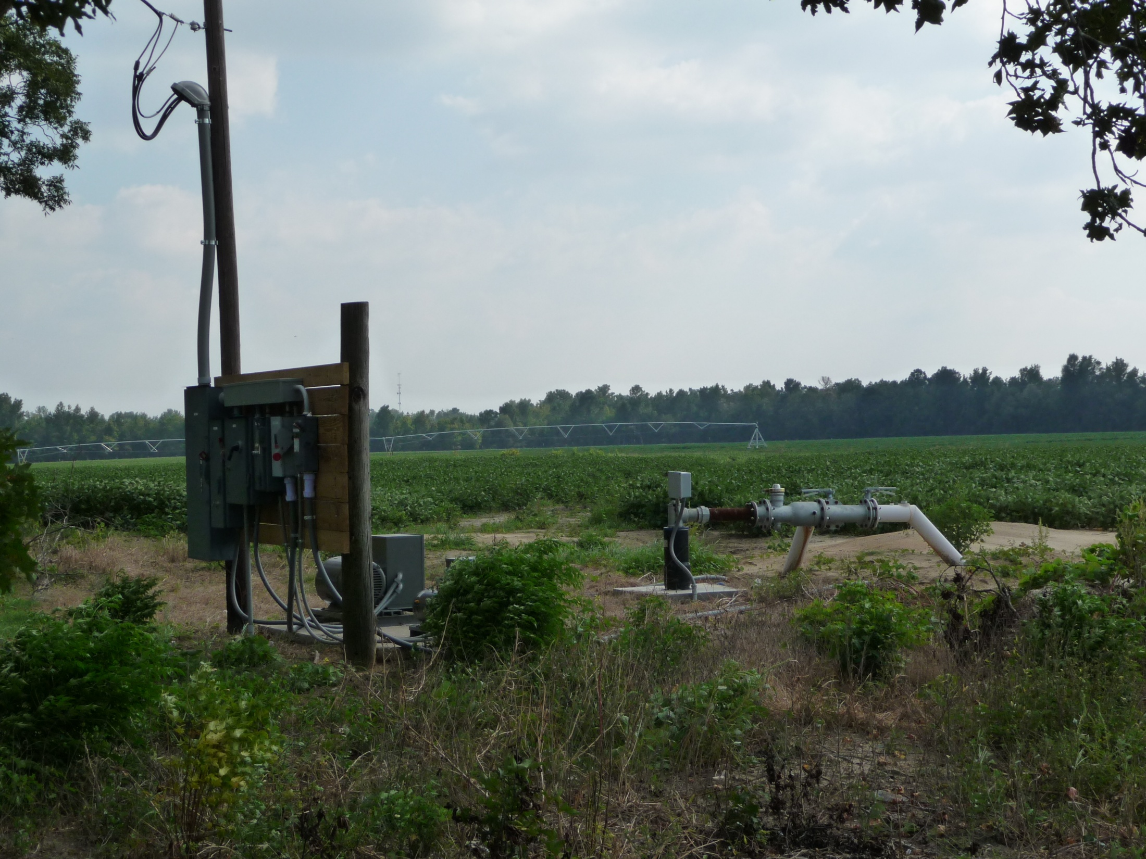
Pathways to Energy Conservation in Irrigation
Improve System Performance
Enhance Management
Energy source
Pump & Motor
Pivot 1
Supply lines
sprinklers
A Continuous System
Water at the discharge nozzle is physically connected to the impeller in the well some 100s or 1000s ft away.
Change in one part of the system could easily affect performance or conditions at other parts.
Notes:
Picture shows a typical center pivot irrigated land in Southeast USA.
Pathways to energy conservation in irrigation systems can originate from Improved System Performance and/or Enhanced Management as discussed in the following slides.

Slide 3
Pathways to Energy Conservation in Irrigation
Energy use is primarily a function of:
Water flow, Pressure, and Operating time
  Management decisions to reduce operating time, flow, or pressure directly reduce energy use.
  Better equipment (pumps, pipes, motors, VFD, engines, sprinklers, etc) improves energy efficiency (reduces energy use).
Changes to when energy is used or what energy source is used can reduce energy use and save money.
Source: Published article by Dr. Blaine Hanson at UCDavis
Notes:
Energy use in irrigated agriculture is primarily a function of changes in three variables:
Water flow
Pressure
Time
Management decisions that lead to reduced operating time, water flow, or pressure directly Reduce Energy Use.
Use of better equipment (pumps, motors, VFD, sprinklers, etc) Improves Energy Efficiency to Reduce Energy Use.
Changes to when energy is used or what energy source is used can reduce energy use and save money.
As summarized by Dr. Hanson: “Many times, only one or the other can be done (but we suggest saving both energy and money).”

Slide 4
Pathways to Energy Conservation in Irrigation
Increase the Efficiency of the Pumping Plant
Remember: This may increase flow, pressure, or even input HP
Reduce Quantity of Water Pumped (reduce flow and/or time)
  Water management (scheduling), change type, deficit irrigation
Reduce Irrigation System Pressure
Renozzle to lower pressure (may need to modify pump)
Increase System Performance (reduce quantity pumped)
Correct non-uniformity, leaks, worn/missing nozzles
Manage Time of Use (reduce unit cost of energy)
Convert and Use Different Energy Source (diesel to electric)
Notes:
Slide lists major pathways to energy conservation in irrigation systems.

Slide 5
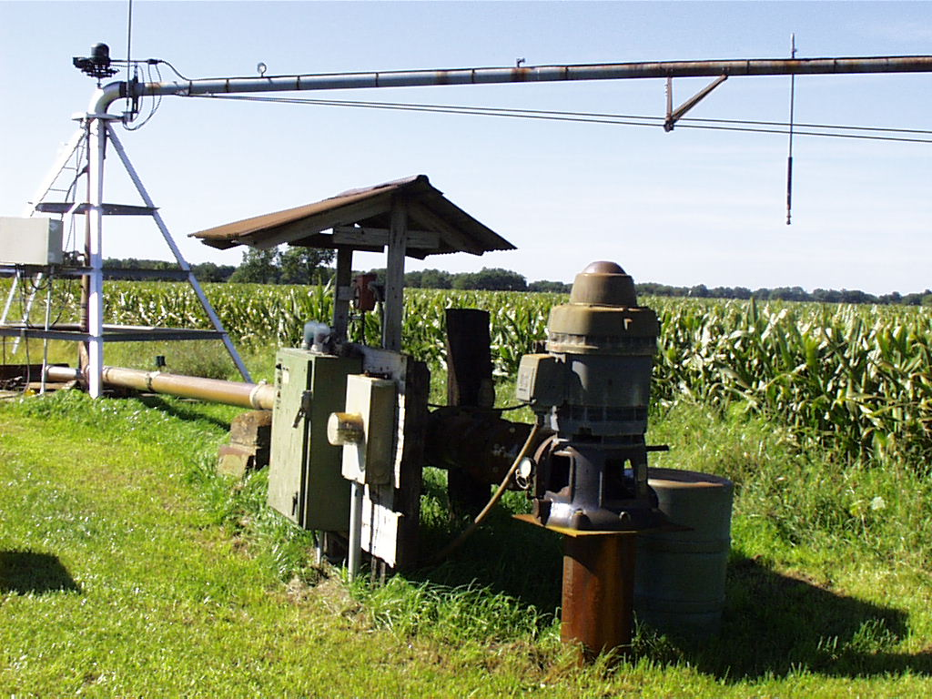
Pathway 1: Increase the Efficiency of the Pumping Plant
See Presentation by Jerry Walker
Notes:
Increasing the efficiency of the pumping plant is a potential pathway to reduce energy use in many irrigated farms. For a detail presentation, see presentation by Mr. Jerry Walker.

Slide 6
Overall Pumping Plant Efficiency
For electric motors: Wire to Water Efficiency
Output Water Horsepower
Overall Efficiency = -----------------------------------------
Input Motor Horsepower
Q x TDH
Overall Efficiency = -----------------------------------------
3960 x Input HP
Need:
Capacity (flow rate, Q), TDH (lift + discharge pressure), and Input horsepower
Notes:
At a minimum, determine overall efficiency and look up guidelines by NE Performance Criteria

Slide 7
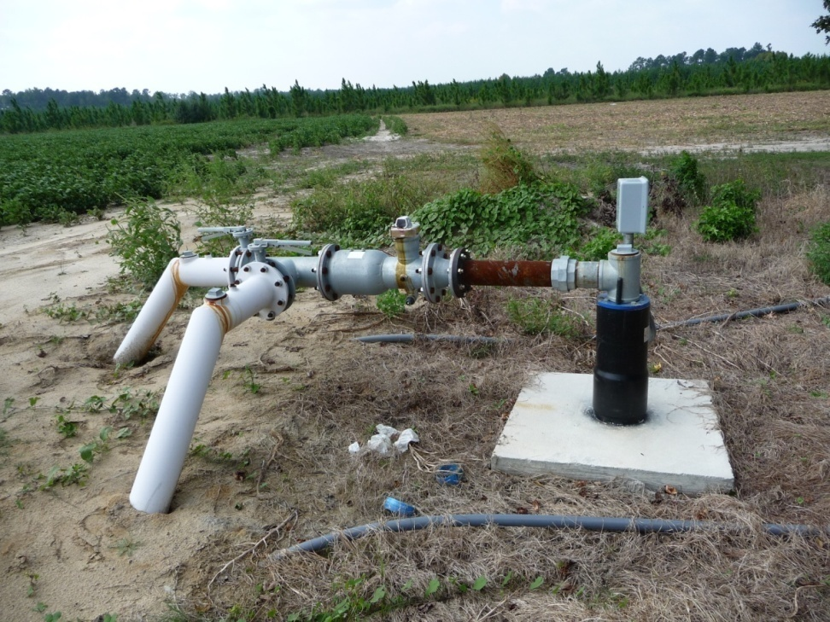
Challenges in pumping plant evaluations: Lack of data, gauges, and meters
No meter or pressure gauge
Serving two irrigation systems: Potential for variable operating conditions (Consider VFD)
Notes:
Slide alerts to challenges in performing preliminary pumping plant tests. It also shows a pumping station in Southeast USA without any meter or other gauges installed. Also note that the pumping station services two irrigation systems (two conveyance pipes). This is a potential source for variable operating conditions for the pumping station, especially if the systems have a different flow requirements. VFDs (variable frequency drives) are useful additions in electric systems to adjust motor speed as flow demands change.

Slide 8
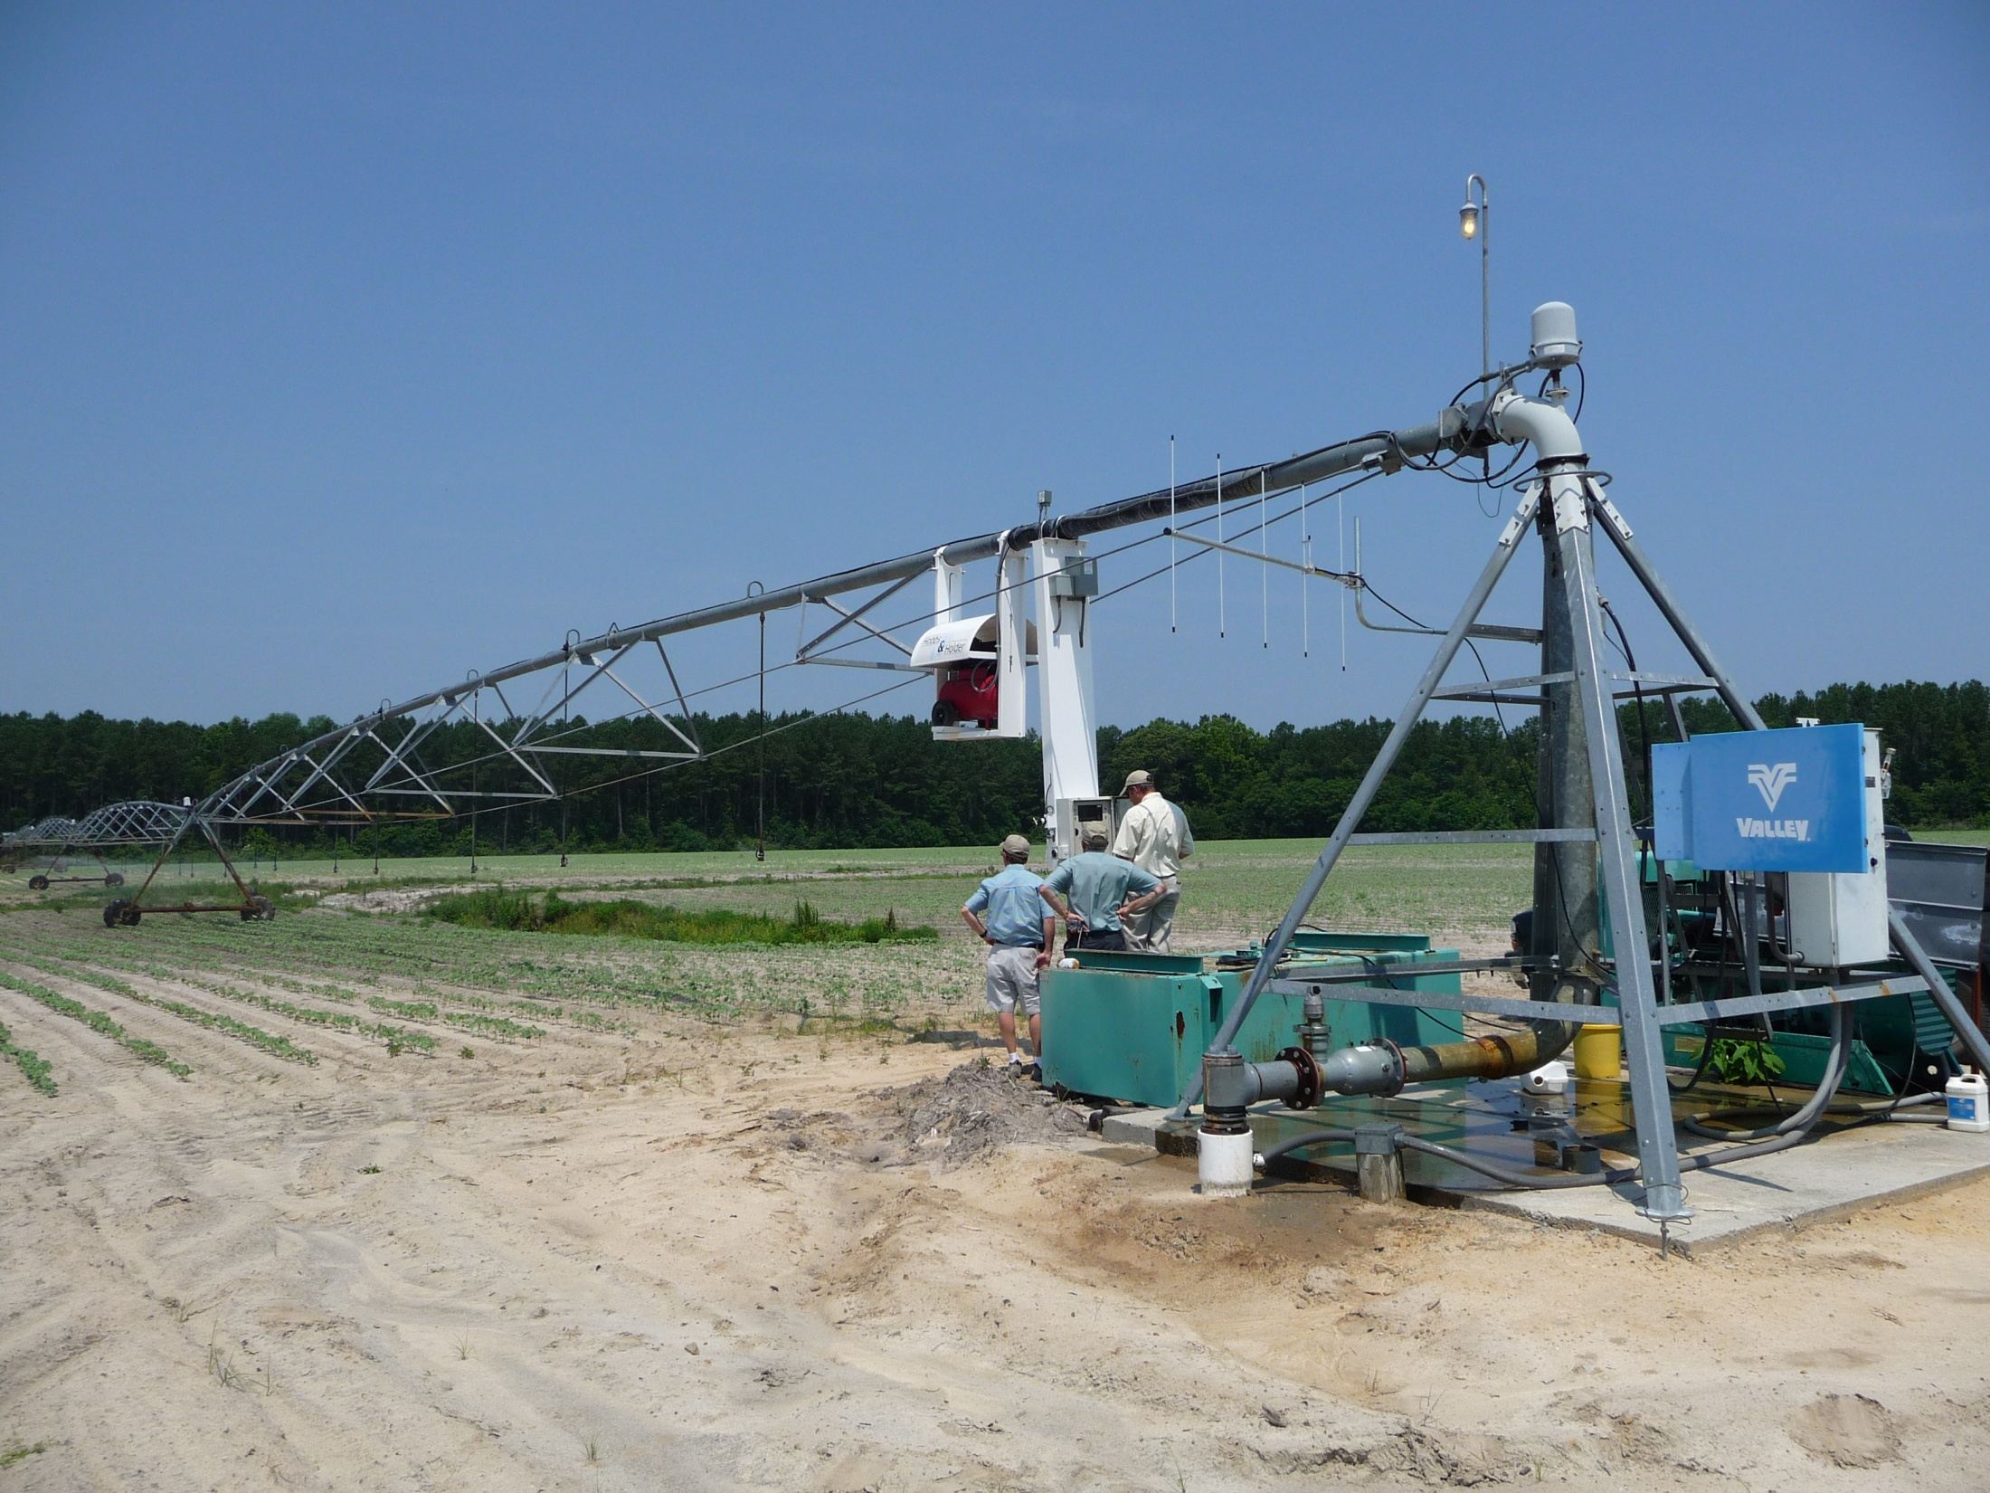
Pumping plant
Notes:
Another center pivot field in the Southeast USA

Slide 9
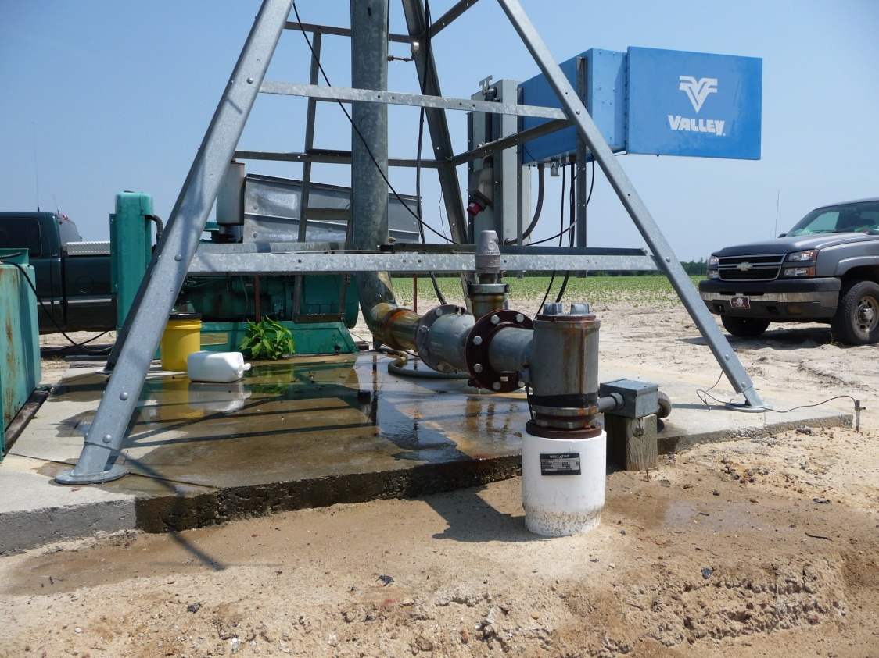
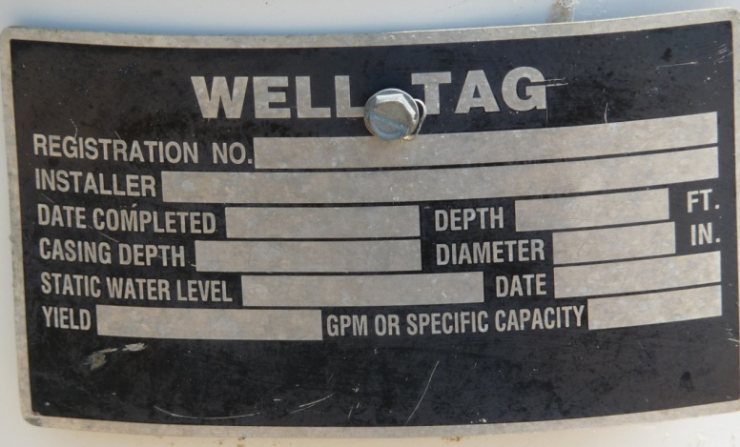
Pressure gauge
No Meter, no info on well tag (submersible)
Notes:
Note missing info on the well tag and lack of other sensors such as a flow meter

Slide 10
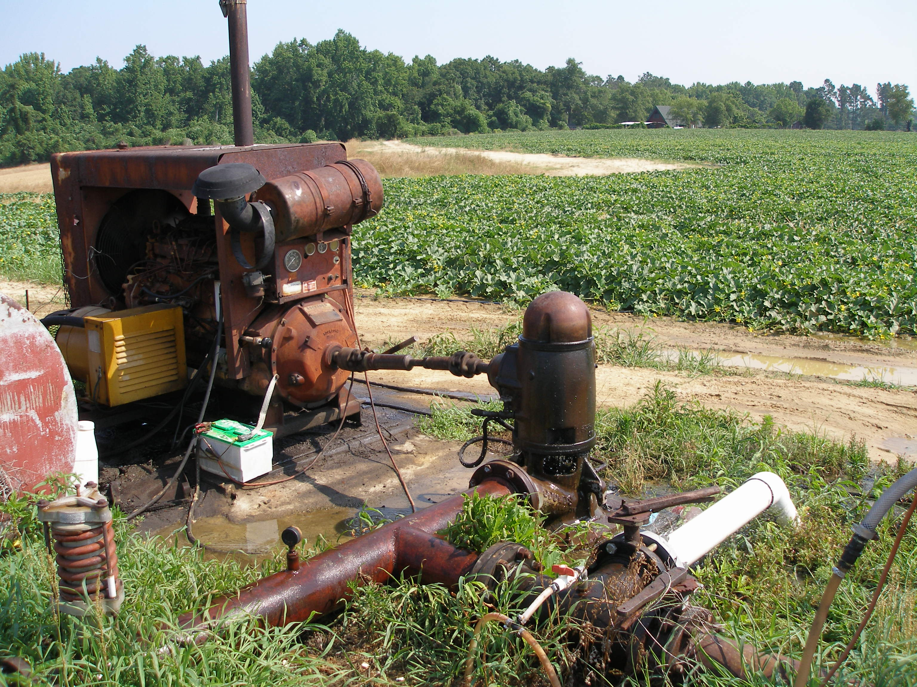
Diesel operated pumping plants – A major challenge to pumping plant evaluation

Slide 11
Quiz
Does improving overall pumping plant efficiency save energy ($)?
Yes
No
Not always
Notes:
Couple of cases where increased efficiency does not translate to energy conservation:
1) Pumping hrs did not change, why flow increased.
2) TDH increased significantly (excess drawdown caused by increased flow)

Slide 12
The answer is Yes and No, depending on who you ask!
Consider a case example in which efficiency was increased via pump impeller adjustment:
Capacity Head efficiency Input HP
gpm feet % hp
Before ……….. 605 148 54 42
After ……….. 910 152 71 49
Before ………… 605/42 = 14.4 gpm / hp
After ………... 910/49 = 18.6 gpm / hp
More Power per Watt-Hour
Why does the farmer think he is paying more for energy?
Source: Dr. Blaine Hanson publication at UCDavis
Notes:
The case example shows that adjusting pump impellers increased flow, TDH, efficiency, and even input HP. Does this mean energy will be saved after the pump was improved?

Slide 13
Continue - Consider a case example in which efficiency was increased via pump impeller adjustment:
Before adjustment:
Irrigator ran the system for 12 hrs and pumped 605 * 12 * 60 = 436,000 gallons
After adjustment: (no change in irrigation management)
Irrigator ranthe system for 12 hrs and pumped 910 * 12 * 60 = 655,000 gallons
Farmer used 50% more water after.
Irrigator only needed to run the system for 8 hrs to get the same amount of water as before.
Farmer could have saved 4 hrs of energy, or a reduction of 33% in energy cost.
Notes:
Watch for increased capacity and hrs of operation as they can not be set the same for before and after the operation and still save energy.

Slide 14
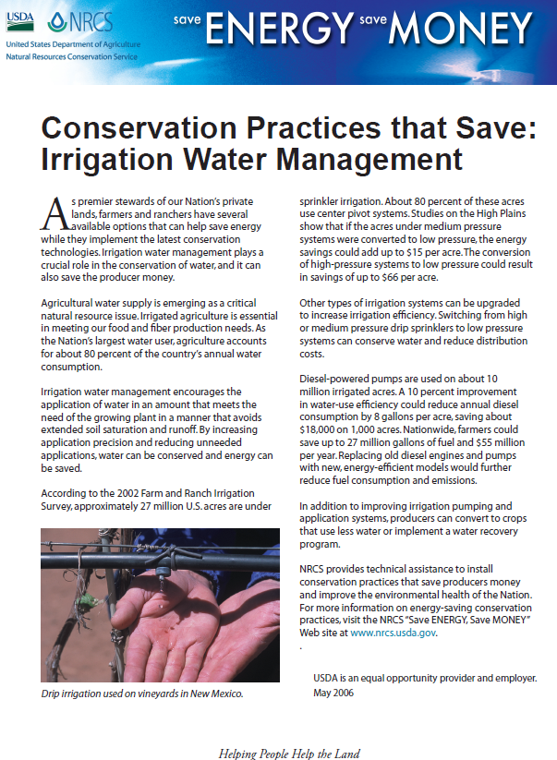
Pathway 2: Reduce Quantity Pumped
Problem: Over-irrigation and irrigation at regular intervals and in routine amounts.
Need: Irrigation water management (scheduling) strategy to reduce waste.
Solution: Irrigation scheduling encourages the application of water at the right time and in an amount that meets the need of the growing plant.
Crop growth and soil moisture monitoring methods of scheduling can be used.

Slide 15
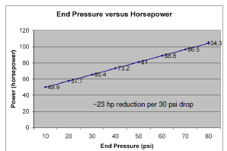
Pathway 4: Reduce System Pressure
I.E., Re-nozzle to low pressure spray or LEPA
Source: Published article by Dr. Blaine Hanson at UCDavis
Notes:
Large pressure reductions (i.e., change in sprinkler package) could result in large energy savings via reduced operating pressure reductions

Slide 16
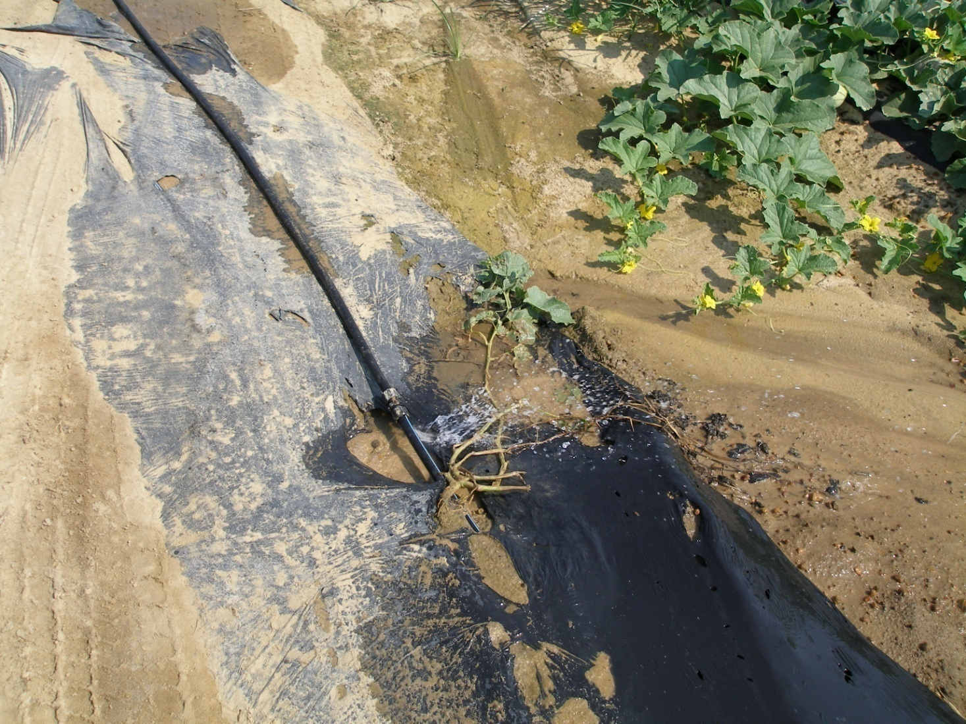
Pathway 4: Increase Irrigation System Performance
Non-uniformity and leaks increase energy use by increasing pumping volume
Notes:
Correct non-uniformity, leaks, and other system deficiencies that cause waste of water and pressure

Slide 17
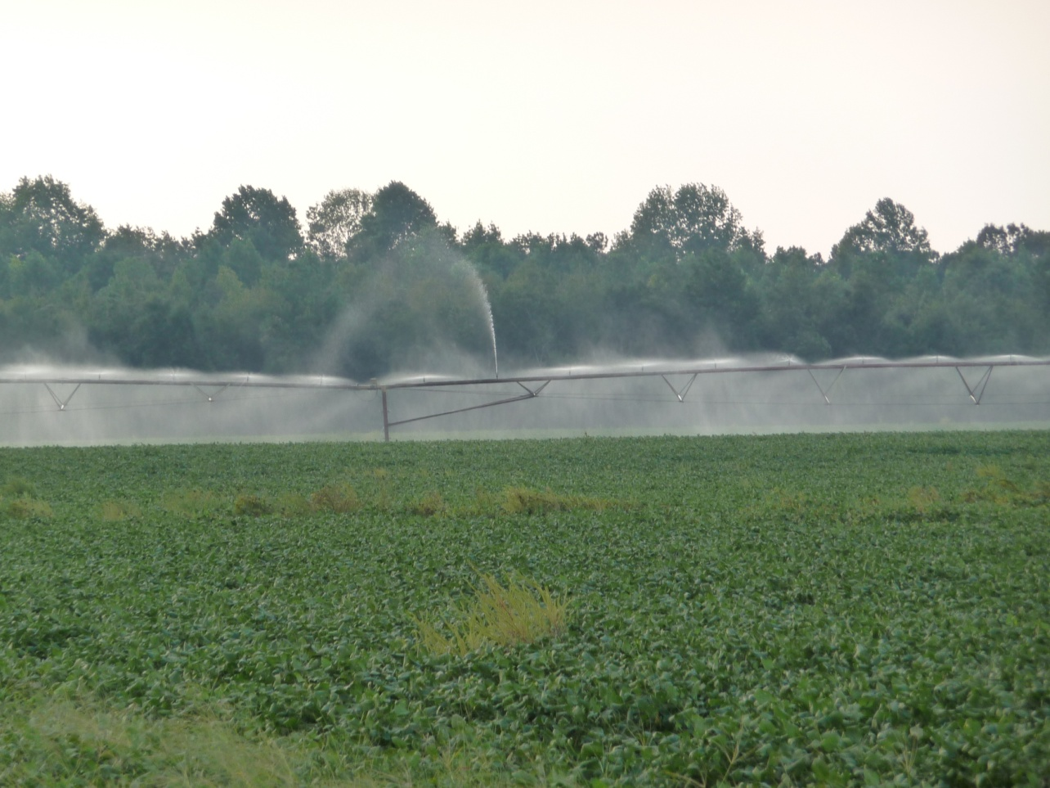
Worn, missing or wrong size sprinklers and leaky boots increase energy use by increasing pumping volume

Slide 18
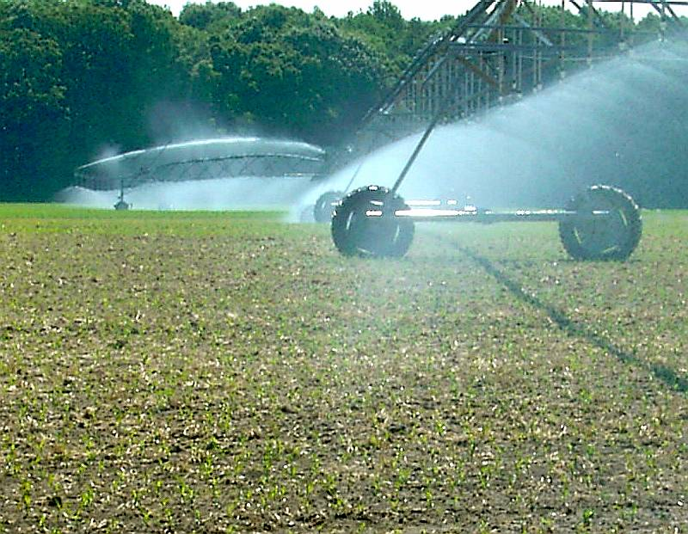
Uniformity
Notes:
Slides borrowed from Dr. Ian McCain (Formerly with University of Delaware)
Effect of non-uniform water application is shown by excess leaching and thus waste of water and energy for pumping

Slide 19
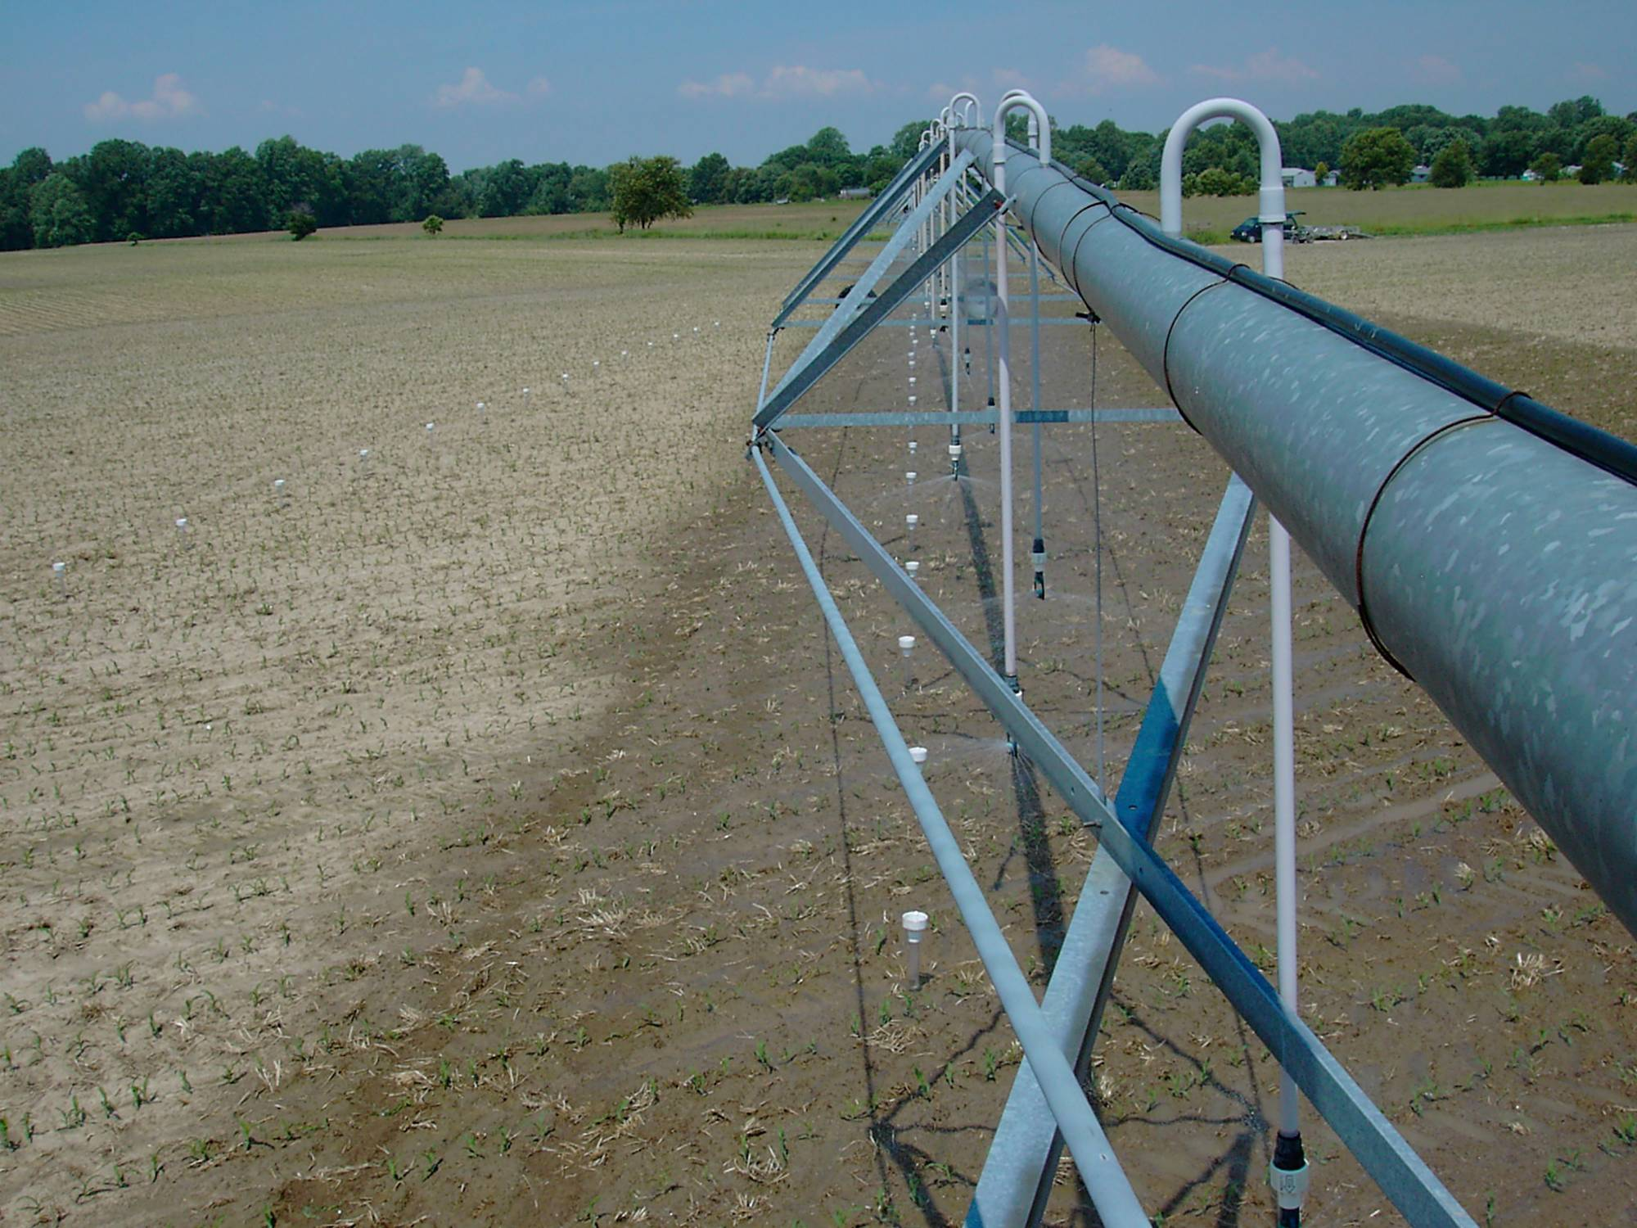
Notes:
Catch can tests can help detect non-uniformity

Slide 20
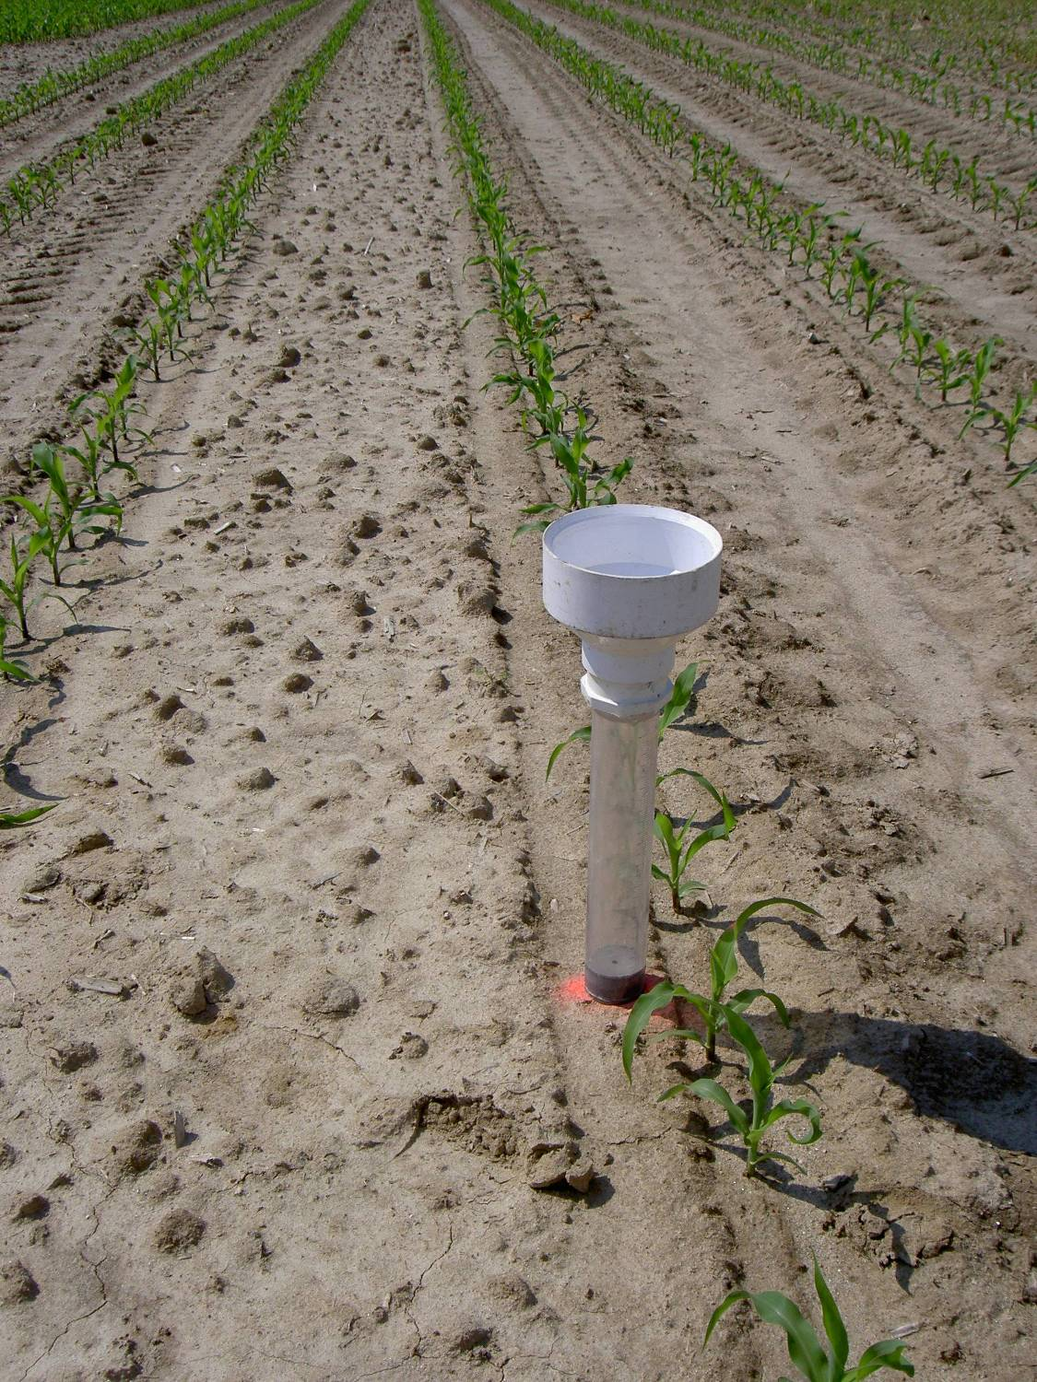
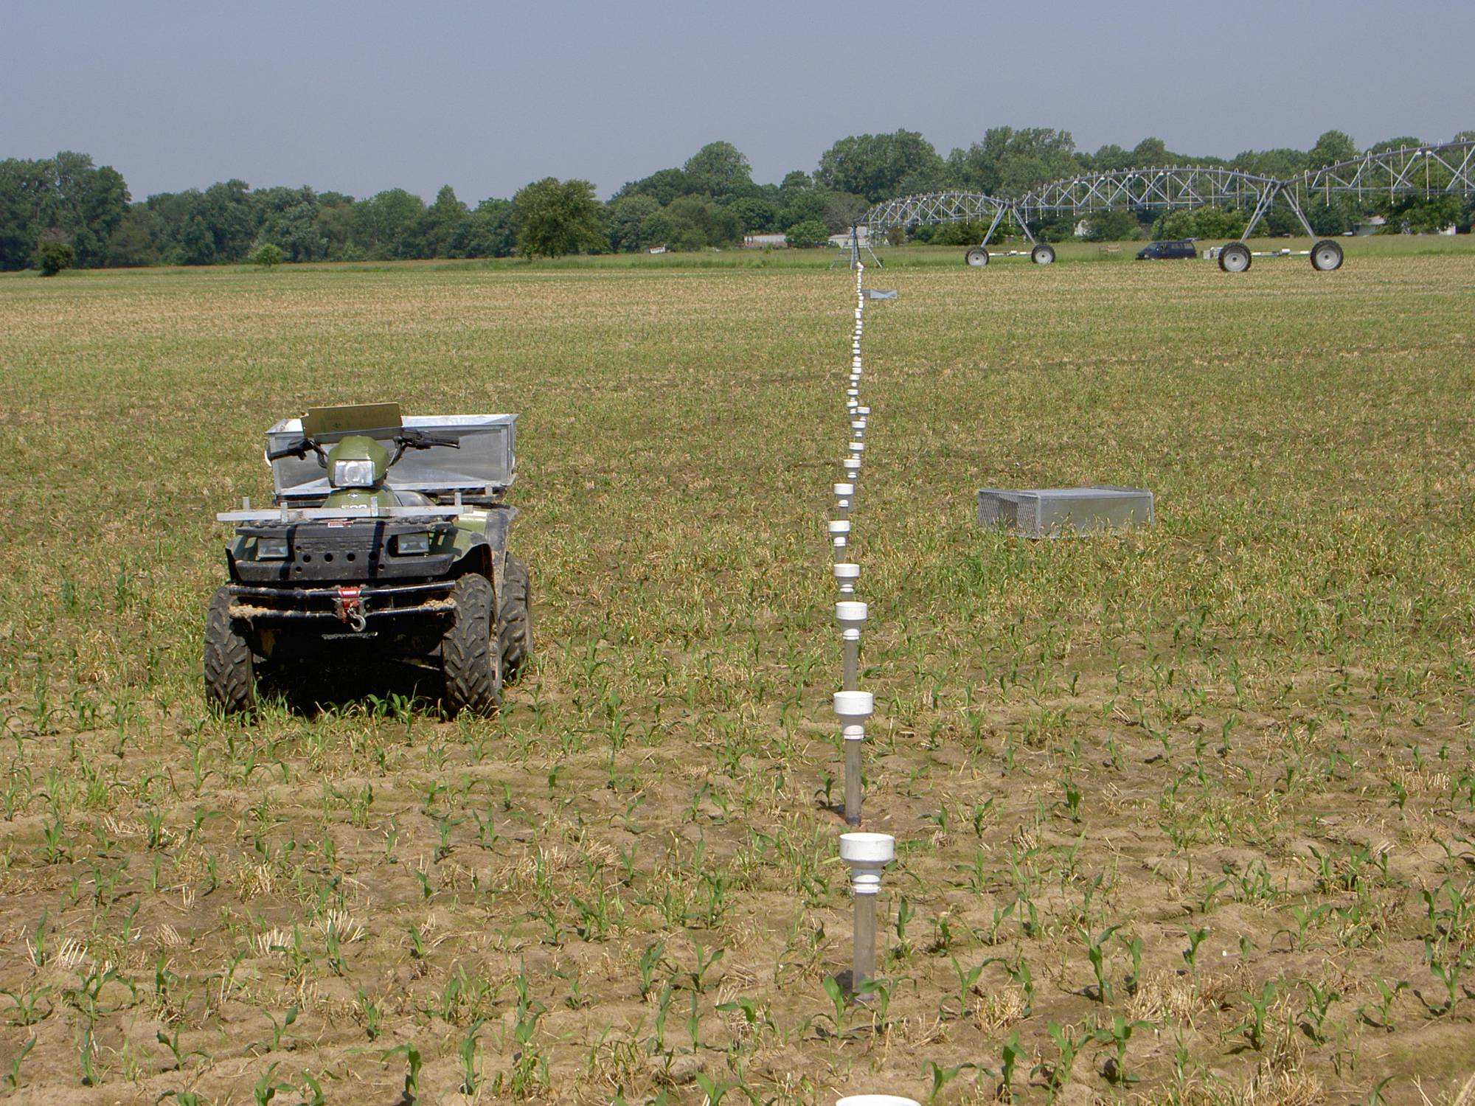

Slide 21
Coefficient of Uniformity (CU): 94%
Dr. Ian McCain, Univ. of Delaware

Slide 22
Coefficient of Uniformity (CU): 69%
Dr. Ian McCain (Formerly with University of Delaware)

Slide 23
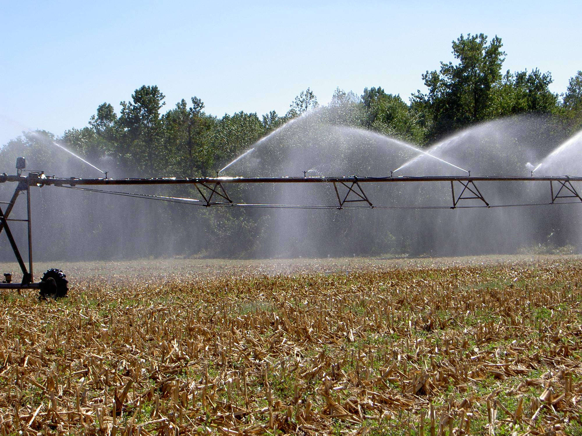
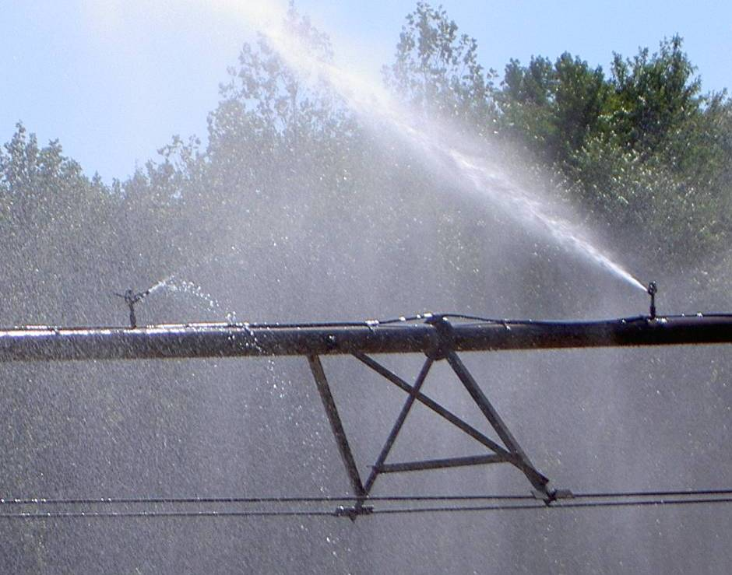

Slide 24
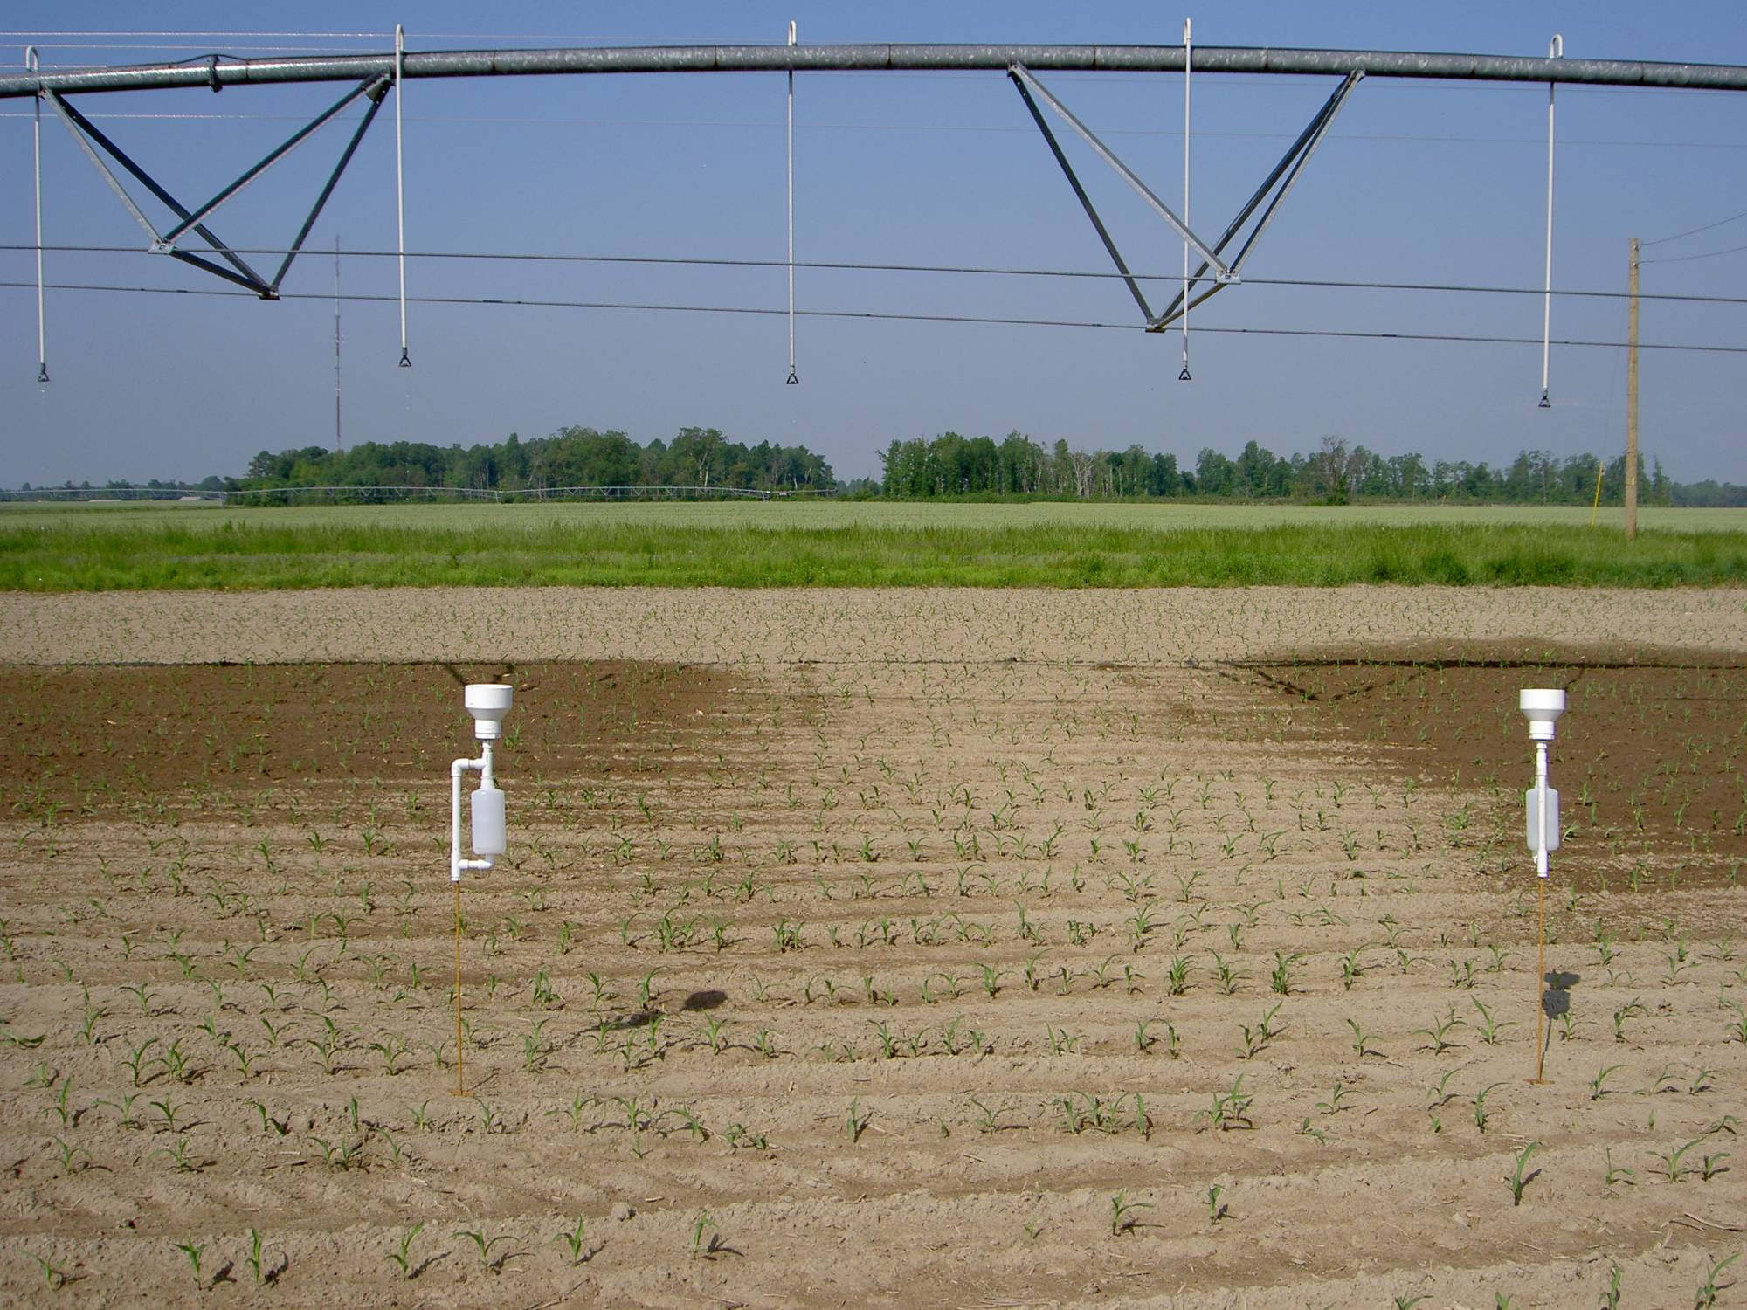
Dr. Ian McCain (Formerly with University of Delaware)

Slide 25
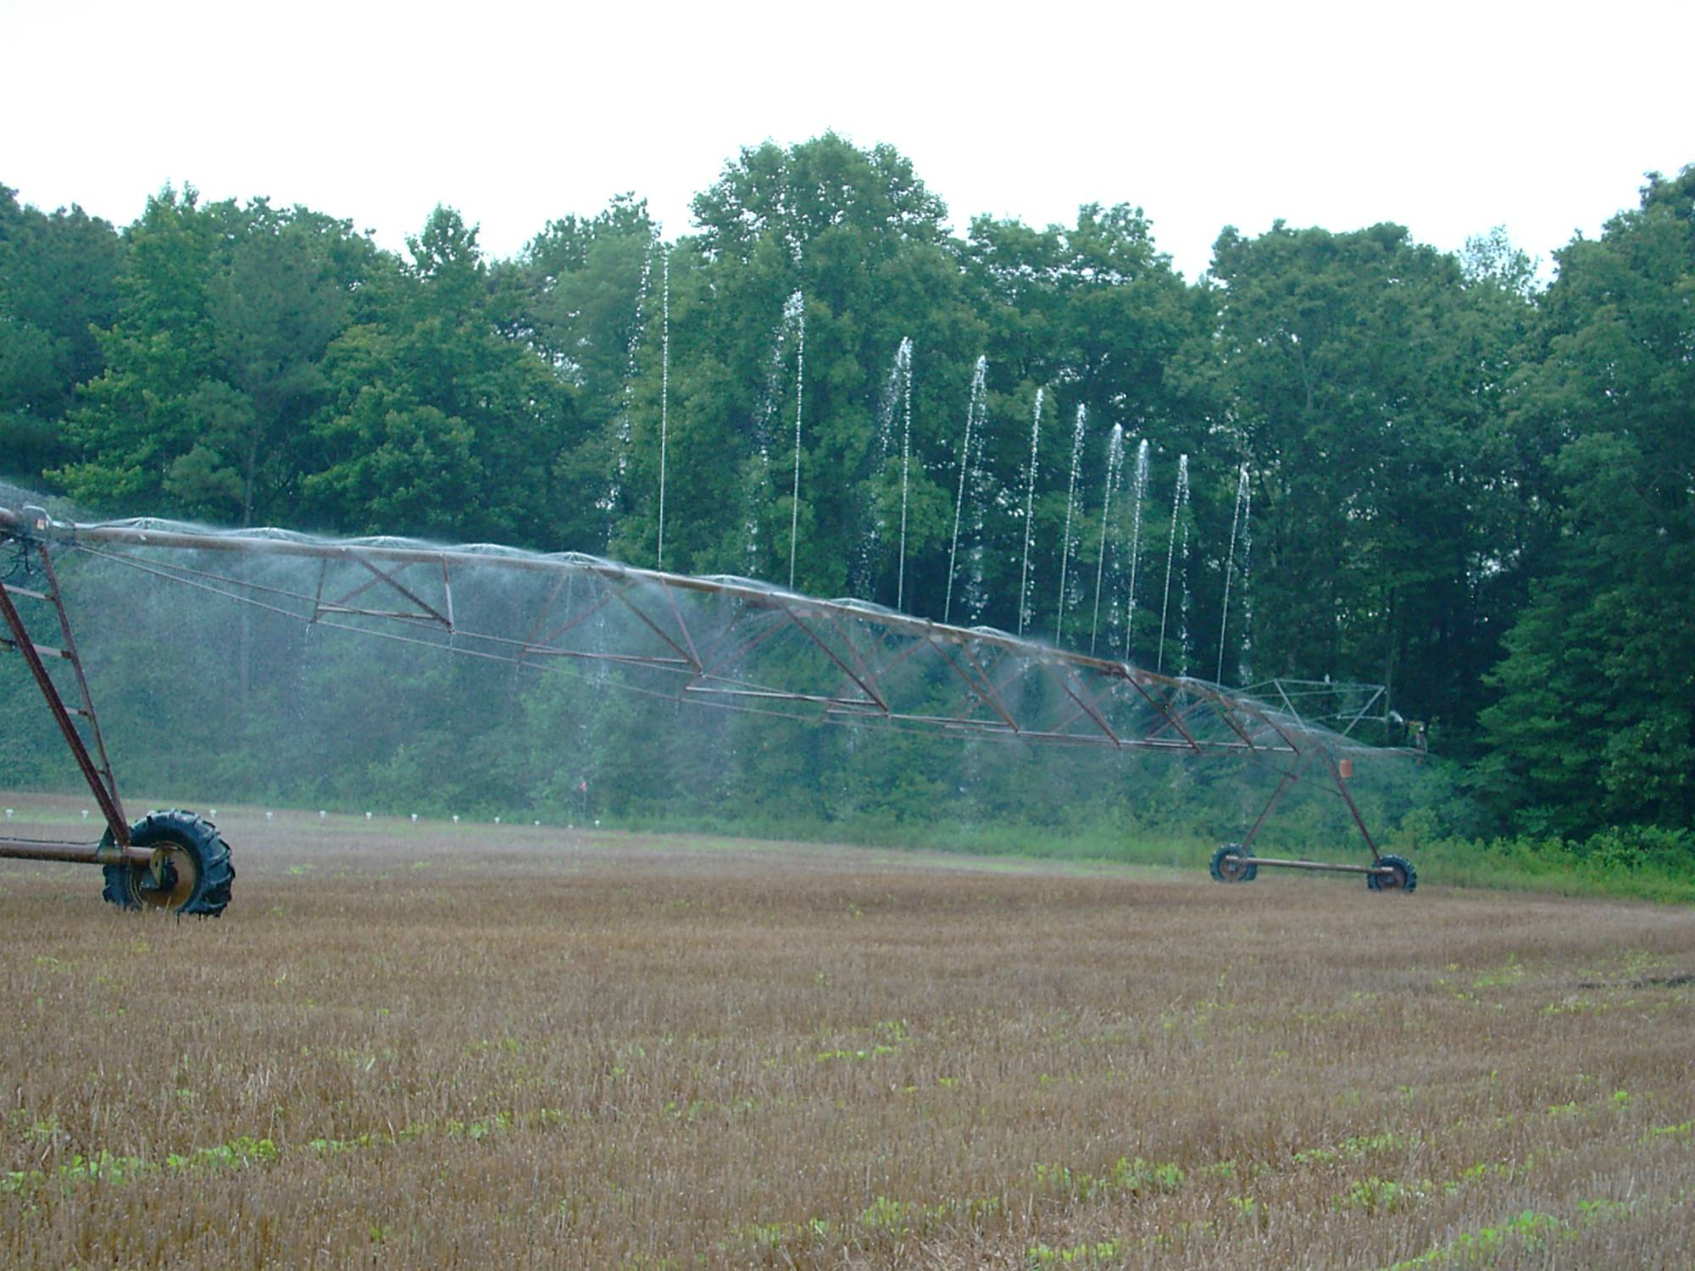
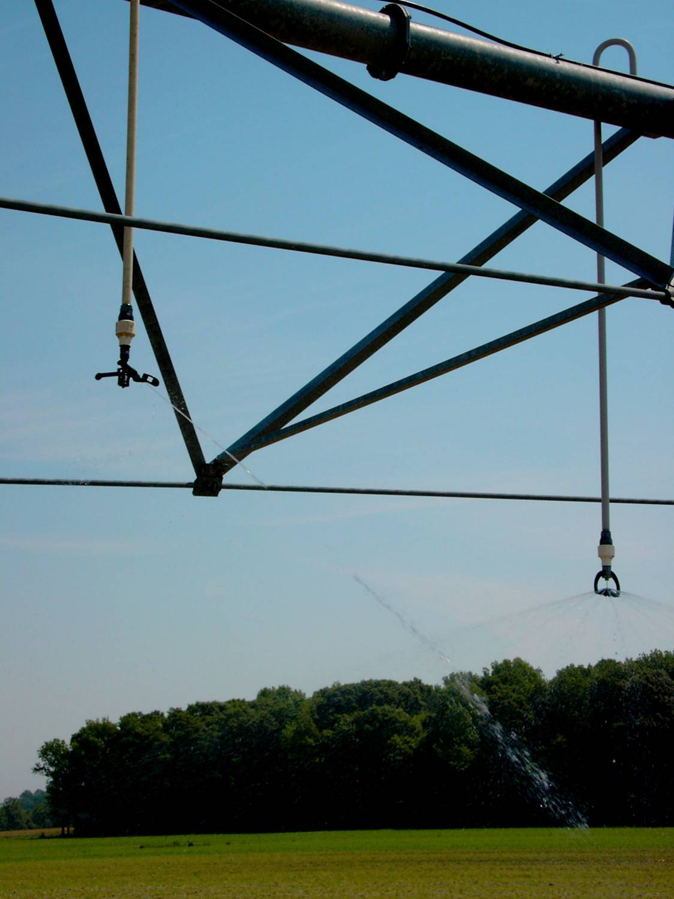

Slide 26
Consider Available Electric Load Management Options
Pathway 5: Reduce Unit Cost of Energy
(Time of Use Management)
Off peak electric rate cost/kWh
On peak electric rate cost/kWh
Time of day operation restrictions
Shut down concessions
All considered actual rate can be below 3 cent to more than 15 cents per Kilowatt hour.
Notes:
Talk with your rural electric company to explore their load management options towards reducing energy use cost

Slide 27
Next presentation by Jerry Walker

