Slide 1
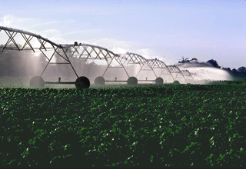
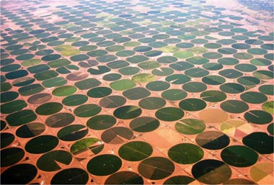

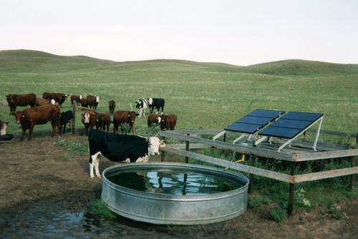
Energy Conservation in
Irrigation Systems
> Part I Evaluating Energy <
July 27, 2011
Kip Pheil – Energy Technology Development Team
Notes:
This is one in a three part webinar presentation hosted by the NRCS East National Technology Support Center. This version follows the net meeting presentation and includes various changes. Most notably:
Corrected reference to previous webinar which covered 10 irrigation CPS with an energy purpose. [slide 3]
Clarified note that energy use in pumping systems is primarily dependent on flow, pressure, and time. [slide 5]
Added note of attribution for the Energy Priority Pyramid. [slide 5]
The webinar announcement included this background information.
Energy Conservation in Irrigation Systems.
Jerry D. Walker, P.E.; Agricultural Engineer (Water Management), NRCS Central NTSC.
Kip Pheil; Energy Specialist, NRCS West NTSC.
Hamid J. Farahani, Ph.D.; Water Management Engineer, NRCS East NTSC.
Wednesday, July 27, 2011 :: 2:00 – 3:00 p.m. Eastern
NRCS recently adopted energy as a resource concern because its conservation and efficient use is of great importance to society. Irrigation systems use significant amounts of energy in the form of electricity, diesel and natural gas to pump and pressurize the large quantities of water needed for growing crops. This webinar will cover specific pathways to reduce energy use as well as improving energy use efficiency in irrigation systems while meeting crop water needs. These pathways include: 1) reducing the unit cost of energy, 2) reducing water use by efficient and uniform application using advanced water management practices, 3) reducing irrigation system pressure, and 4) improving overall pumping plant efficiency. All of the scenarios presented can be implemented using the recently revised conservation practice standards that address energy.

Slide 2
Evaluate an Energy System
Irrigation NCPS with an Energy Purpose(?)
Systems Analysis – source to sink
Energy Action Priorities
Energy Sources & Water Units of Measure
Why time matters
Energy Sources, Efficiency, Net Cost
Changing Sources in the Middle of the Stream – caution advised
Notes:
Overall method to approach energy analysis –
intended to provide direction specifically on irrigation systems
But…
broader approach offers methods to evaluate most any energy dependent system.
Hamid & Jerry will focus on more specific strategies to reduce energy use and evaluate the energy savings
Based on (e)xisting calculators & other tools mostly used for water system analysis & design.
My time includes a brief look at changes from one energy source to another.
Most common change is from diesel to electricity.
Fuel above 4 $/gal tends to focus the mind of a farmer (if they spend much time on a tractor)

Slide 3
Irrigation Practices for Energy
Anionic Polyacrylamide (PAM) Application (450)
Irrigation Ditch Lining (428)
Irrigation Pipeline (430)
Irrigation Reservoir (436)
Irrigation System, Micro (441)
Irrigation System, Sprinkler (442)
Irrigation System, Surface & Subsurface (443)
Irrigation System, Tailwater Recovery (447)
Irrigation Water Management (449)
Pumping Plant (533)
Notes:
These NCPS have all been revised to include an Energy Purpose, related Criteria, Considerations, etc.
These NCPS were discussed during the Energy Calculators webinar on 7/13/2011. Links on reference page [~ slide 13].
Post-Meeting addendum (incl. strikethrough, above):
NCPS were discussed during the Energy in CPS webinar on 6/15/2011. Links on NRCS Energy Webinars (2011) page [slide 13].

Slide 4
Systems Analysis
Power needs determined by:
water flow
pressure
Energy use determined by:
power
time
BEST
Start at the End
&
End at the Start
Notes:
[Irrigation image, NEH Part 652 Chapter 6 (pdf page 64).]
Many NRCS staff already know the basics of pumping energy:
Power is a function of how much water you push and how hard you have to push it.
Energy use is a function of the Power you need and how long the system runs.
Other factors (pipe friction; sprinkler type; pump efficiency & operating points; etc.) influence both Power and Energy result.
Important to remember that the parts are connected but they can be isolated also (this will come up again later).
Best Practice for Energy? (Note that this applies to Irrigation, Lighting, Cooling, Heating, Tilling Operations, etc.)
1) Start at the End – go to the field or other end point for the water.
Controlling load is the best first step for energy (other resources, as well?) – almost always.
(Hamid will cover this realm of reduced energy use in more detail.)
2) End at the Start – look at the initial point of withdrawal and how that’s accomplished.
Once loads are minimized and as well ordered as practical, then improve or modify the pumping plant.
(Jerry will cover this realm of reduced energy use in more detail.)

Slide 5
Energy Priority Pyramid
Use Renewable Resources
Improve Energy Efficiency
Analyze Energy Use
Reduce Energy Use
Evaluate
Implement
Repeat
Change Energy Source - Save $$ (Energy?)
Manage Time of Use - Save $$ (Energy?)
Adapted from various sources.
See, e.g., EnSave (c. 2009) and Minnesota Power (c. 2008, 2011).
Notes:
Primary Concept / Principle of Energy Efforts
Follows the general Planning Process
Identify Problems : Determine Objectives : Inventory Resources : Analyze Resource Data : Formulate Alternatives… etc.
Recall that energy use [in pumping systems^^] is primarily a function of these three things:
Water flow, 2) Pressure, 3) Time
In this framework:
Management decisions to reduce operating time, water flow, or pressure directly Reduce Energy Use.
Better equipment (pumps, pipes, motors, VFD, engines, sprinklers, etc) Improves Energy Efficiency to Reduce Energy Use.
Use of Renewable Resources to power the equipment can Reduce Energy Use of non-renewable energy resources.*
* on-site energy capture and use can reduce use of other renewable (and non-renewable) energy resources where electricity or transmission and transportation of solid and liquid fuels results in higher energy consumption. This is generally a relatively small fraction of overall reduced energy use.
Timing energy use or choice of energy source can reduce energy use and save money. Many times, only one or the other can be done (but we suggest saving both energy and money).
^^ Post-Mtg Addendum. Also added slide reference to similar, copyrighted graphic images of the energy pyramid. Those images provide an alternate view of energy analysis and action. Another interesting graphic is the Pyramid of New Water Sources (c. 2011, Yudelson Assoc.) – mostly relevant to NRCS as this view ranks Irrigation water savings as the third priority for ‘new water’ relative to complexity and investment.

Slide 6
Start at the End ….
Can I stop doing this?
Can I do it less often?
Can I do it with less (mechanical) effort?
Can I do it at a different time?
Can I do it with renewable resources?
Can I afford to change my systems and practices?
Notes:
A simple set of questions derived from the priority pyramid.
Underlying each question is our objective to satisfy the landowner’s objectives.
As mentioned before:
The first two questions revolve around Irrigation Water and System Management to be addressed in the next segment today (by Hamid)
The third question reaches to the Pumping Plant to be addressed in the final segment today (by Jerry)
I’ll talk a bit about the questions of time and renewable resources.
The last question is answered by the analysis and support from Programs and other entities (other Federal incentives, State incentives, electric utilties, etc.)

Slide 7
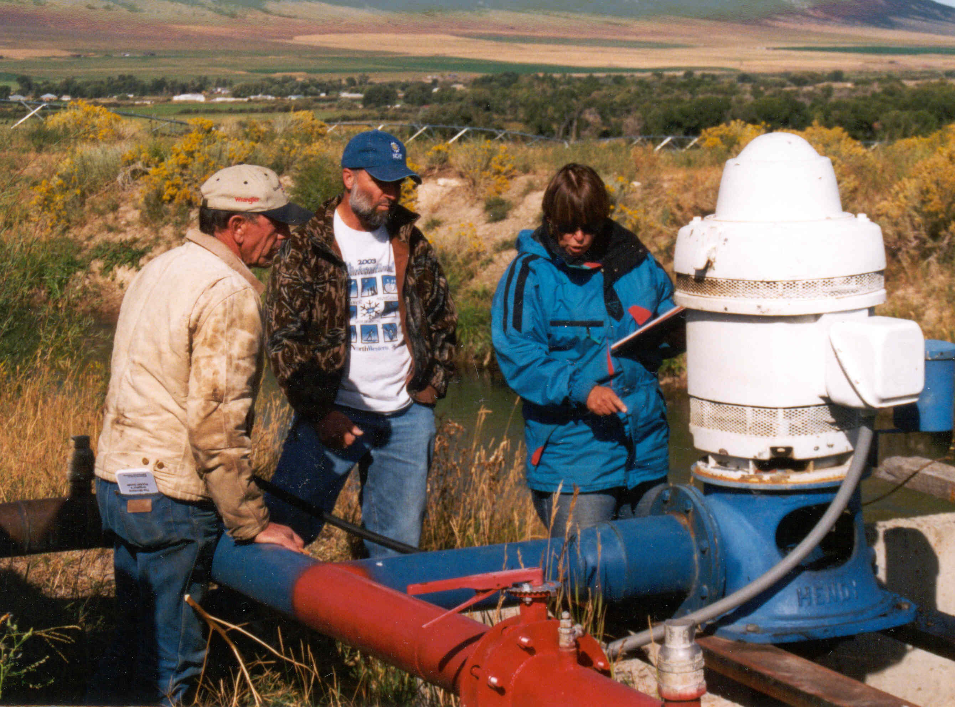
Landowner View, though…
Noisy, costly:
gateway to a decision maker’s mind (& heart)
Notes:
End goal for conservation planning is to minimize the demand & use before retrofit or upgrade the pumping plant
but
Landowner is more likely to pursue the demand & use analysis after some simple, immediate changes at the pumping plant produce quick cost savings or improved operation.
(Jerry will provide more detail on those analysis steps and outcomes in the last portion of this webinar.)

Slide 8
Energy & Water Units
Value | Water | Electric | Diesel | Nat’l Gas | ‘Energy’
Flow | gal/min | kW | gal/hr | MCF/hr Therm/hr | Btu/hr
Use | Ac-ft | kWh (i.e., kW-h) | gallon | MCF Therm | MMBtu
MCF = thousand cubic feet => 1,00,000 Btu
  fuel density of about 1,000 Btu per cu.ft of natural gas
Therm = 100,000 Btu
decatherm = 10 Therm = 1,000,000 Btu
as defined; gas co. accounts for varying fuel density in billing
MMBtu = million British thermal units.
Energy is most often compared using Btu as the base unit.
M = 1,000 (Roman numeral)
MM = ‘thousand, thousand’ , ergo million
Notes:
Since Electricity flow is measured as kiloWatt, total electricity is flow X time
Therefore, kW x h = kWh
Nat’l Gas is billed under varying methods throughout the country.
Note that 1 MCF = 1 decaTherm when 1 MCF of natural gas is delivered at a guaranteed density of 1,000 Btu/cu.ft.
Rate of Nat’l Gas use is not as important, typically, as is the rate of water flow or electricity use.
(Pipelines are usually not capacity constrained but some customers are on interruptible schedules when capacity is an issue. Service to irrgation is unlikely to coincide with other peak uses.)
Note that:
MBtu = 1,000 Btu (widely used in HVAC industry for boiler or furnace sizing)
Mbtuh = 1,000 Btu/hr (ditto)
k = 1,000 (SI units)
M = 1,000,000 (SI units)
To minimize confusion, good practice for use of units is one of these three options:
Btu, Btu/hr
kBtu, kBtu/hr
MMBtu, MMBtu/hr
since
kBtu is difficult to read as anything other than 1,000 Btu
Mbtu might be interpreted as 1,000 or 1,000,000 Btu
MMBtu is difficult to read as anything other than 1,000,000 Btu

Slide 9
Why Time Matters
Power = f (water flow, pressure)
Energy = f (water flow, pressure, time)
Time is the critical variable for
Total Energy Use and Cost
Case | P (kW) | Time (h/yr) | Energy (kWh/yr) | Cost ($/yr)
A | 1,000 | 100 | 100,000 | 10,000
B | 100 | 6,000 | 600,000 | 60,000
Notes:
As noted earlier, energy derives from water flow, pressure, and time.
More in Plant Analysis and Upgrades section at the end of this webinar but key direction for field staff from the importance of time is this:
Regularly used equipment offers best chance for a good investment
Rarely used equipment can be ignored or paid only minimal attention.
Example assumes an electricity rate of 0.10 $/kWh
an average electric cost rate can skew an annual cost savings estimate by significant amounts;
the average should only be used for initial assessment or where the cost savings are either:
so poor as to rule out further analysis, or
so good as to rule out further analysis.
Exceptions IF electric utility, e.g., has very high demand charges. ($/kW_peak)
The importance of Time applies to any kind of energy evaluation (electricity, fuels, etc.).

Slide 10
Why Time (Still) Matters
Energy Conservation Measure (ECM) Costs
Case | P (kW) | Time (h/yr) | Energy (kWh/yr) | Cost ($/yr)
A | 1,000 | 100 | 100,000 | 10,000
B | 100 | 6,000 | 600,000 | 60,000
As per previous slide.
Case | ECM Saving | Savings (kWh/yr) | Savings ($/yr) | ECM Cost ($) | Payback (yr)
A | 15% | 15,000 | 1,500 | 12,000 | 8.0
B | 15% | 90,000 | 9,000 | 12,000 | 1.3
=>
Notes:
Carried over from the last slide, two cases of P(ower) and Energy Costs.
Consider scenario where 15% savings is possible for the Energy Conservation Measure investment shown here….
SPB is a rough measurement stick but useful as easily understood. It helps direct attention and is a good first order priority tool. Some situations and landowners will want to look at return on investment, cost/benefit, lifecycle costs, etc. At this stage in the NRCS adoption of energy those more nuanced metrics may not be useful or needed.
Note also:
ECM is generally synonymous with EEM (Energy Efficiency Measure)

Slide 11
Energy Sources, Cost, η
Equivalent Cost Example for Specific Case !
PPE = Pumping Plant Efficiency
PPE (%) Diesel : Electric | Diesel Cost ($/gal)
 | 3.00 | 3.25 | 3.50 | 3.75 | 4.00
 | Equivalent Cost ($/kWh)
100 : 100 | 0.074 | 0.080 | 0.086 | 0.092 | 0.098
23 : 68 | 0.22 | 0.24 | 0.25 | 0.27 | 0.29
Energy Type | Density | Quantity | Total Btu
Diesel | 139,000 Btu/gal_d | 1 gal | 139,000
Electricity | 3,413 Btu/kWh | 41 kWh | 139,000
Notes:
Details of Equiv. Cost Calc (and others) to be available in post-webinar documents.
A gallon of diesel fuel contains about 139,000 Btu (Higher Heating Value, HHV).
Full 139,000 Btu can be recovered in a condensing system
(exhaust gases must be cooled to around 100 F and heat extracted for a useful purpose to do this)
About 130,000 Btu is recovered in a typical combustion systems (engines, boilers, etc.)
(Other 9,000 Btu is ‘exhausted’ as uncondensed water vapor)
(Lower Heating Value, LHV)
Other system losses further reduce energy delivered to the end use.
For pumping; less than 30,000 Btu of energy ends up in moving water with a diesel-driven pumping plant.
(More details on PPE covered by Jerry in part three of the webinar.)

Slide 12
Changing Energy Sources
Q: If electricity is less than 0.20 $/kWh why not dump the diesel?
A: Power lines are Costly!
15,000 to 40,000 $/mile
(site & utility specific)
Landowner’s more direct concern?
$_irrigation/yr•acre-foot water basis
$_irrigation/yr•acre land basis
$_irrigation/yr•bushel yield basis
or…?
Notes:
System analysis is critical to consider any substantive capital upgrade.
‘Substantive’ is relative.
Perhaps a fraction of annual associated energy costs.
Depends on the operator.
Cost can be viewed (or indexed) in many ways.
The NRCS focus is on energy (and water) savings but we need to be able to talk to the landowner from their perspective.
Their perspective may be more cost-based than resource-based.

Slide 13
NRCS Energy Webinars (2011)
Energy SharePoint Site (West NTSC)
[https://nrcs.sc.egov.usda.gov/st/wntsc/energy/default.aspx] (…Training > Web meetings…)
  4/24 Bioenergy Atlas (NREL)
  5/19 Solar PV Site Assessment (NREL)
  6/8 Energy Policy and Basics
  6/9 Programs Support for Energy
  6/15 Energy in CPS
  7/13 Energy Tools
  7/27 Energy Conservation in Irrigation
Notes:
NREL = National Renewable Energy Lab (US DOE)

Slide 14
Questions – now | later
West NTSC contacts
  Stefanie Aschmann
  Leader
  Energy Technology Development Team
  stefanie.aschmann@por.usda.gov
  503.273.2408
  Kip Pheil
  Energy Specialist
  kenneth.pheil@por.usda.gov
  503.273.2437

Slide 15
Reference Information
This and the following slides are not part of the formal presentation.
Possible “A” during Q&A sessions.

Slide 16
Units for Counting Energy
Common Purchased Units
    Gallon - liquid fuels, e.g. diesel, gasoline, propane
    kWh - electricity
    Therm, Cubic Foot, Btu - natural gas, propane
    …
    $ - all energy sources
Common Reference Unit (U.S.)
  British Thermal Unit (Btu)
  1 Btu = Energy to increase temperature of 1 lb water at 1 atmosphere (sea level) by 1 degree F
  1 million Btu usually rendered as MMBtu
Notes:
“Common” as in US Dept. of Energy (USDOE); US Energy Information Administration (USEIA); US Forest Service, Forest Products Lab “Fuel Value Calculator.”
Note that the Fuel Value Calculator has apparent conversion factor error for electricity; shown as 3,340 Btu/kWh rather than accepted values of 3,413 or 3,412 Btu/kWh. Possibly a series of errors. Thirty-four ‘thirty’ (3,430) has a phonetic approximation to thirty-four thirteen (3,413) and a tranposition error could finish it off. Also possible that USFS has made some (unusual) adjustment for conversion or transmission efficiency.
Perhaps not intuitive but a kitchen match releases about 1 Btu when burned.
Since a Btu is so tiny, MMBtu is used most often.

Slide 17
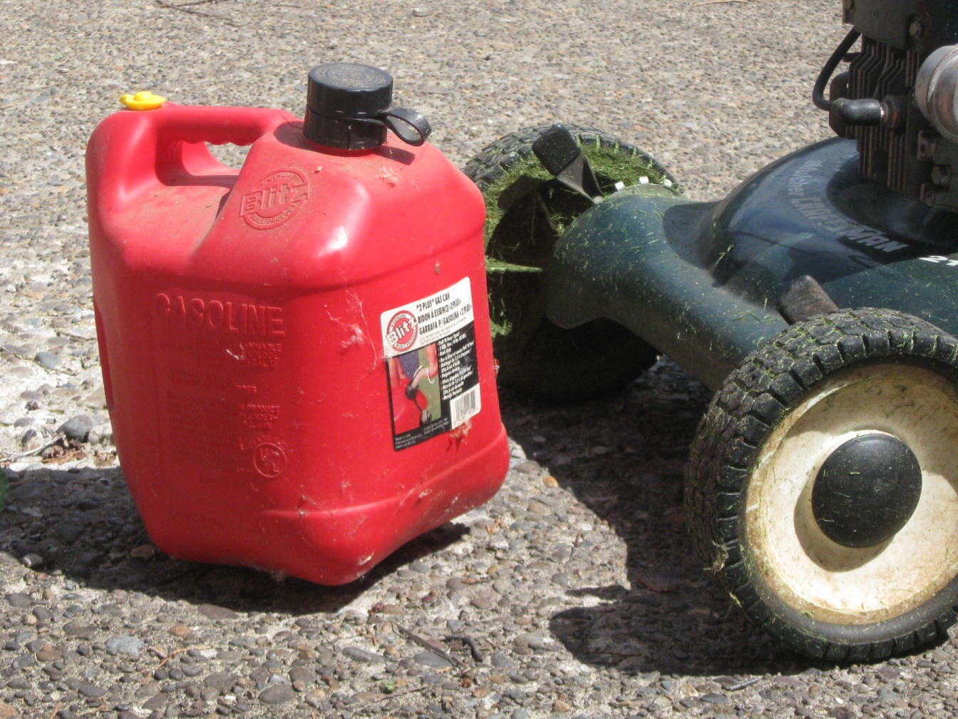
Energy Content
Energy Content if…*
  Diesel?
  B5?
  Unleaded?
  E10?
  E85?
  Propane?
  Electricity?
  Water?
2 gallon, 8 oz fuel container
* 2 gallon fill, 8 oz freeboard
Notes:
2 gallon 8 oz for gas-oil two-stroke engine mixture

Slide 18
Conversion Factor Example
Notes:
Density of fuels varies by season and effective blend.
LHV = Lower Heating Value
(LHV accounts for exhausted energy in the form of water vapor which takes useful heat from the products of combustion; HHV presumes exhaust is cooled & that heat is extracted for some benefit)
Hydropower calc not peer reviewed.
Gravitational affects near 5,000 miles may not be consistent.

Slide 19
Energy => Work
Work = Energy Transferred to an Object
    Raise Temperature (increase thermal energy)
    Raise Height (convert to potential energy)
    Raise Speed (convert to kinetic energy)
Measure of Work: force x distance
  10 lb raised 55 feet = 550 ft-lb of work
Work versus Useful Work:
  Water through a throttling valve.
  Water through a turbine-generator.
Notes:
Heating a chicken house.
Lifting a bale of hay.
Release the clutch on an old truck.
This 550 ft-lb may be familiar and comes up again.
Water through a throttling valve creates noise, raises water temperature, and may protect sprinkler valves from damage.
Neither noise or higher water temperature are usually useful.
Protecting sprinkler valves from damage is useful; it just isn’t work in a thermodynamic sense.
Water through a turbine-generator makes electricity, creates (less) noise, raises water temperature (less), and may protect valves from damage.

Slide 20
Energy|Work => Power
Power = Rate of Energy Transfer
    also … Power = Rate of Work Done
  Walk or Run up Stairs?
    Low and Slow – energy management rule of thumb
Measure of Power: (energy or work) / time
  1 horsepower = 550 ft-lb / sec
  1 hp = 0.746 kW
  1 kW = 3,413 Btu/hr
  Note that each measures a rate of energy transfer
Notes:
Walk or Run depends on available time, purpose (fitness or transit), and distance.
Usually take the elevator?
[following points not discussed but can be off-line]
Stress on energy transfer is that many people confuse Capacity Rating (e.g., 1.5 MW) with energy output.
Skylark theory of transit… (if 120 mph, 24/7, how many miles possible per year compared to actual miles?)

Slide 21
Efficiency Scales
Pure Efficiency (equipment analysis)
    Output Energy / Input Energy
    Similar units required
    % result (no unit)
Energy Use Index (system analysis)
  Input Energy / Baseline Quantity
  Mixed Units
Productivity Metric (system analysis)
  Material Output / Energy Input
  Mixed units
Notes:
Thus far, mostly,
Ignore friction and other real world losses
Real world has these things
Radiator & Tailpipe on your rig = engineers’ concession that the perfect machine can’t be built
The top section probably makes sense; focus on all a bit more closely.

Slide 22
Pure Efficiency
  Electric Motor, typical efficiency > 85%
    Output (shaft) = 5 hp
    Input (electric) = 4 kW
    Efficiency = Output Energy / Input Energy
          = (5 hp / 4 kW ) x (0.746 kW/hp)
          = 93%
What about resource ‘harvest’ efficiency?
Notes:
Irrigation team does this kind of analysis on a regular basis.

Slide 23
‘Harvest’ Efficiency
System | Conversion Efficiency (%) [a]
Wind Turbine | < 35
Biomass | < 40
Geothermal | < 15
Solar PV | < 15
Hydroelectric | < 90
Chickens [b] | 40
[a] Efficiency in Electricity Generation (July 2003). Based on instantaneous conversion. [www.eurelectricity.org/] | [b] Feed Efficiency of Rainbow Broilers in Pastured Poultry Systems (2004). [www2.truman.edu/~mseipel/poultry/NCUR2004.pdf]
Typ. large generator efficiency (shaft to wire) is 99%.
More steps = more loss.
The chicken is raw, cooking adds steps; farm to feed efficiency excluded.
Notes:
Conversion of available (potential/kinetic/etc.) energy to electricity.
Unusual view of energy conversion by european utilities; main point seemed to be to show that conversion of fossil fuels isn’t so bad, after all, since less of the “available energy” is wasted.

Slide 24
EUI | Productivity
Notes:
Various options to reduce energy use.
Different considerations.
Point is to get data to then analyze, evaluate, etc.

Slide 25
Work
Measure: force x distance
  10 lb raised 55 feet = 550 ft-lb of work
  1 Newton exerted over 1 meter = 1 Joule
      and
  1 amp through 1 ohm resistance for 1 sec = 1 J
Newton = kg-m/sec²
(force = mass x acceleration)

Slide 26
Energy|Work => Power
Measure of Power: energy [work] / time
  1 horsepower = 550 ft-lb / sec
  1 watt = 1 N-m / sec = 1 joule / sec
  1 watt = 1 amp x 1 volt (DC system)
  1 kilowatt = 1000 watt
kW measures a transfer rate of energy
(not an accumulated or consumed volume of energy)
Notes:
Recall that:
1 joule = 1 Newton x 1 m

